Slide 1
Alex Weidner4

Slide 2
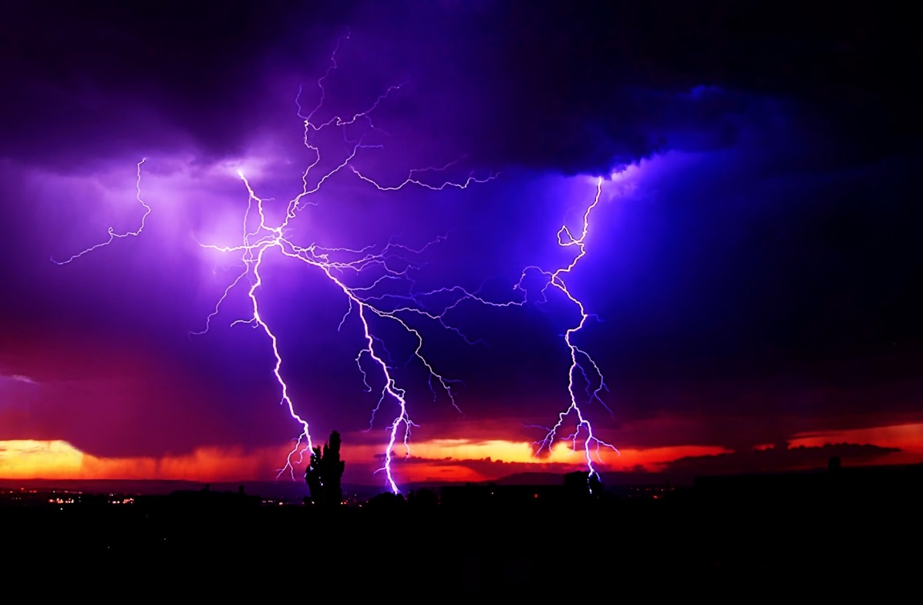
Once upon a time…
There was a giant storm of Zombies.
Swordmaster Ken was walking around when he saw people running away.
Go toarwards the storm
Run away

Slide 3
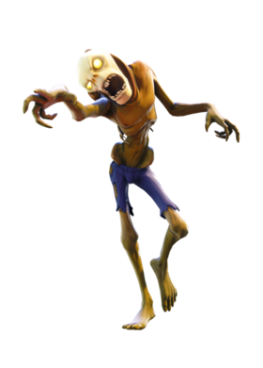
Go toarwards the storm
You get to the storm and you die

Slide 4
Run away
You gather materials and craft a MasterSword
Do you…
Go to the storm
Try and craft a glider to fly of cliff

Slide 6
.

