Slide 1
Alice s L3
jello

Slide 2
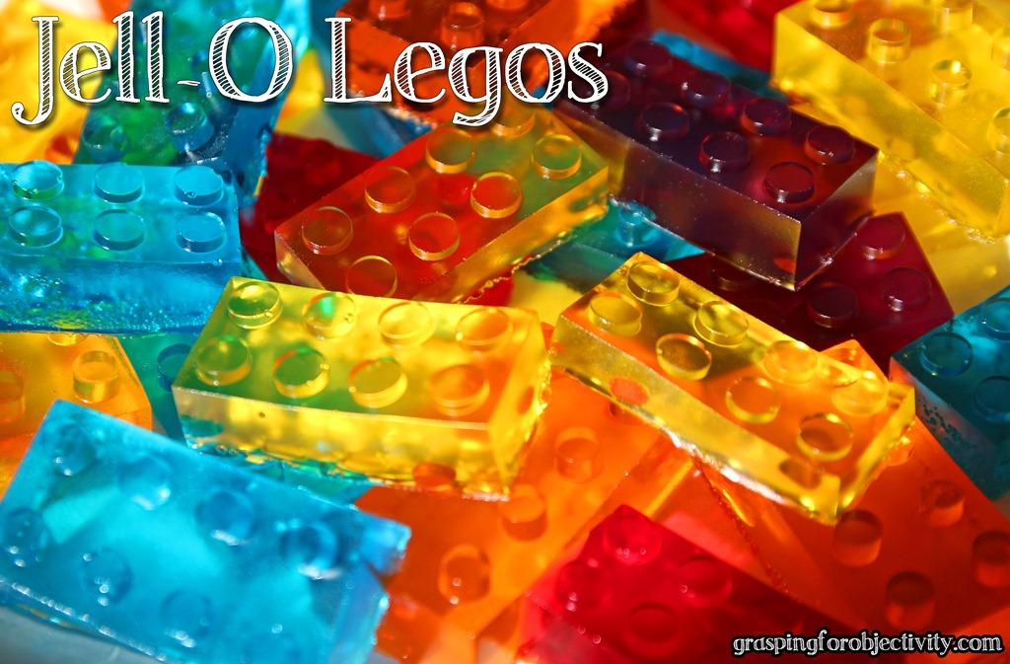
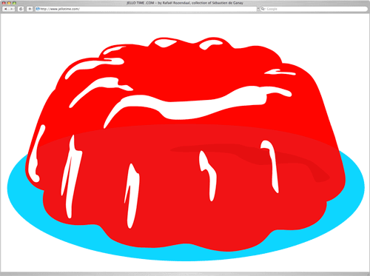
Who invented it?
Pearl B. wait

Slide 3
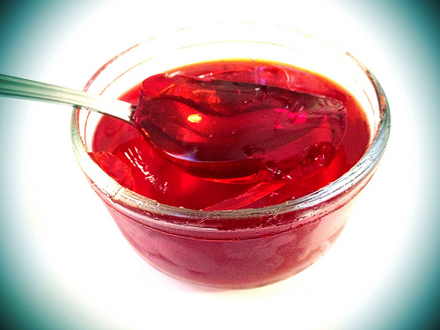
Where? when?
1897
United states

Slide 4
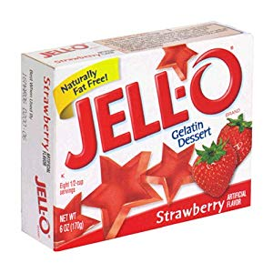
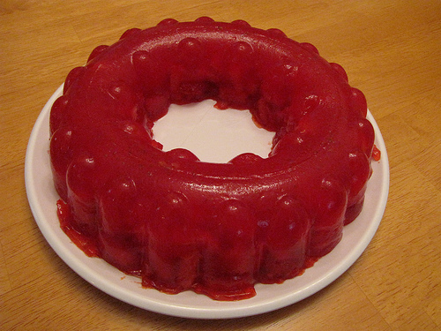
fun facts
Jiggly
Made by gelatin

