Slide 1
Andrew w4
THE ATTACK OF THE FAT SNAKES

Slide 2
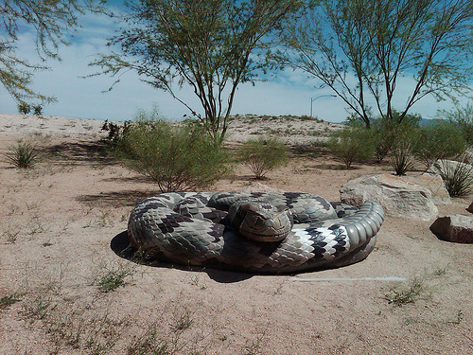
IN A CITY FAR AWAY…………………
You are on a hill in n the city park when you hear a fat snake coming
Do you throw a pie at it THROW a pie at it
Or run away screaming in terror\laughing Run away screaming/laughing

Slide 3
THROW a pie at it
YOU THROW A PIE AT IT AND IT DECIDES TO GO FIND A NEW MEAL BECAUSE YOU WERE GENOROUS TO IT WHEN SUDDENLY A MOB OF ANGRY TOWNS PEOPLE COME AFTER YOU FOR FEEDING THE BEAST! YOU RUN AWAY BUT THEY ARE FASTER THAN YOU, YOU GET CAUGHT AND ARE TAKEN TO JAIL.
DO YOU TRY TO ESCAPE
OR STAY PUT

Slide 4
TRY TO ESCAPE
One night you try to escape the guard can’t hear you for he is asleep
YOU WIN!!!!!!!

Slide 5
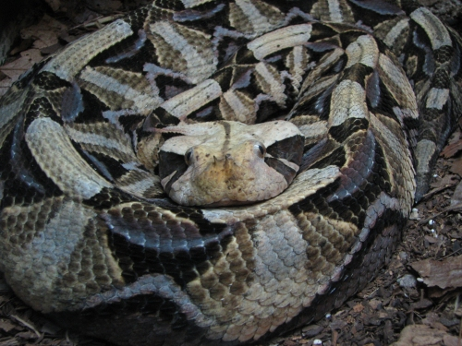
STAY PUT
You stay put and over the years you DIE from lack of treatment
THE END

Slide 6
Run away screaming/laughing
The snake wobbles after you slow but dangerous and it eats you because you have fallen over laughing
THE END

