Slide 1
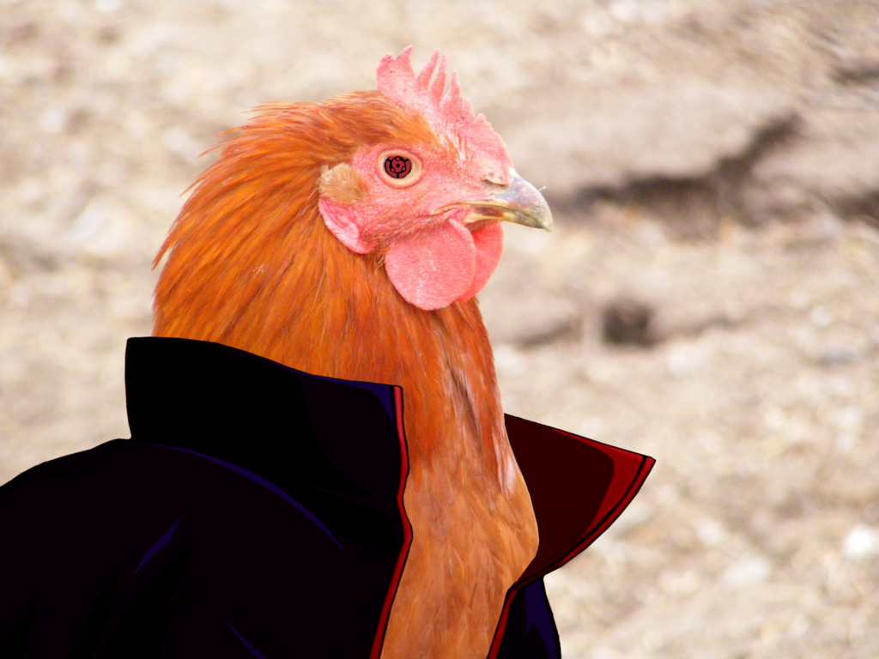
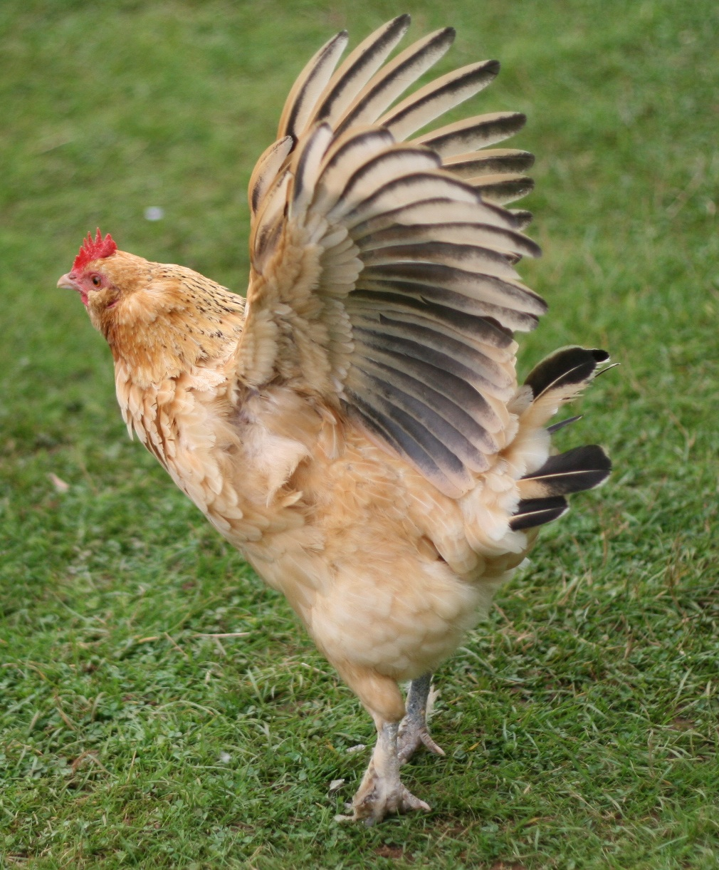
Brittan a4
A man eating chicken

Slide 2
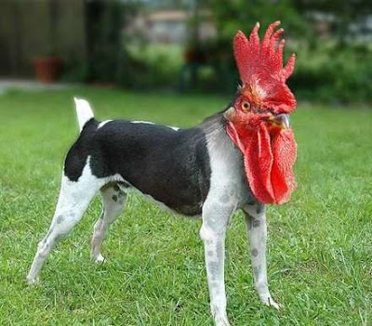
I was walking home on a bright and sunny morning
I walked tward a weird looking house and you saw a man waching you
A. do you ask him why he is watching you
B. do you keep walking

Slide 3
you ask him why he’s watching you
YOU GET KIDNAPED BY a criminal and he shows you his man eating chicken. What do you do.
A . Do you try to escape
B. Do you face your fate and get eaten by a chicken.

Slide 4
Do you keep walking
Good choice . he is a criminal that the police are looking for
A.do you get on the bus to go to school
B. do you call the police

Slide 5
You called the police
Good job you got him , for now!

Slide 6
You got on the bus to go to school
Be carful and look out for the crimanal you’ll never know when he’ll strike.

Slide 7
You escaped!

