Slide 1
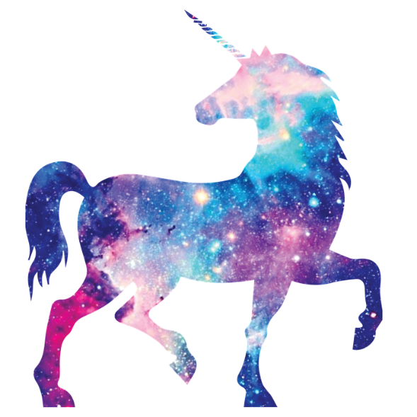
CadenA4
The blue fluffy unicorn

Slide 2
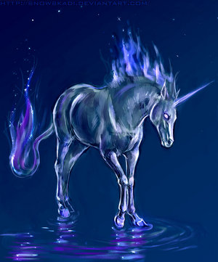
Ones upon a time
an evil unicorn came to town.
What do you do
Run at it
fart

Slide 3
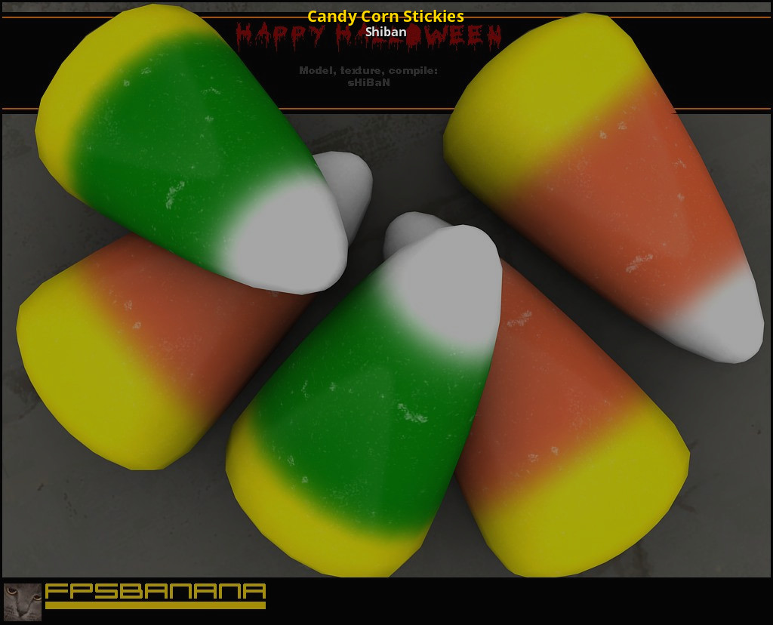
run at it
You chose run at it
You run at it and it turns you in to a candy-
Corn`s

Slide 4
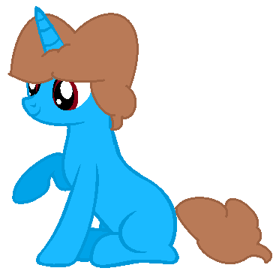
fart
You tamed it every one is saved

