Slide 1
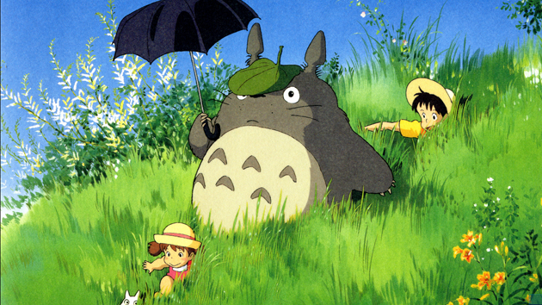
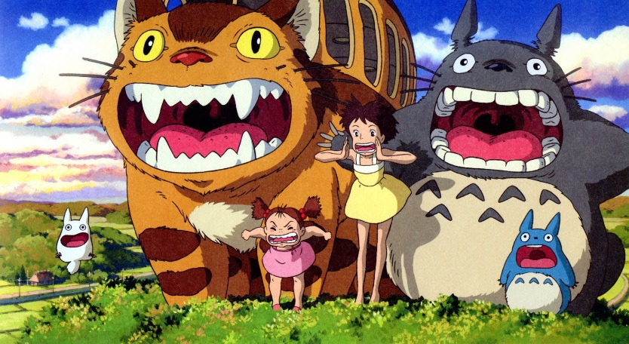
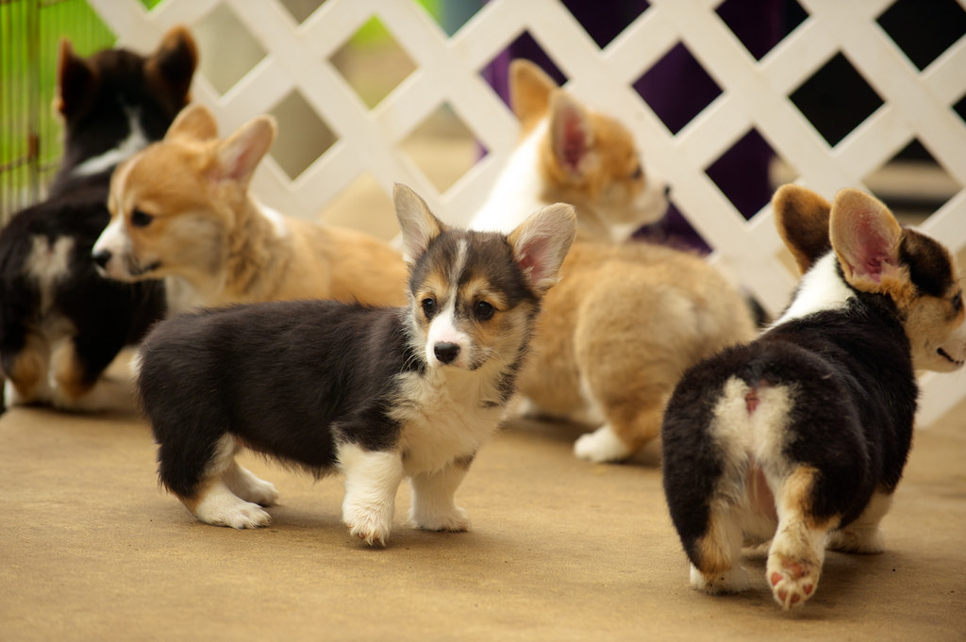
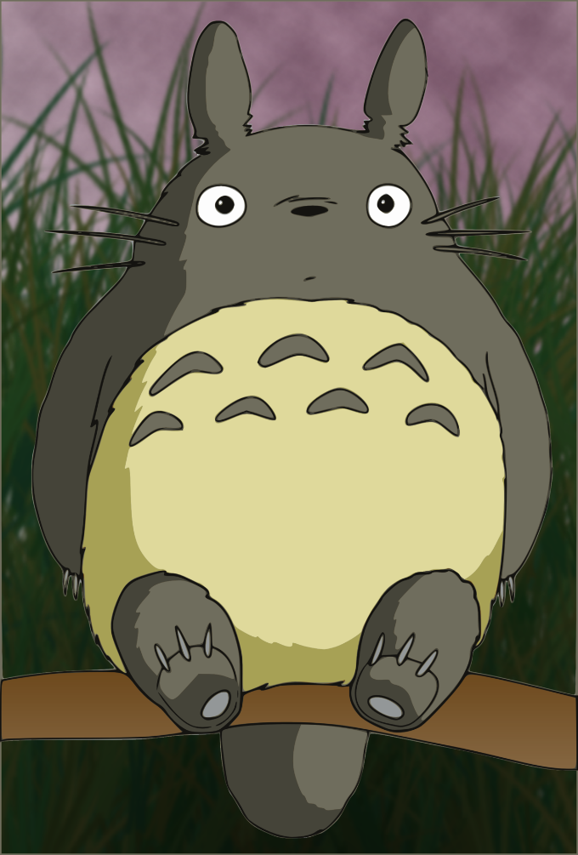
Charlotte A4
A Killer CHICKEN…
Also You Are A Corgi

Slide 2
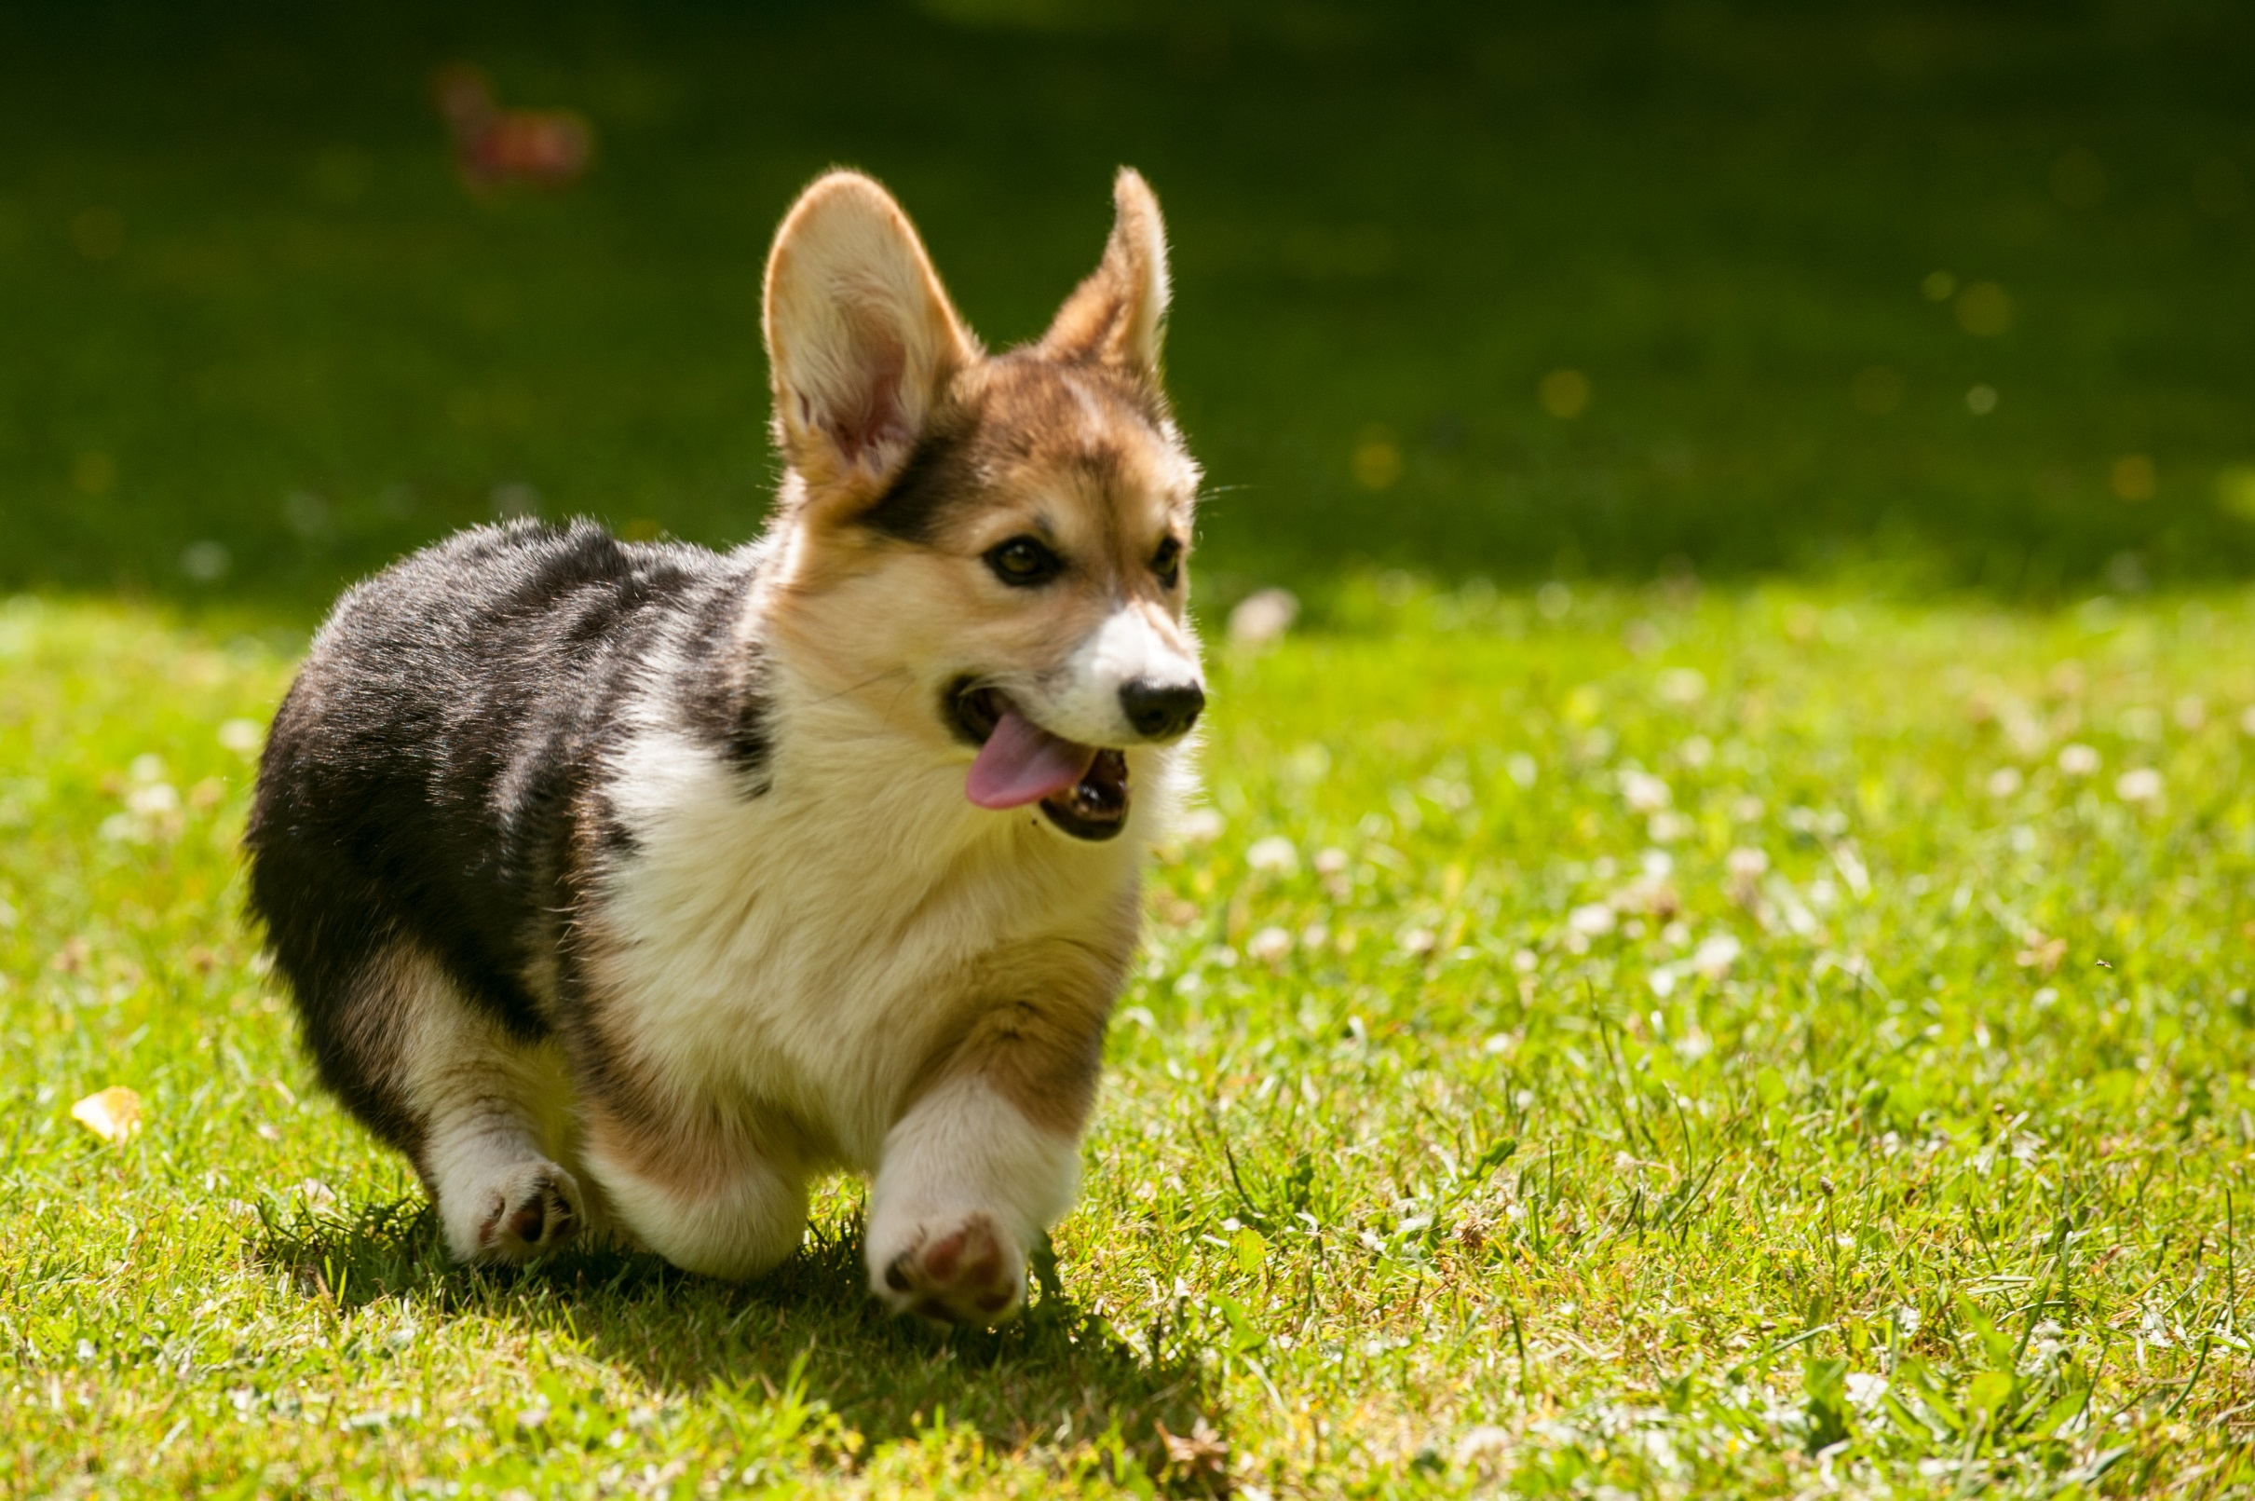
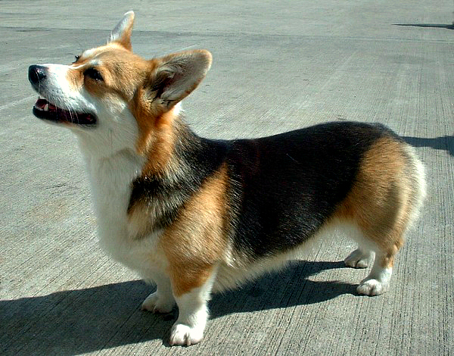
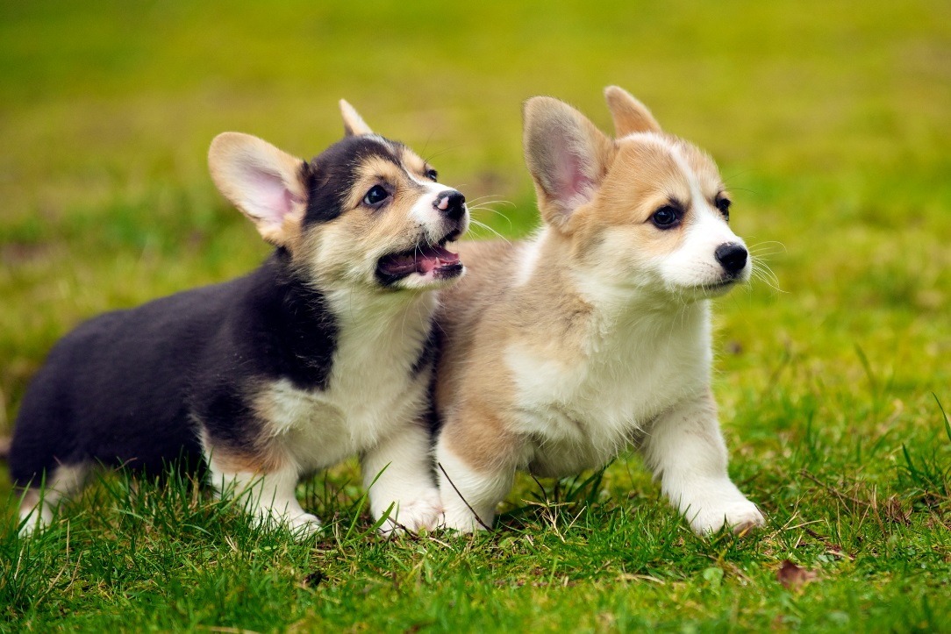
You Are A Corgi So This Is Your Character

Slide 3
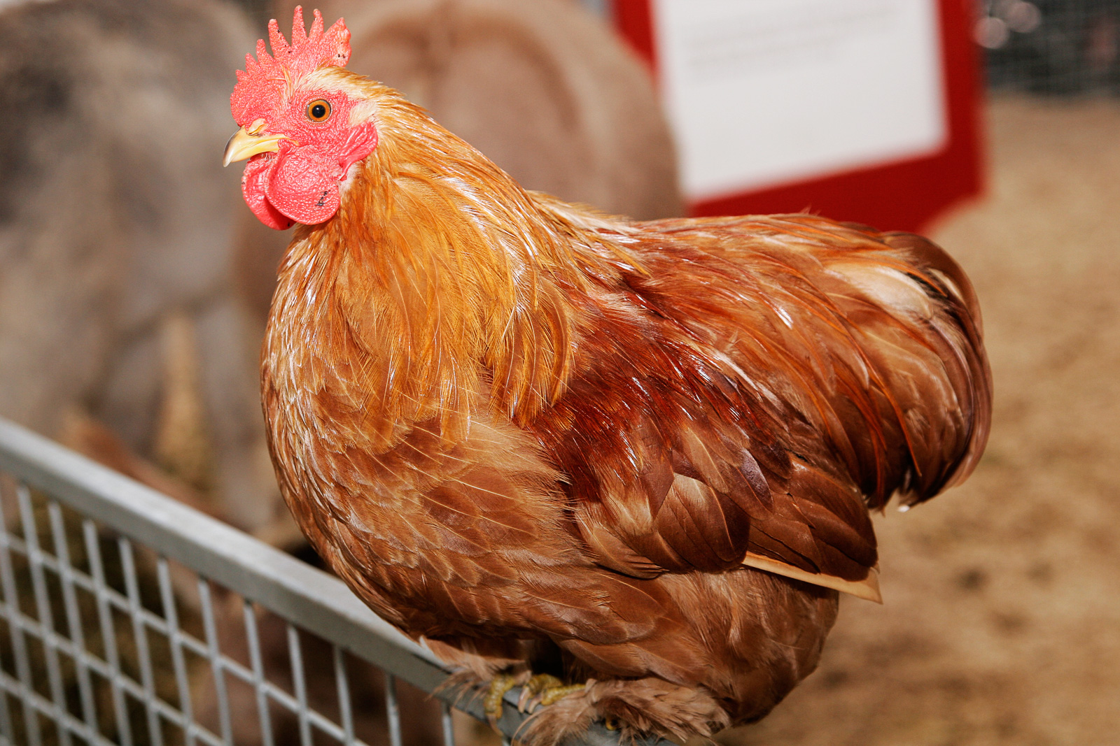
Once In The History Of Evil Killer Chickens…
You Were Walking To Your Favorite Store That Is Open 24 Hours A Day At 3 In The Morning And You Saw The Store Being Invaded By Evil Chickens?
Run And Check It Out
Run For Your Life

Slide 4
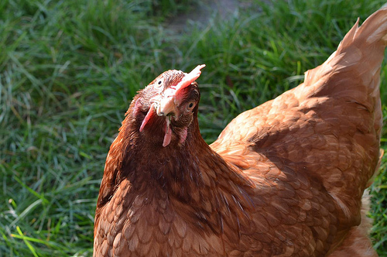
Run And Check It Out
You Run And Check It Out The Chickens Are Eating EVERYTHING You Slowly Walk Away And See A Egg On The Floor
Pick Up Egg
Leave It

Slide 5
Run For Your Life
You Run For Your Life And A Chicken Egg Falls From The Sky And You Stop And Pick It Up It Hatches And Bites Your Face Off

Slide 6
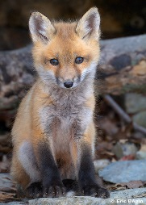
Pick Up Egg
You Pick It Up An Adorable Fox Hatches Out And It Helps You Kill Them

Slide 7
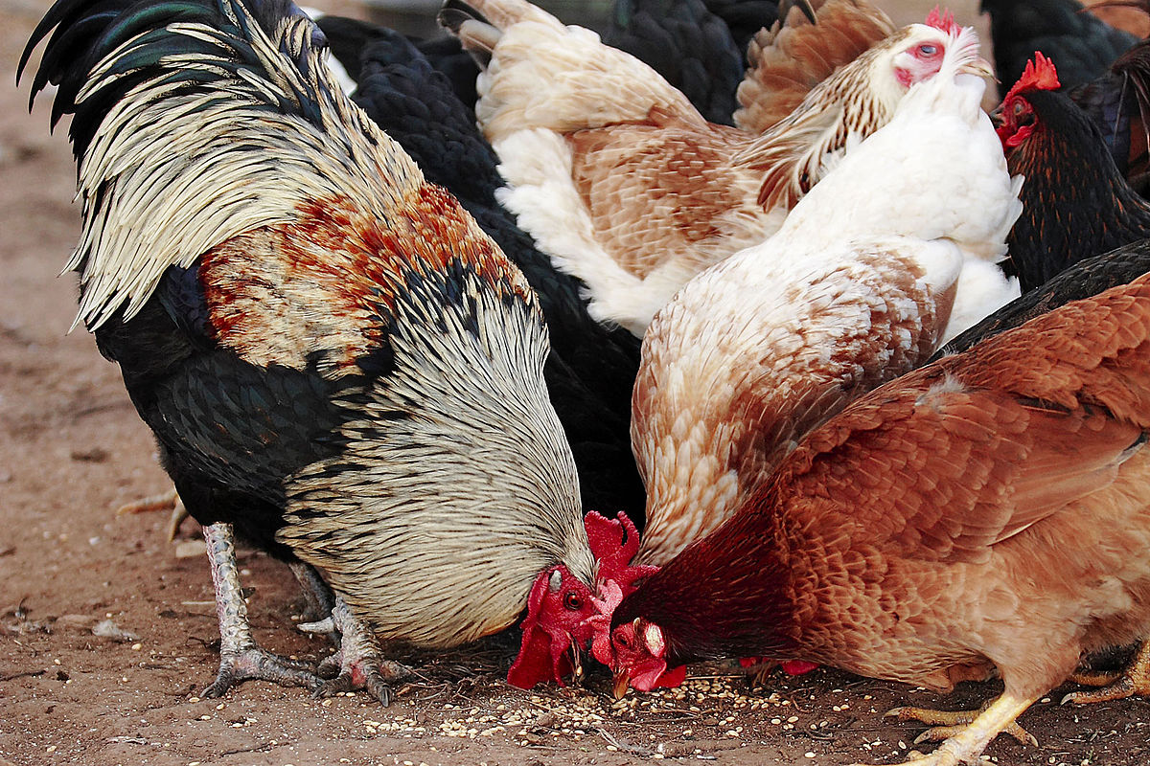
Leave It
A CHICKEN COMES OUT AND DEVORES YOU

