Slide 1
gabil3

Slide 2
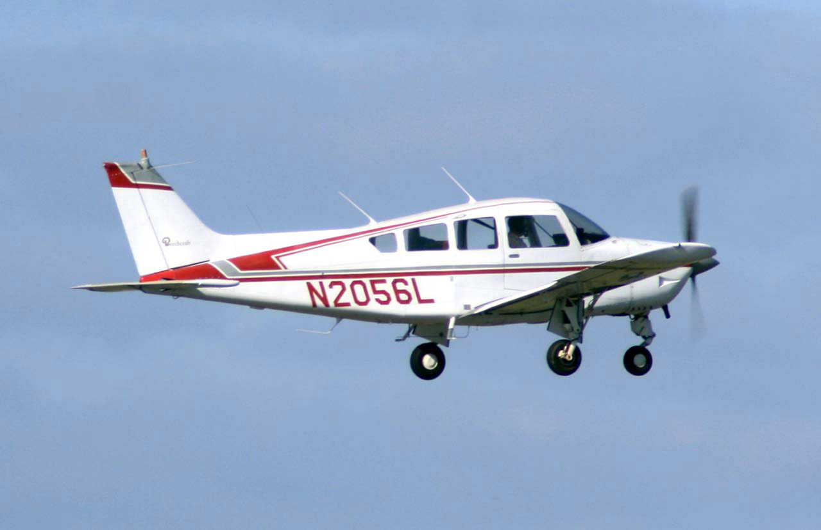
The Air plain was made in 1903 by Wilbur and orville wright.
Who was when and wear

Slide 3
I THINK THEY ARE COOI
I LOVE AIR PLAINS
I WANT TO BE ONE WHEN I GROW UP

