Slide 1
Gloria w4

Slide 2
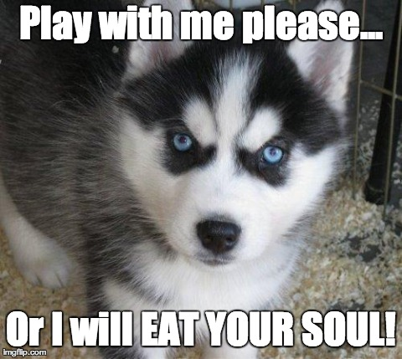
Ones upona time
There was a vileelleg you werer going for a strooll and an evil puppy
1 run away
Attack with a cat

Slide 3
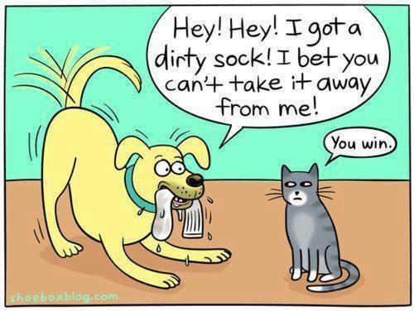
Cat fhithe
The pup eats the cat
1 panick
Play with it

Slide 4
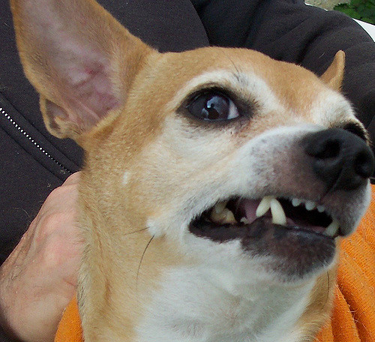
Run away
The pup runs for you and it eats your soll

Slide 5
you win but then you die from old age

Slide 6
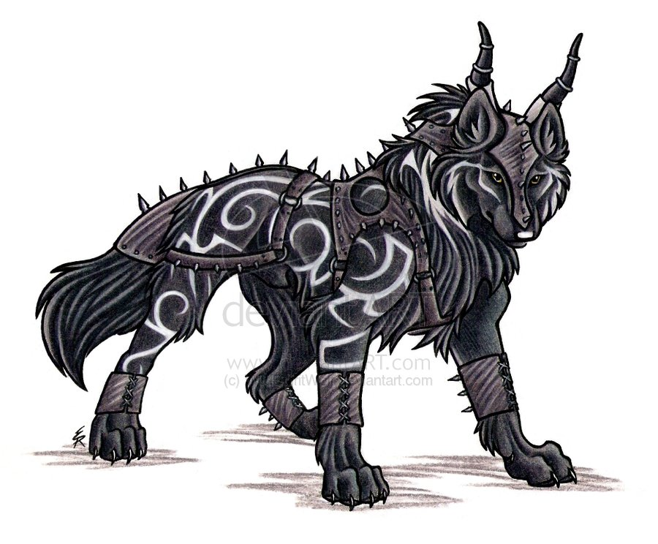
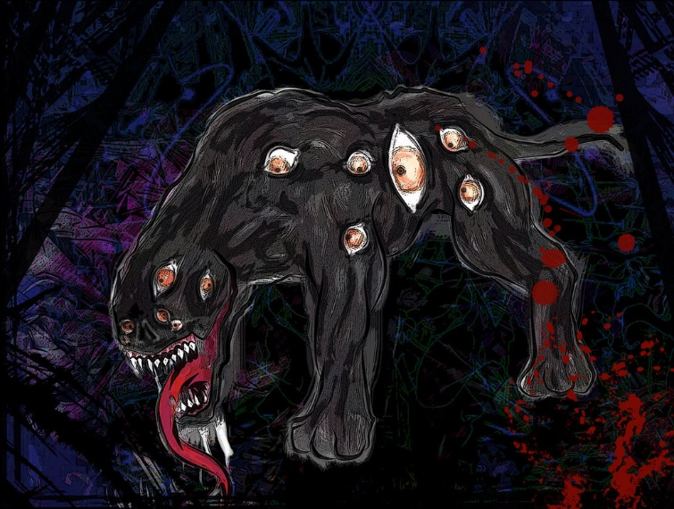
You play with the pup and you die mwmwmwmwhhwhhwhhahahahahahah

