Slide 1
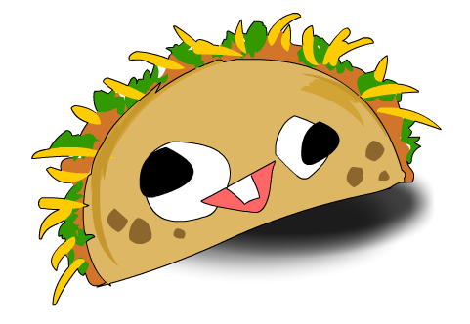
grant
It is raining tacos

Slide 2
Once upon a time…
It was raining tacos all over the city! you wanted to escape so he…
Run away
Summon a chicken

Slide 3
Run away
You get bonked in the head by a taco!
You lose!

Slide 4
Summon a chicken
The chicken nocks the tacos out of the way.

Slide 5
What do you do?
Do you get a boat or a plane?
Boat
plane

Slide 6
plane
Bad guys capture you!
You lose!

Slide 7
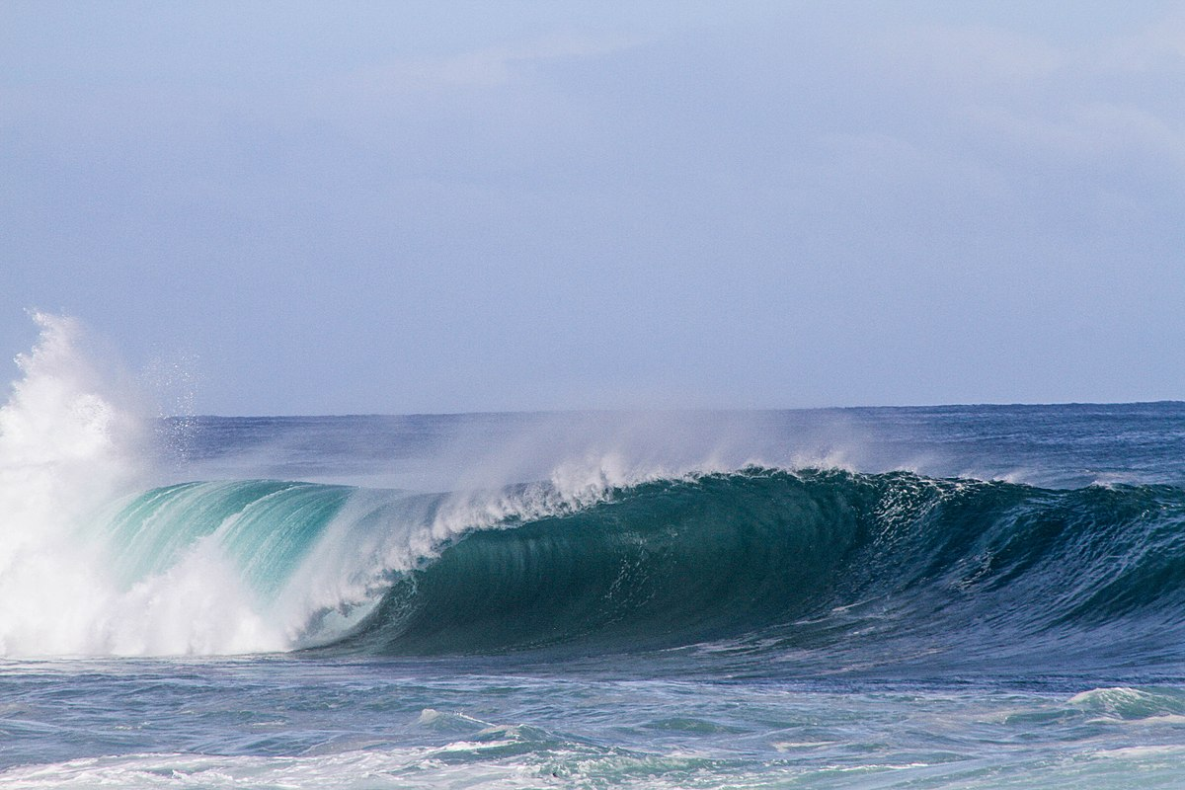
boat
You sale the sea.
You win!

