Slide 1
Hamza a4
Fortnite

Slide 2
VBUCKS
A person was playing fortnite and his mom would’nt let him get vbucks.

Slide 3
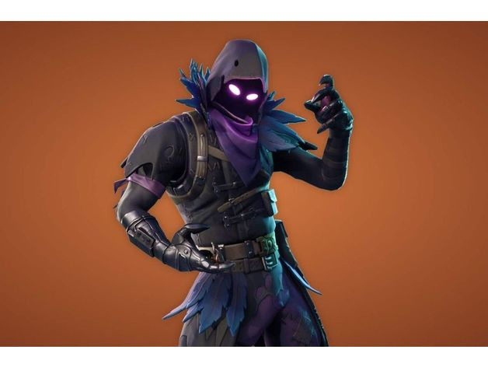
Raven
He really wanted to get a new skin THAT CAME IN THE Item Shop.

Slide 4
Hard disition
So should he…
Get vbut
Do not get vbut

Slide 5
Good Job Mashallah you listen to your mom and get a win

Slide 6
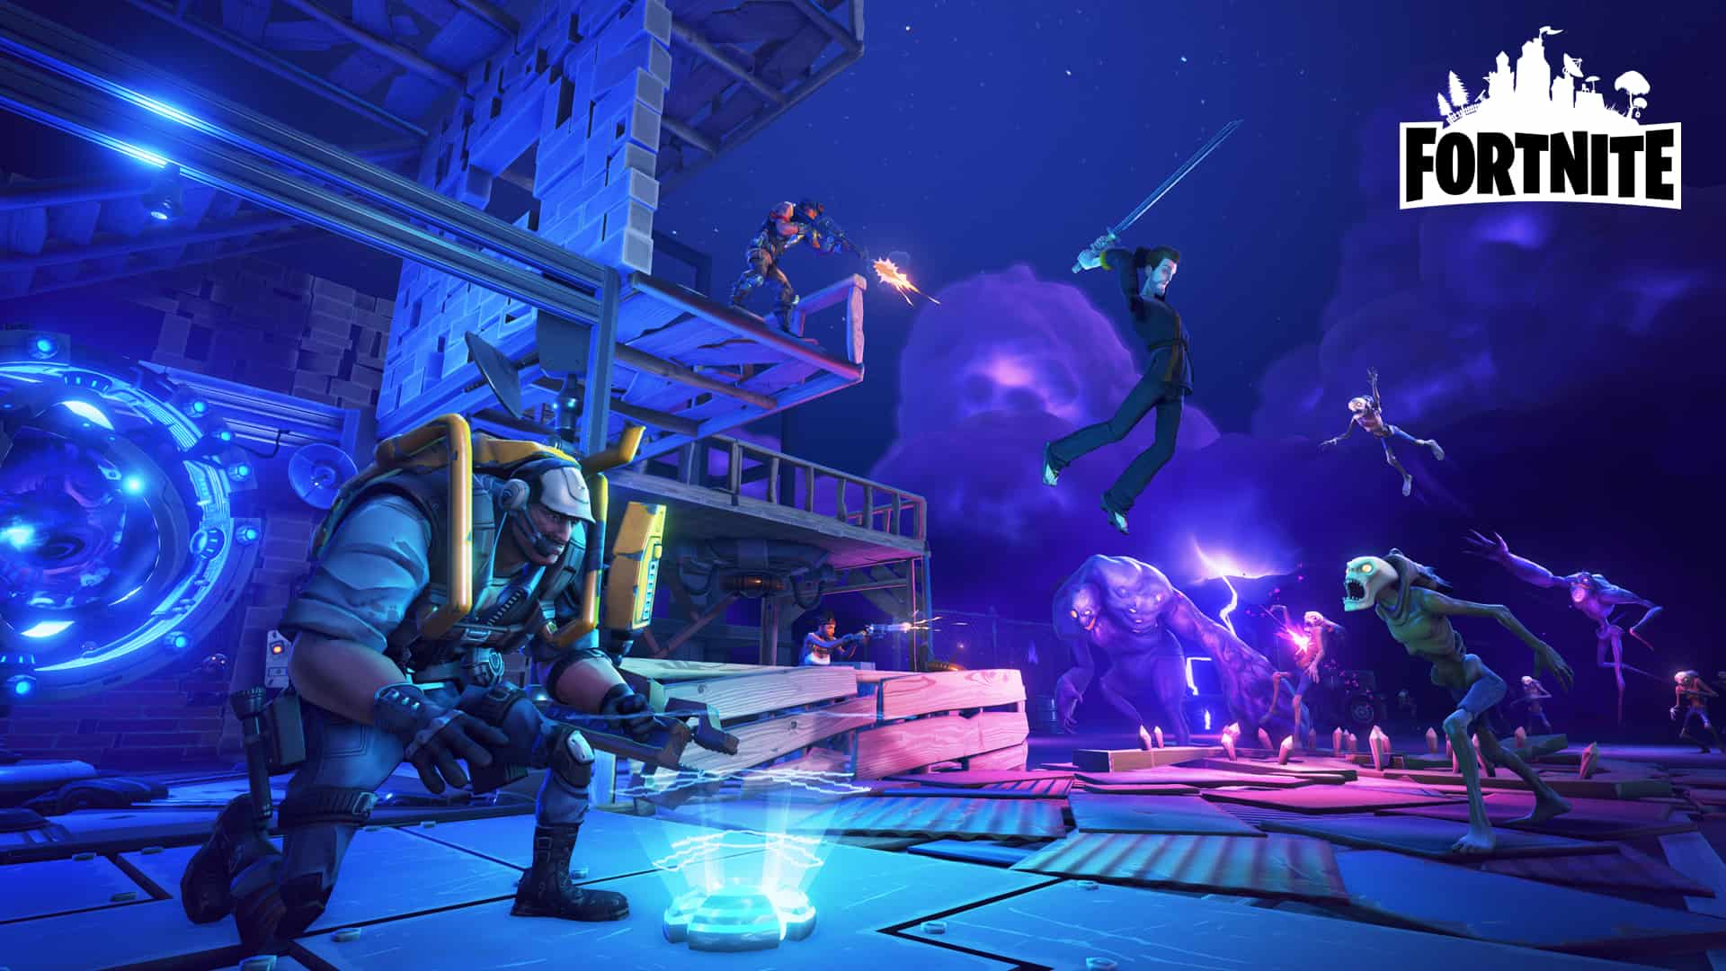
Instint Karma
You buy the vbucks but don’t get them.

