Slide 1
Hanks w4
Plane like it is cool

Slide 2
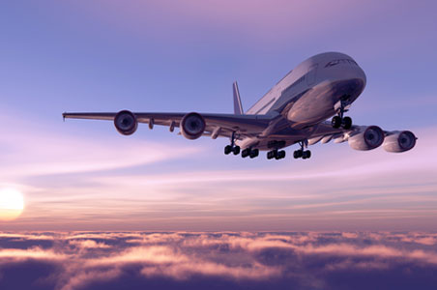

Slide 3
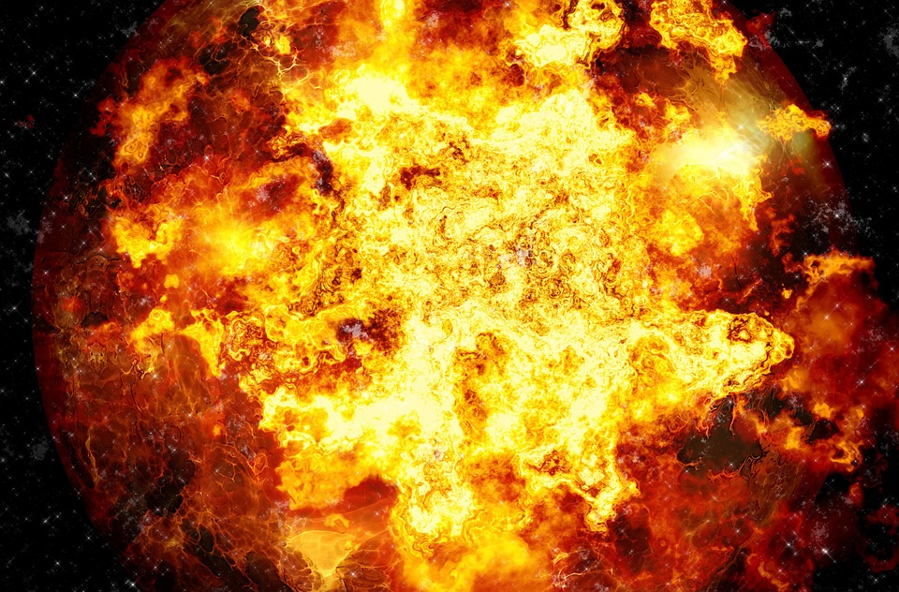

Slide 4
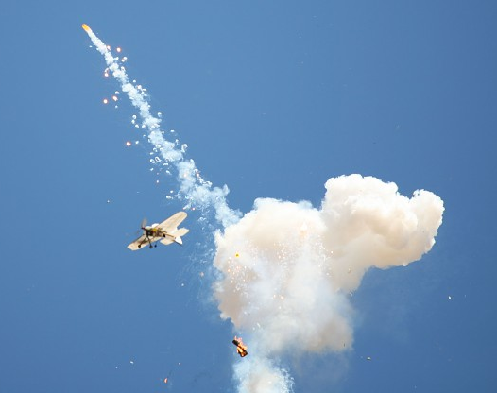
Ow on
The plane exploded what do you do
Jump
Stay on

Slide 5
You fall in to a river you died

Slide 6
You win
You

