Slide 1
Hannaw4
Riding a dragon

Slide 2
Ouce a upon a time…
You lived in a villige that had the meenesd people
Do you…
Stay
Run away to be a explorer

Slide 3
Run away
You have jerned far and long with no food or water
Do you…
Give up
Keep going

Slide 4
Stay
They are so mean to you that they kill you

Slide 5
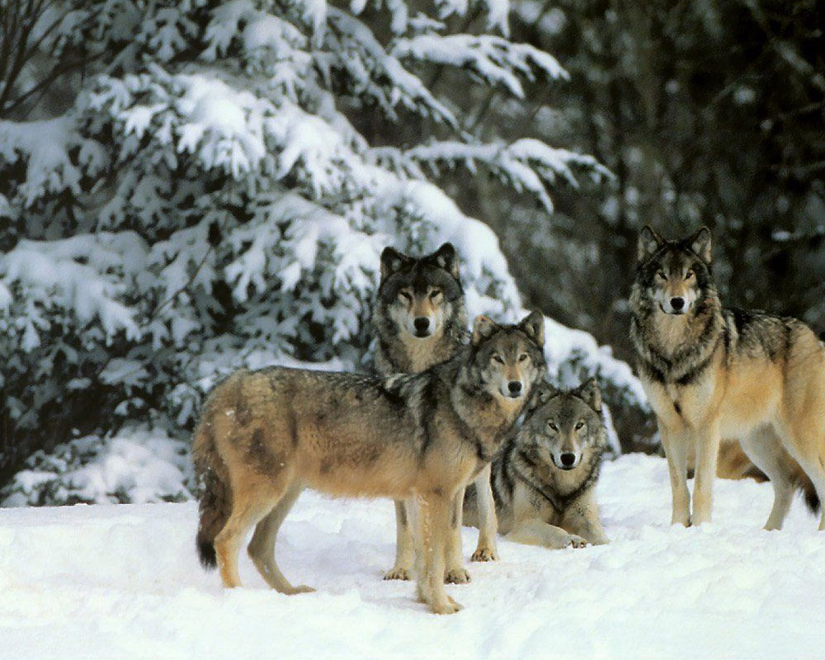
Give up
Wolves find you and eat you.

Slide 6
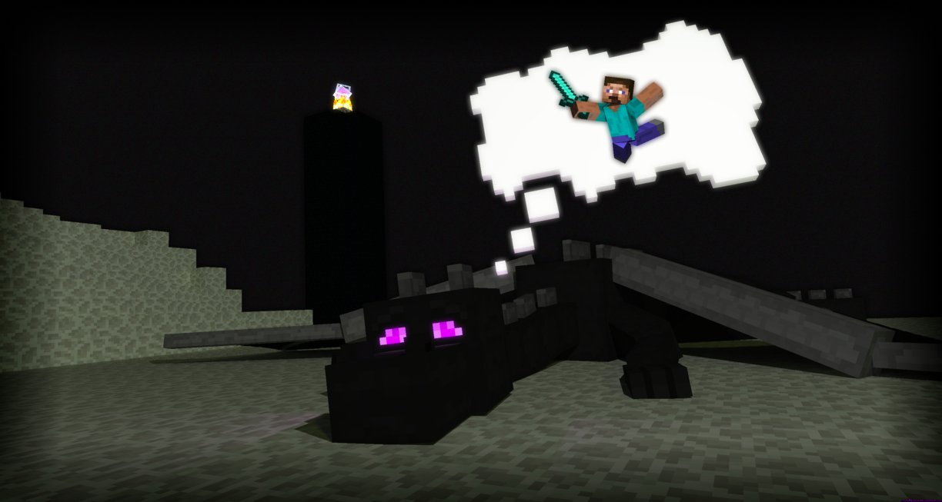
Keep going
You take the risk and keep going but you see a hurt dragon
Do you
Save it and have the rick of being killed
Leave

Slide 7
Leave
The dragon kills you

Slide 8
Help it
The dragon loves you and you become best friends.

Slide 9
The End

