Slide 1
HasanA4
The War of Swords

Slide 2
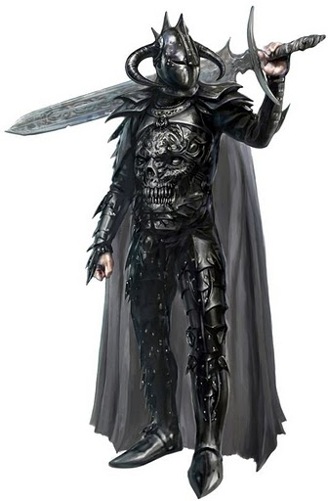
The war has begun
You are the Black Knight and a lot of knights run at you what do you do…
You run at them
You run away and make a plan

Slide 3
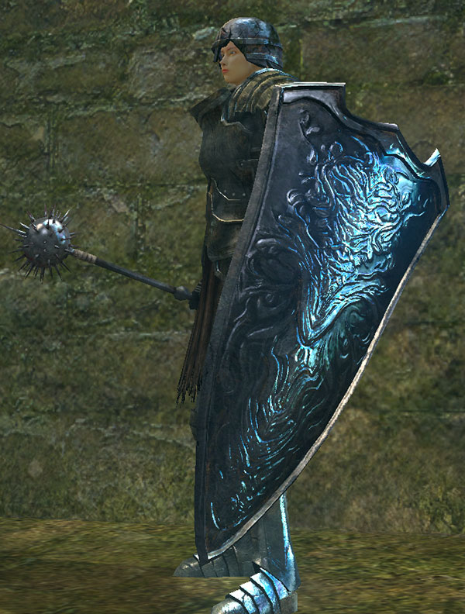
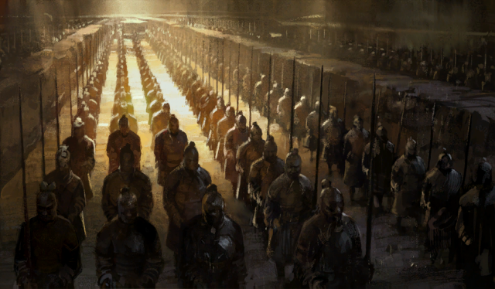
You run at them
You run at them you start killing some of them
But you see a giant knight with a big sword run at you what do you do…
You trip him
You run at his head

Slide 4
You trip him
You trip him then you stab him in the heart you won the fight

Slide 5
you Run at his head
You hit his head with a sword he died won the fight

Slide 6
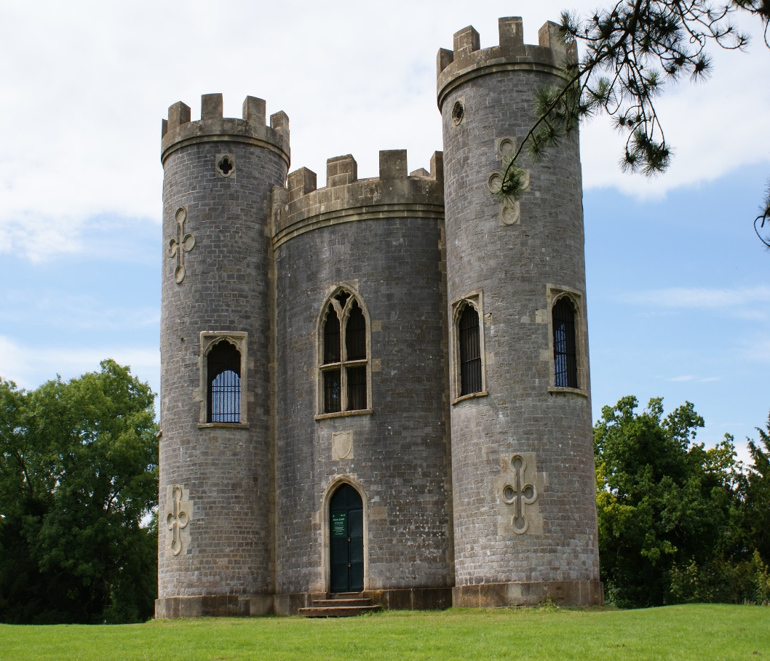
You ran away
You go back to the castle and make a plan your plan: you kill one at a time.
You run at them this time the white knight has came what do you do …
You run at him
You run away and give up the fight

Slide 7
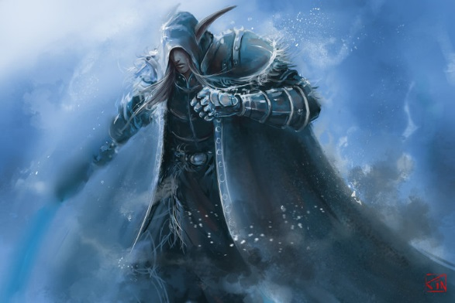
You run at him
He grabs you and throws you
And he stabs you in the head you have lost the fight

Slide 8
You run away and give up
Your king kills you for failing

