Slide 1
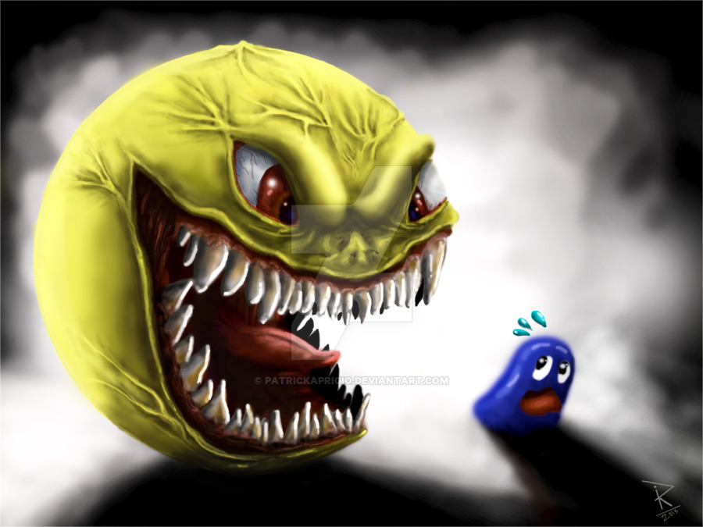
Hayat R4
The scary monster

Slide 2
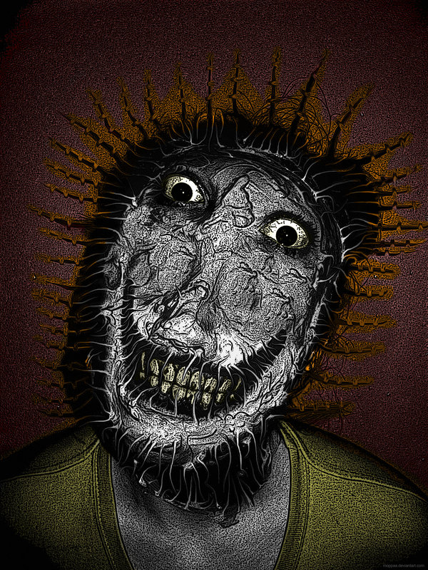
Intro
You came out your house and heard people screaming and howling so you came to see what was happening so you saw a big ugly evil black monster what will you do
Go to a different country
Or fight the monster

Slide 3
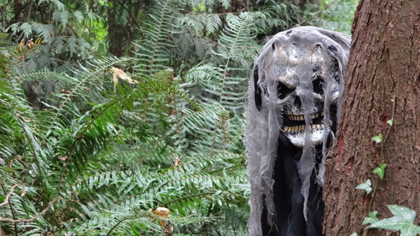
Go to a diffrent country
You ran away to try to run to the airport but the monster heard your foot steps so he reached his evil hand and held and ate you up
Try again

Slide 4
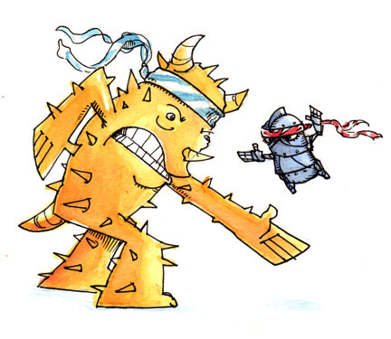
Fight back
You tried to fight back and you kicked the monster and you discovered that the monster was very weak so he died and you ran away

Slide 5
The End
The End

