Slide 1
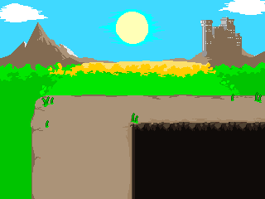
Hero R4
Ebott-ian Terror

Slide 2
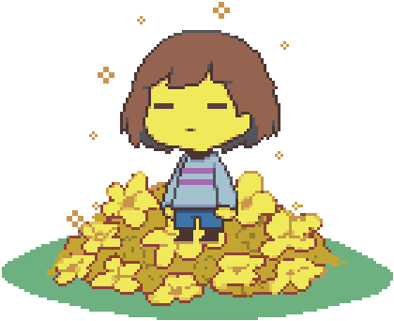
You have fallen down…
Woshua greets you with a sponge to the head.
Will you:
Ask to be cleaned
Touch him
Get up and run

Slide 3
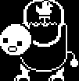
Asked to be cleaned…
Woshua hops around excitedly!
He gives you 20000000000 LV.
Will you…
Get up
Punch him

Slide 4
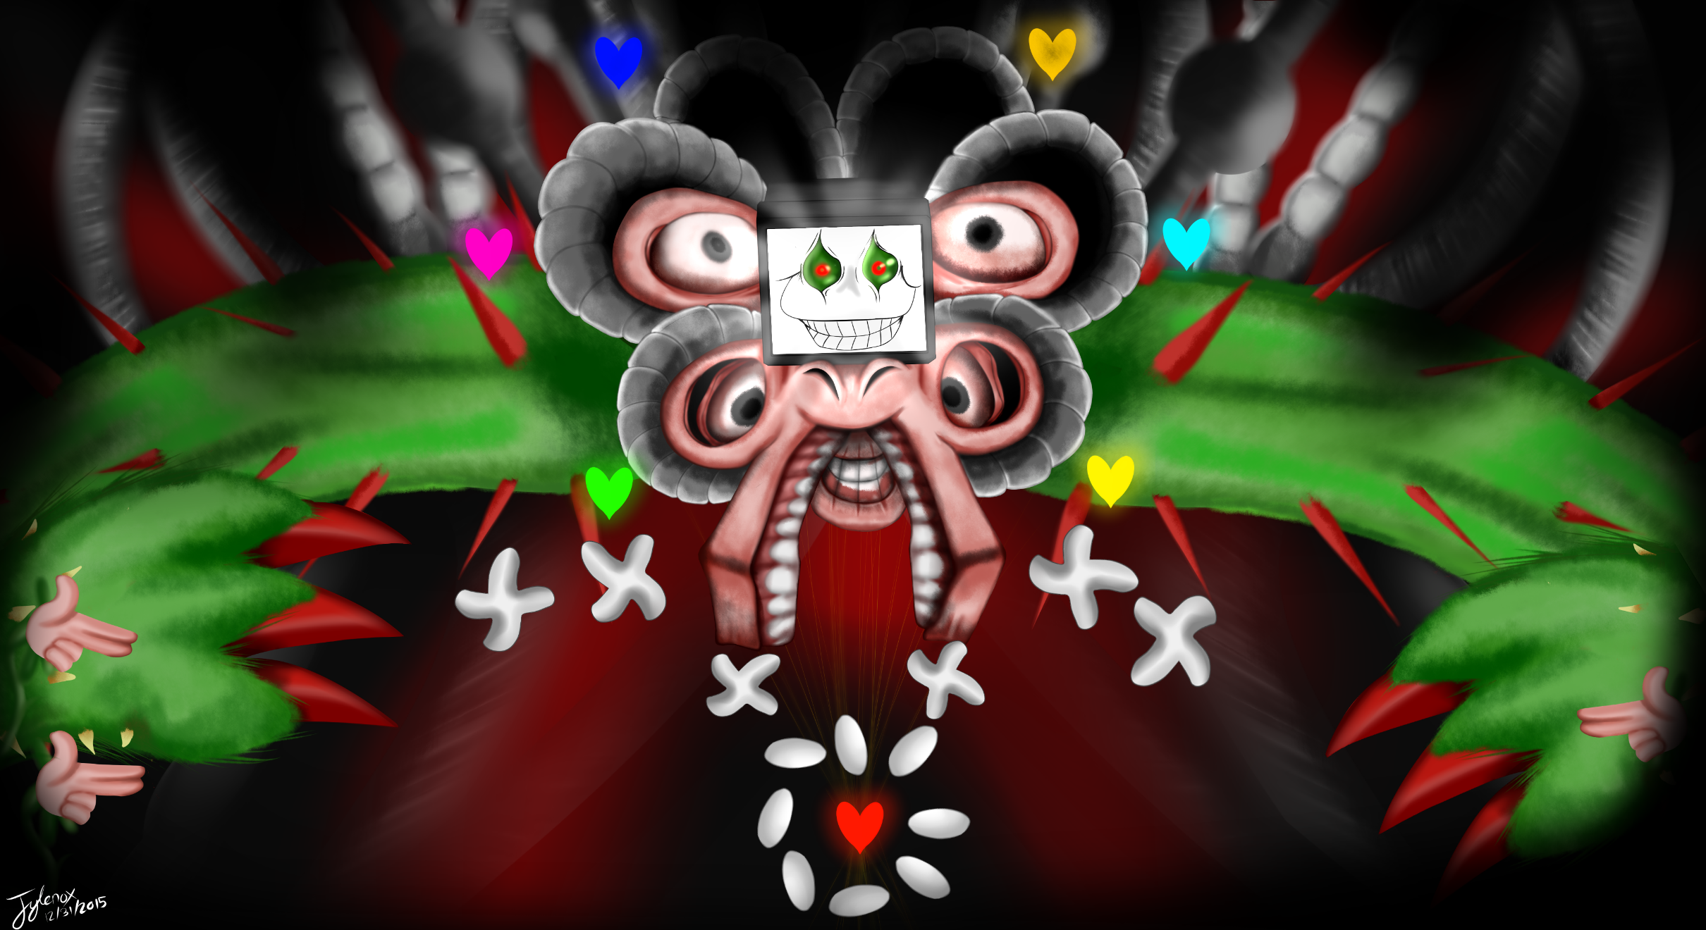
You punched Woshua.
You make it to the end of Mt. Ebott and Flowey attacks!
You defeated Flowey! YOU WIN!
You won!

Slide 5
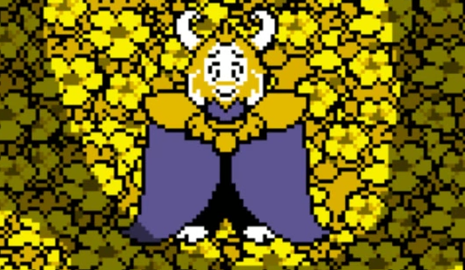
YOU TOUCHED THE WOSH?!?!?!
Woshua gets SO angry…
He insults you with a
YOUR SOUL’S UNCLEAN!
You died!
Continue?

Slide 6
You ran away.
Froggit assaulted you!
Do you:
FIGHT him
Compliment and MERCY

Slide 7
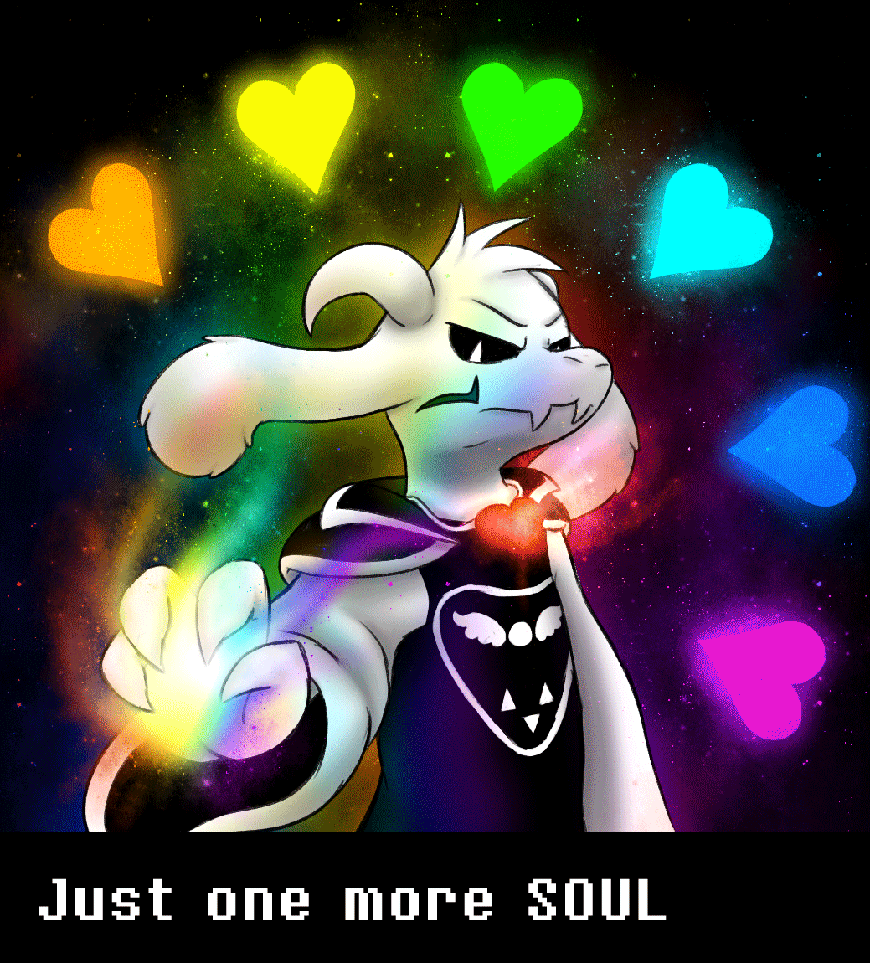
You complimented Froggit.
You make it to the end of Mt. Ebott and Asriel attacks!
YOU SPARED ASRIEL! YOU WON!
YOU WON!

Slide 8
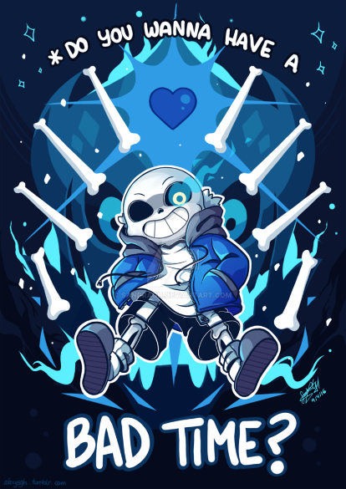
You fought back.
You got to the end of Mt. Ebott and Sans attacks!
Will you:
FIGHT Sans
Use MERCY on Sans

Slide 9
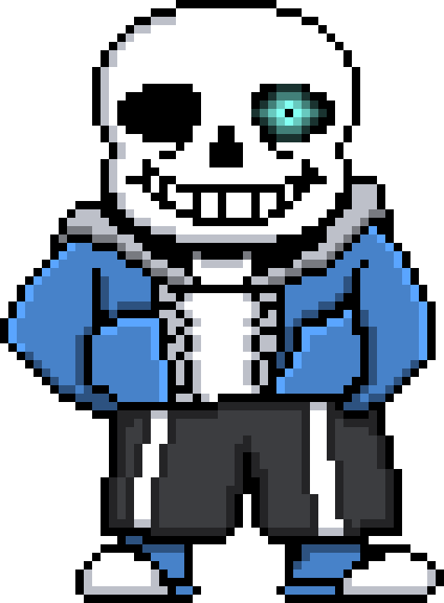
You fought Sans.
He has defeated you with a bone attack!
You died!
Continue?

Slide 10
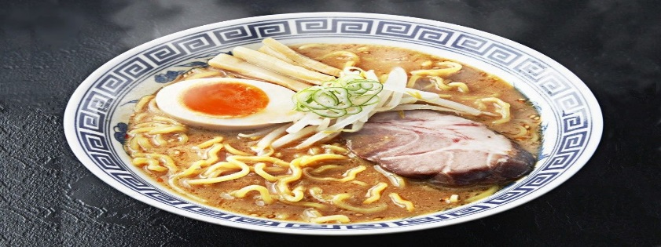
You won!
Good job!
YOU WON!
Now you can eat this ramen! ☺
|
|
|
V

