Slide 1
Jersi a4 The women who wanted to destroy the world
Jersi a4

Slide 2
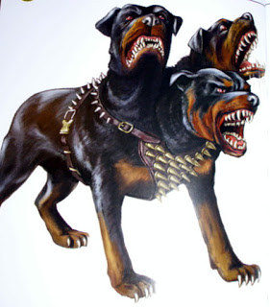
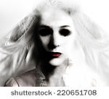
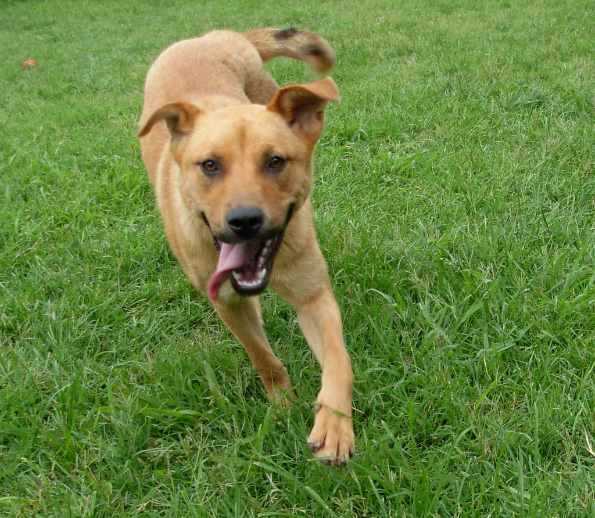
Once upon a time there was a scary women who wanted to destroy the world and make it her evil land
Hop on a airplane
Try to stop here

Slide 3
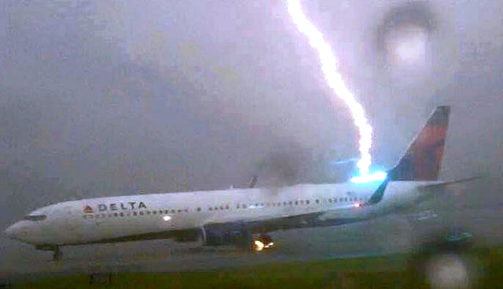
Hop on a airplane
die
Hop out

Slide 4
Die
You are dead!

Slide 5
Hop out
The lady made a big storm what do you do
Find a taxi
run

Slide 6
taxi
there are no taxis

Slide 7
run
Want to get there press here

Slide 8
You made it!
Destroy her
Or run for your life

Slide 9
Destroy here
You destroyed her!

Slide 10
Run for your life
Hide at home in bed
Hide in a hotel

Slide 11
Hide at home in bed
You are safe!

Slide 12
Sorde

Slide 14
Hide in hotel
You are safe!

Slide 15
Try to stop here
Use sorde
Use axe

