Slide 1
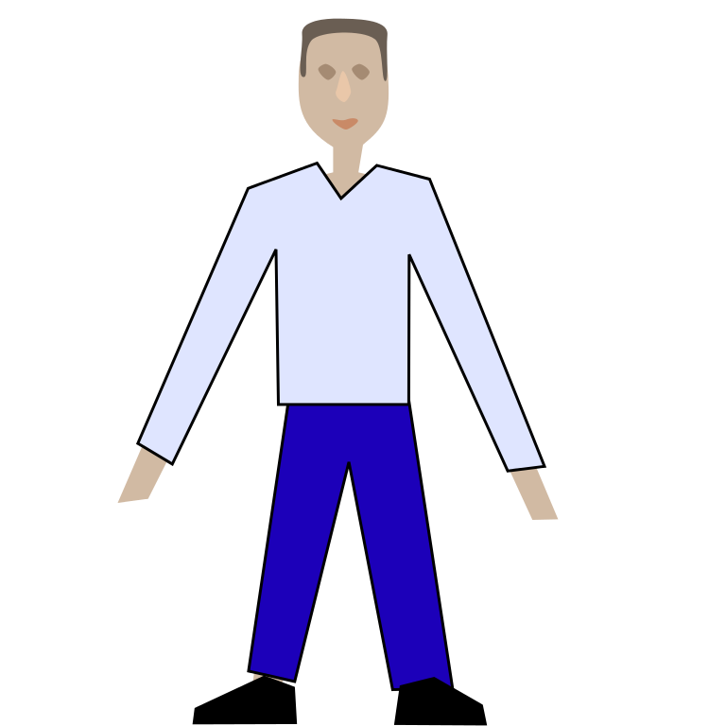
Joachim Maratita
Legendary dragon world

Slide 2
Once upon a time…
There was a man called Jo Johnson. He has 2 friends,jeffry makemake,Damien cock. He was a good friend. He LOVED adventures. One day there was a portal. Woah said Jo. What said jeffry. A portal said Jo.
What should he do

Slide 3
options
Go in the portal
RUN AWAY
leave

Slide 4
Go in the portal
Jo went in the portal. NOOOOOOOOOOOOOOO Damien and jeffry said SCREAMING.

Slide 5
If you want to see more come back tomorrow

