Slide 1
Juan r4

Slide 2
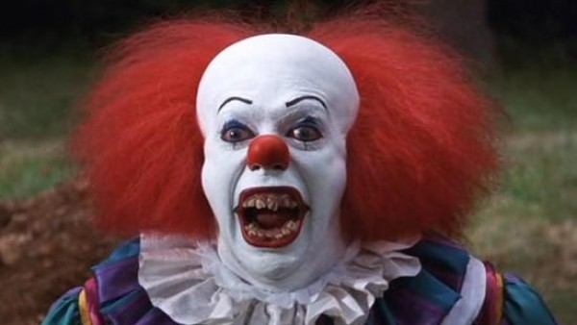
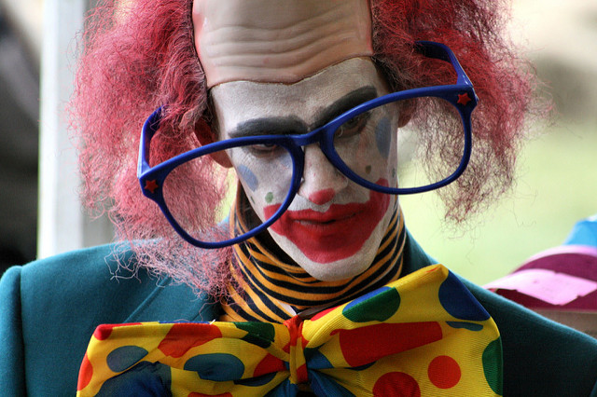
The night of the living killer clown

Slide 3
It was a cold rainy night a little boy hade a paper bout it got in the swear a clown popped out and he said his name penywise. He said do you want your bout back or a balloon.
Do get your bout back.
Or a balloon. you die

Slide 4
you die
He drags you down in the sewer.

Slide 5
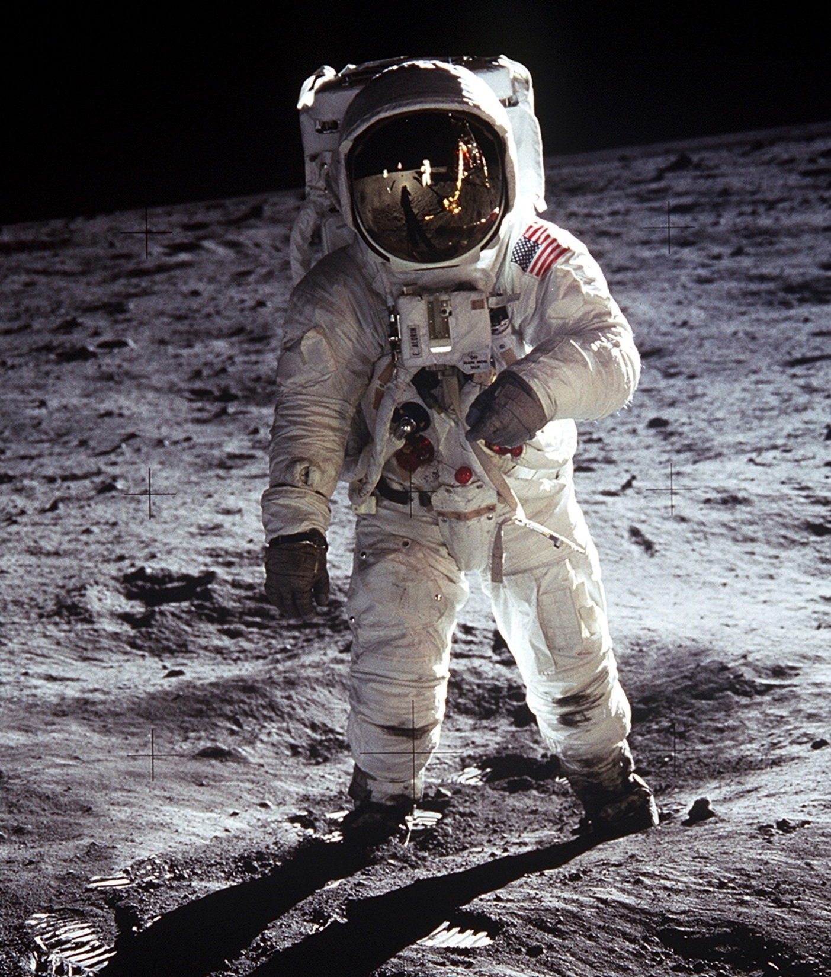
you get a balloon
You get the balloon and fly to space.

