Slide 1
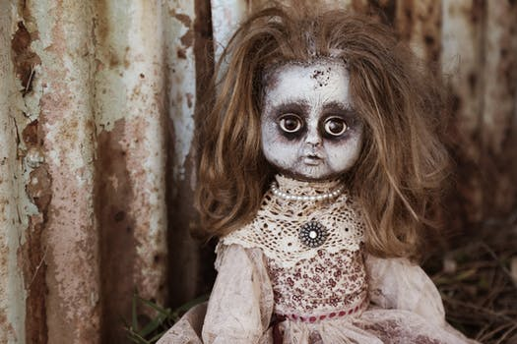
Katie carstairs
The forgottin doll

Slide 2
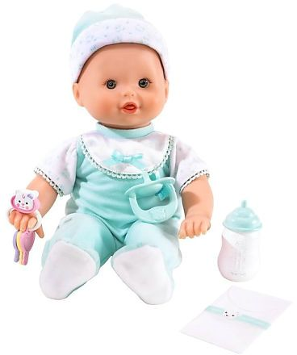
a happy day.
One dao day
you went to the store. your mom bot you a doll.

Slide 3
What do you do when you get home?
What do you when you get home?
Play with doll?
Take a nap?

Slide 4
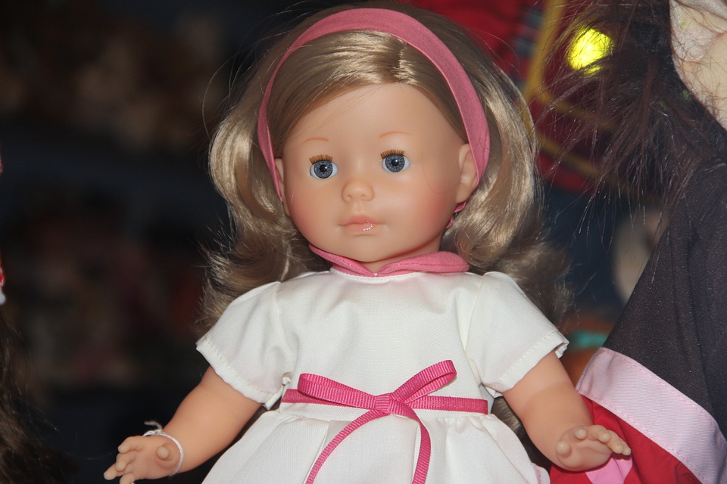
Play whith doll
you dicided to play whith her doll.
you relly liked your doll.
2 minits later.her mom seid it was time for diner.
Go to diner with doll.
Refuse and tho a fit.

Slide 5
Take a nap
You dicided to take a nap. Your doll kills you well you are sleeping!
Restart?

Slide 6
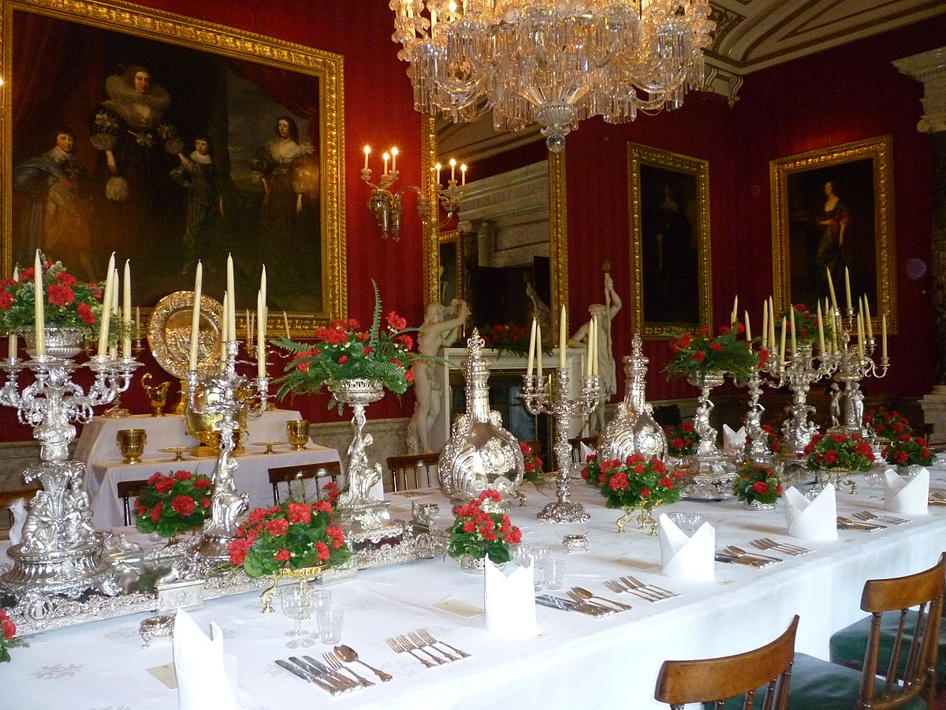
Go to diner with doll
You go to diner with your doll. The food looks so good! You sit down dilightfuly and start eating.
What will you eat?
Hot dog or hamburger?

Slide 7
Hot dog
You dicied to eat a hot dog. You finish up and you and your doll live
Hapily ever after!!!!!!!!!!!!!!!!!!!!!!!!!!!!!!!!!!!!!!!!!!!!!!!!!!!!!!!!!!!!!!!!!!!!!!!!!!!!!!!!!!!!!!!!!!!!!!!!!!!!!!!!!!!!!!!!!!!!!!!!!!!!!!!!!!!!!!!!!!!!!!!!!!!!!!!!!!!!!!!!

Slide 8
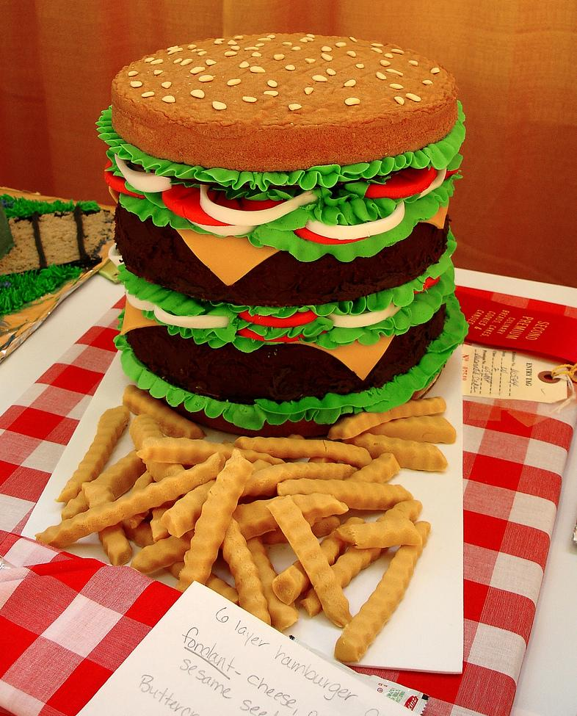
Hamburger
You dicied to eat a hamburger.you finish up and you and your doll live happily ever after!!!!!!!!!!!!!!!!!!!!!!!!!!!!!!!!!!!!!!!!!!!!!!!!!!!!!!!!!!!!!!!!!!!!!!!!!!!!!!!!!!!!!!!!!!!!!!!!!!!!!!!!!!!!!!!!!!!!!!!!!!!!!!!!!!!!!!!!!!!!!!!!!!!

