Slide 1
LeelaL3
Roller skate

Slide 2
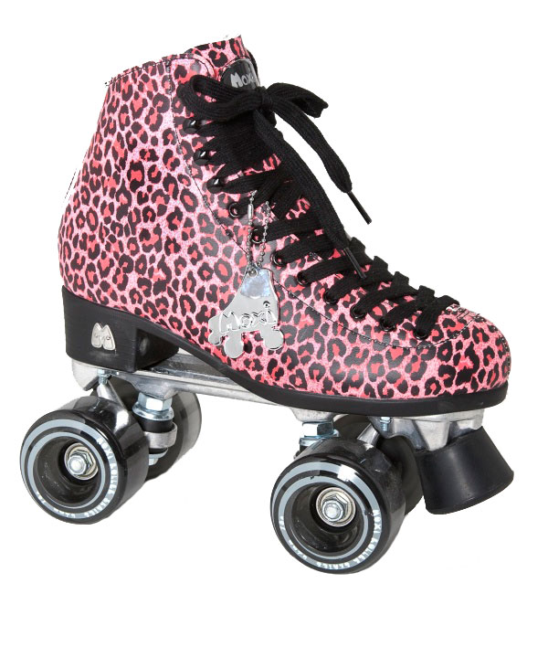
Who and Where?
Belgim
Joseph Merlin

Slide 3
When was it made?
7060

Slide 4
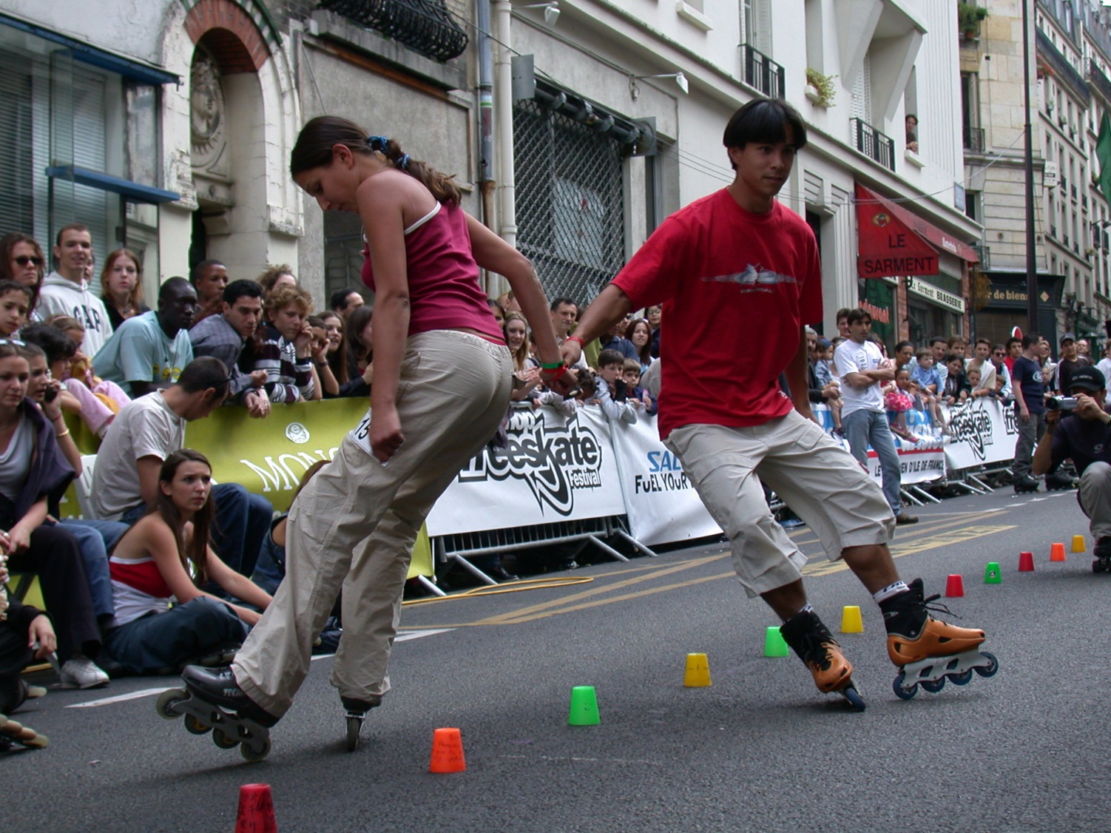
Fun facts!
Roller skating is fun you can also wacth people roller skating.

