Slide 1
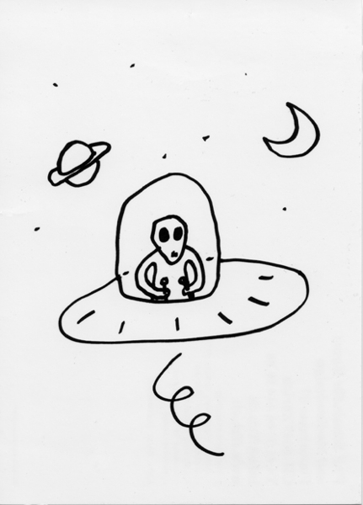
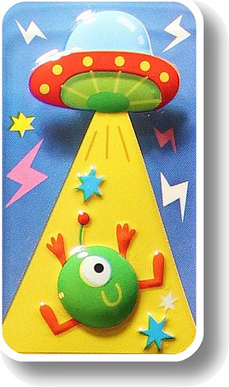
Lily a4
UFO

Slide 2
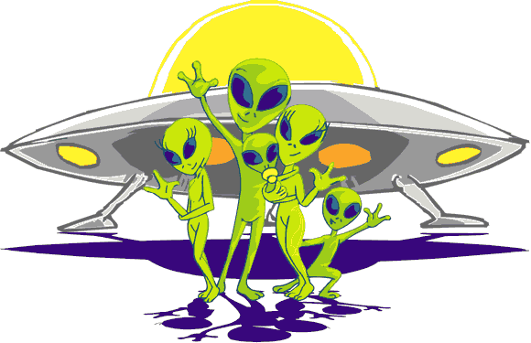
It was dark…
You are walking home from recital. suddenly,a UFO Lands.
What do you do?
Approach it.
Run away.

Slide 3
Approach.
Aliens Come out. They are friendly. They shake your hand.

Slide 4
Run away
Friendly aliens come out. Annoyed,they KILL you.

