Slide 1
Mackenzie R4

Slide 2
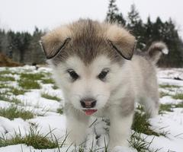
Cute cuddly huskies
A magical husky appears in front of you
Do you…
Cuddle it!

