Slide 1
Maggie r4
The ghost house

Slide 2
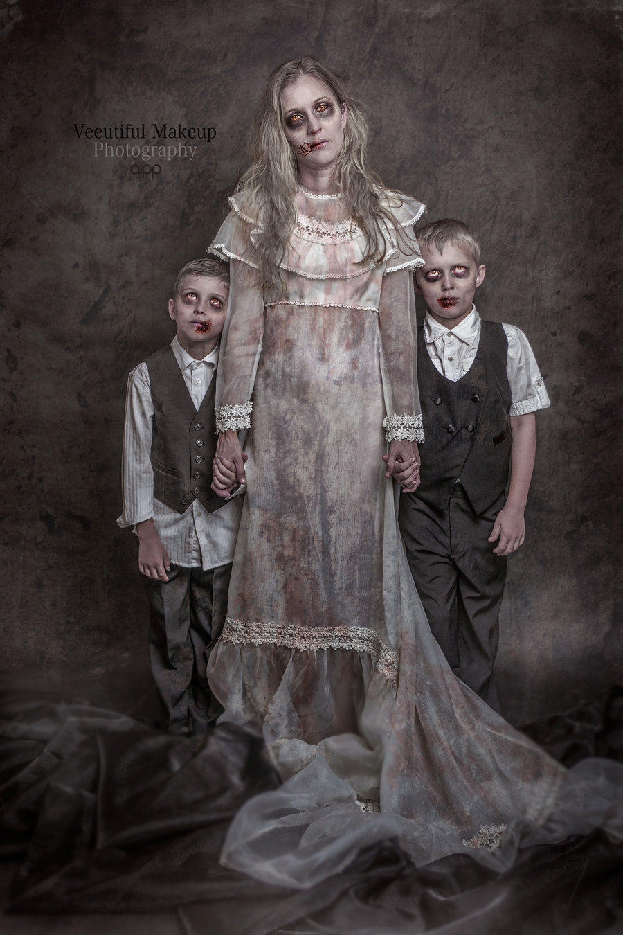
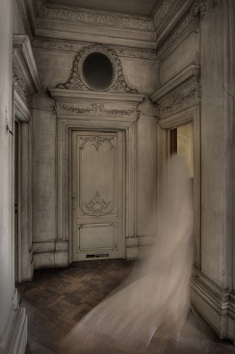
There was a family living in haunted house there cat saw something
a mummy
A ghost

Slide 3
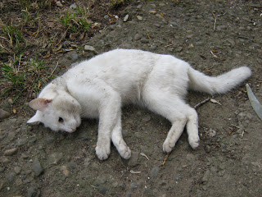
A ghost
The cat dies

Slide 4
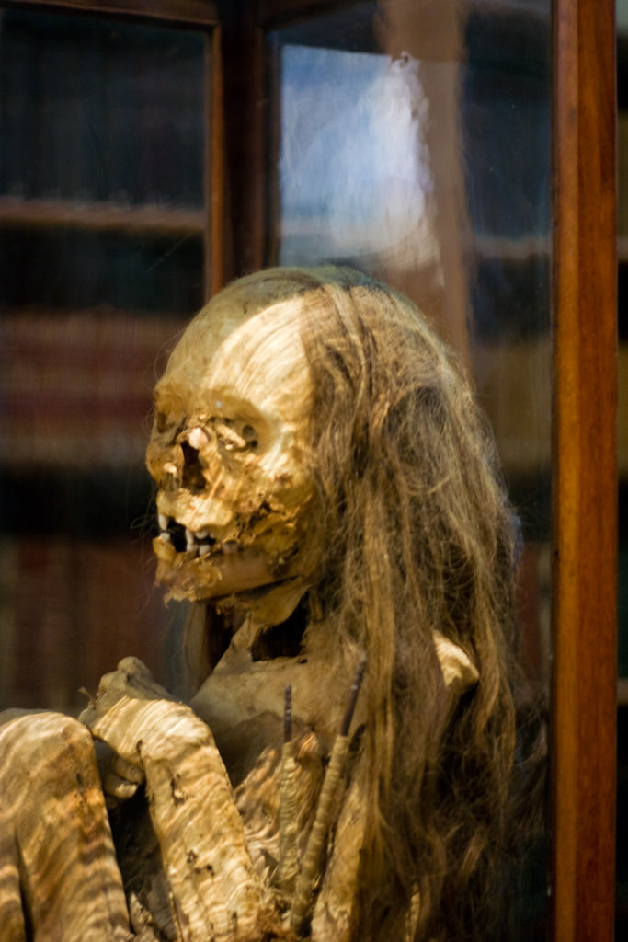
A mummy
You tell your family and you return the mummy and you get a lifetime
Supply of cat treats.

