Slide 1
maiaL3
Gelatin dissert

Slide 2
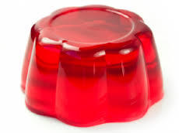
PearleB.
Pearleb invented Jell-o

Slide 3
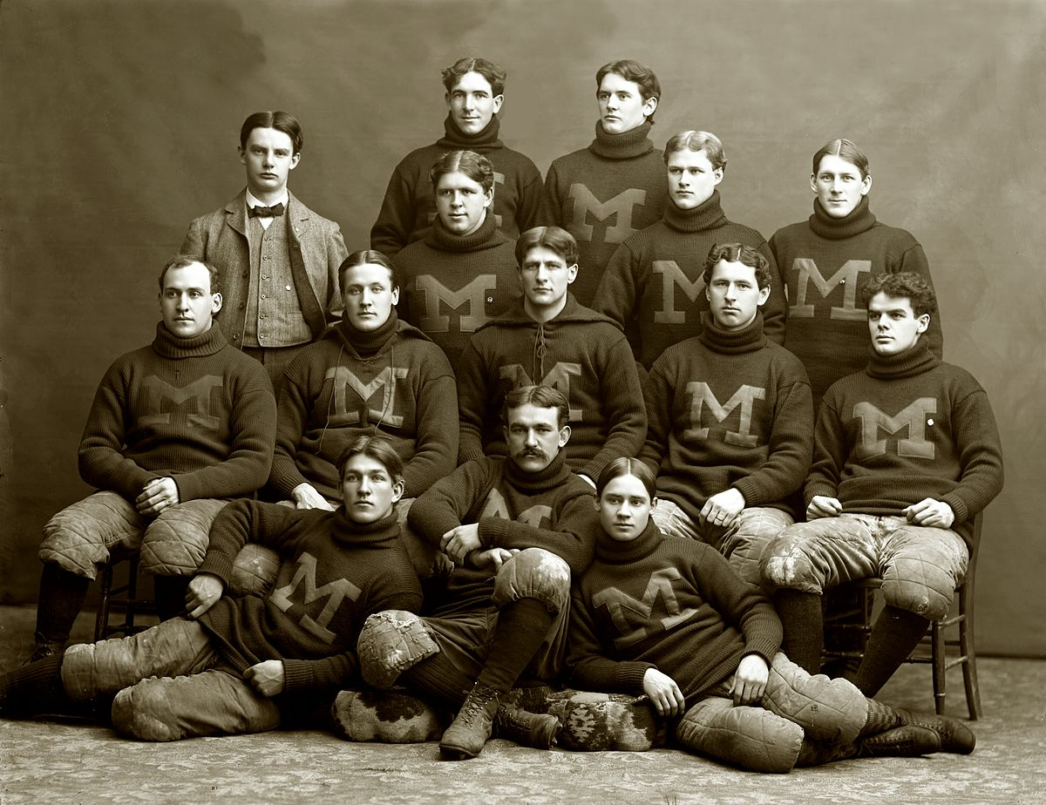
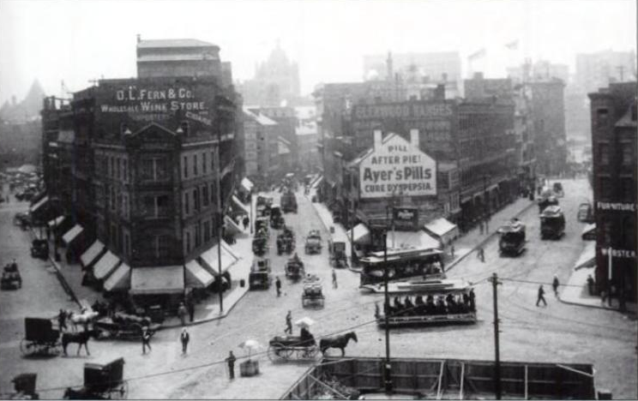
Wen was it invetid
1897

Slide 4
Fun fats

