Slide 1
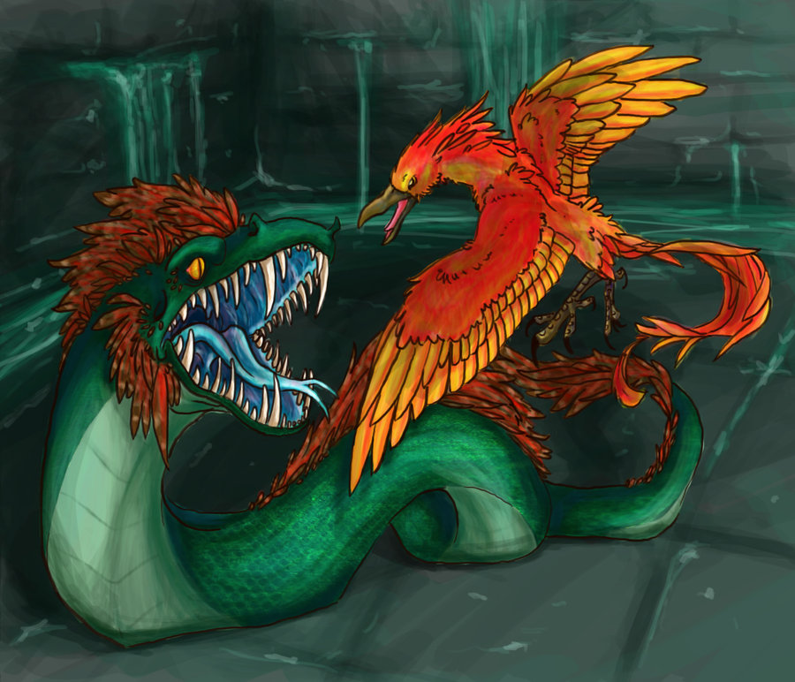
Harry potter and the chamber of secrets
Mia w4

Slide 2
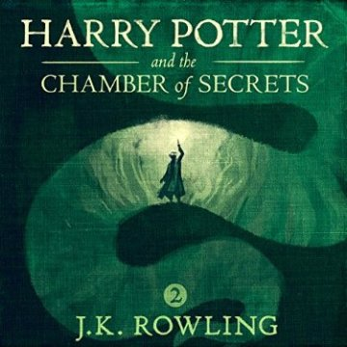
You just got in to the chamber you…
1 decide your scared and run back up the shoot
2 go farther in

Slide 3
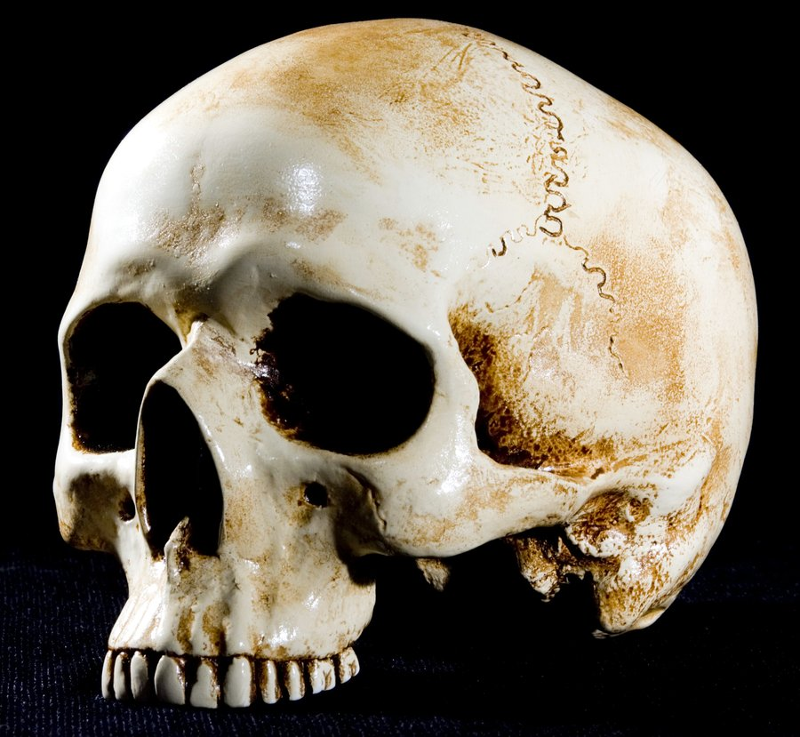
Run back up the shute
You loose your nerve and run back up the shute but the ground is slippery and you fall to your death!
Your dead

Slide 4
You go farther in
You go farther in and come to a door you…
Push on it
Or say open in parsletoung

Slide 5
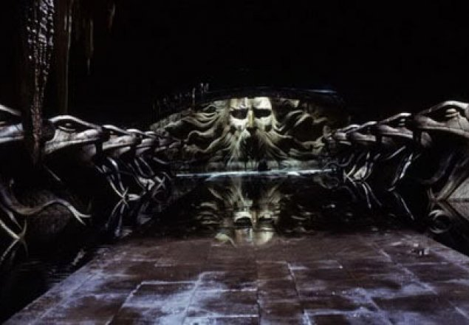
You push on the door
You push on the door but your shirt snags and the last thing you see is 2 yellow eyes.
Your dead

Slide 6
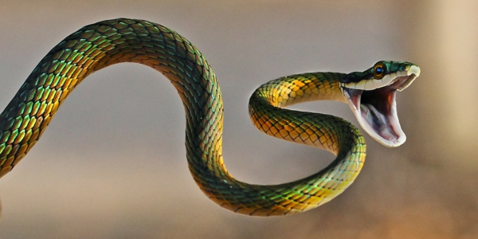
You say open to the door
You say OPEN and the door swings open.
You …
Go inside
Or wait

Slide 7
You went inside!!!
And the baskilisk comes out
You…
Close your eyes
Or keep them open

Slide 8
Wait!
You randomly drop dead!

Slide 9
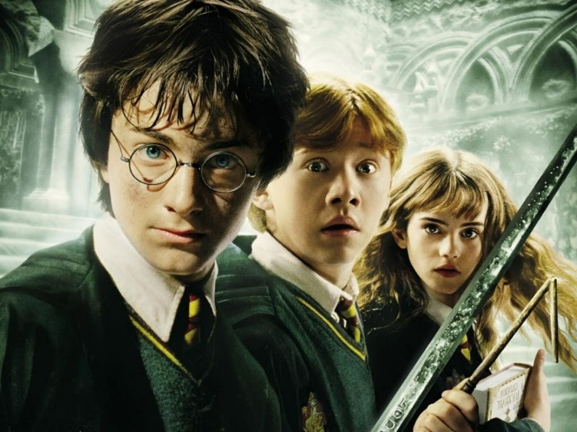
You close your eyes
And faux comes and gives you a sord!
You kill the baskalisk and win!

Slide 10
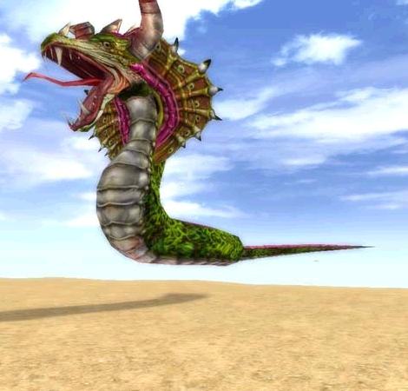
You look into the baskalisks eyes and die!

