Slide 1
MIHAL w4
The zombie basketball

Slide 2
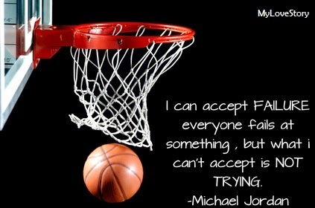
Ones upon a time…
There was zombies attacking the world they LOVED basketball they were playing basketball
Let them play basketball
Attack them

Slide 3
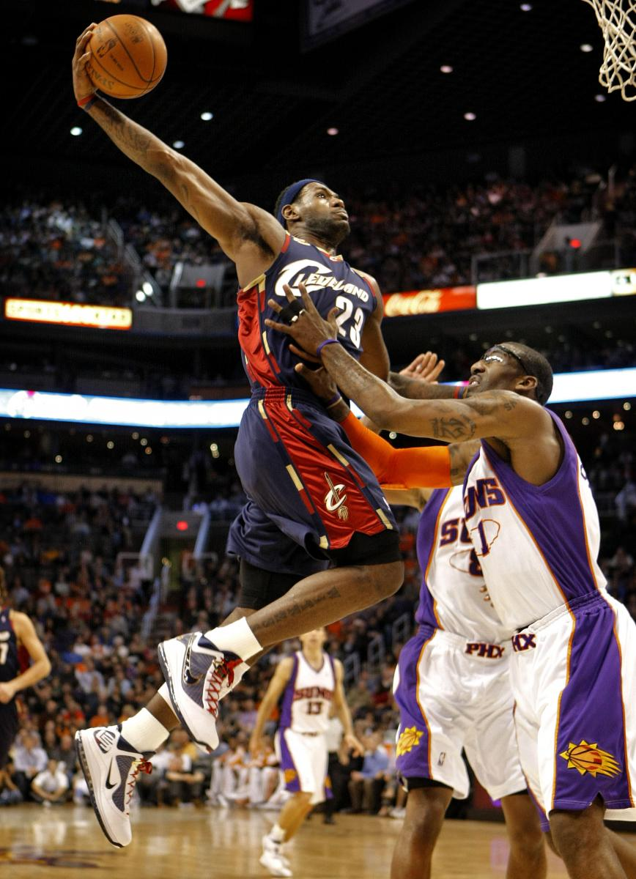
Let them play basket ball
You Let them play basketball and…
Then 1 v 1 who ever wins gets cort

Slide 4
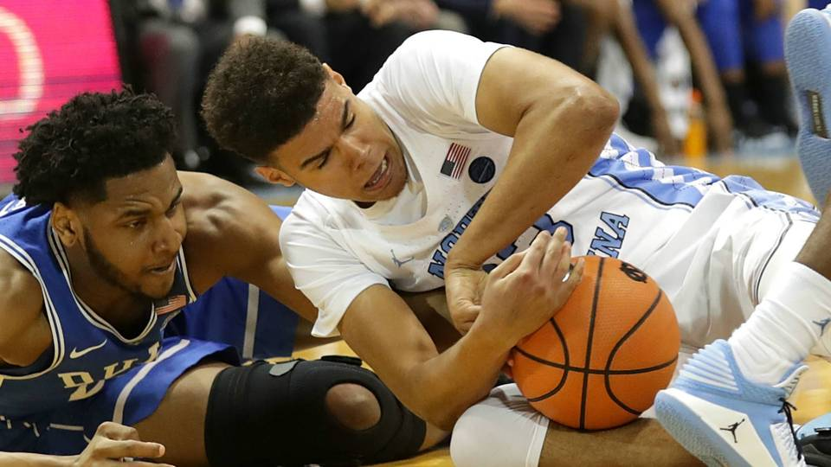
Attack them
I would attack them with my basketball
There dead bro

Slide 5
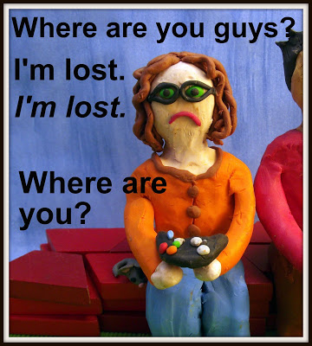
1 v 1 gets the cort
I WIN ZOMBIES GIT OF THE CORT BAM

