Slide 1
Muslimah w4
ZOMBIE CAEERLAEDERS

Slide 2
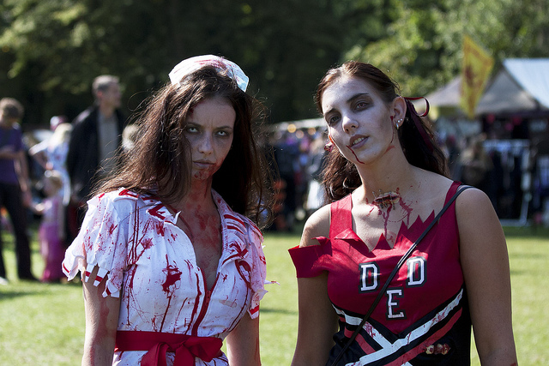
ones
th

