Slide 1
Mykelle W4
Attack of the giant, fast, robotic slugs.

Slide 2
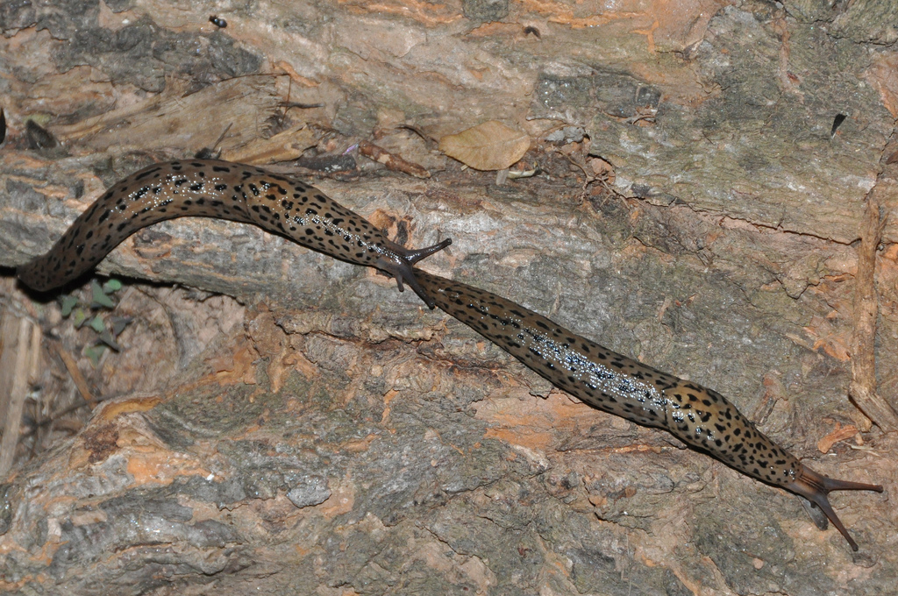
IN A Galaxy far away…
You come apon 5 robotic slugs
Do you…
Tickle them
Run away

Slide 3
You tickle them
You have survived
Go get an elephant
Or run away
Or give up

Slide 4
You go to the pet store
They have a elephant for sale
Do you be generous and give them 1 buck
Or have greed

Slide 5
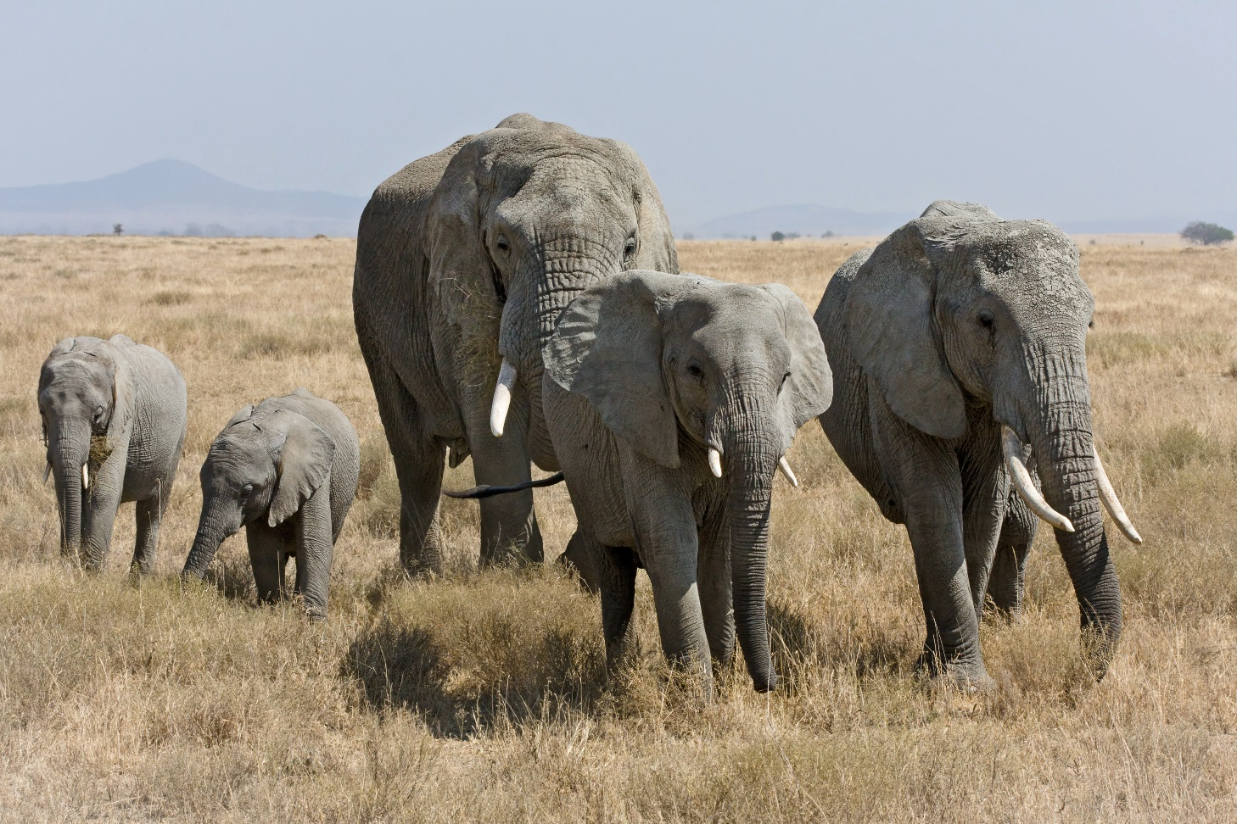
Be generous
They say thank you and give you some salt and 4 more elephants
You go on

Slide 6
You are crushed
They roll over you

Slide 7
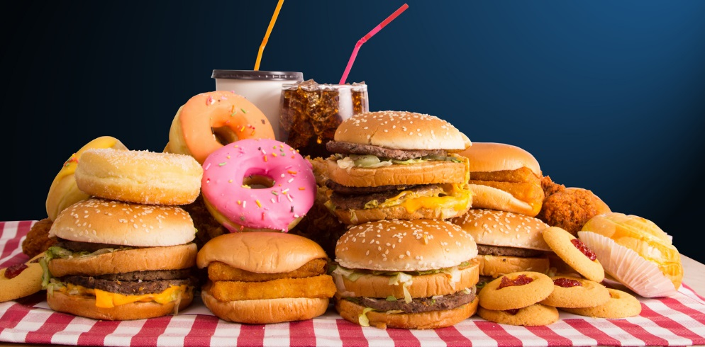
You starve
You go to your house and hide in your bed you die of starvation

Slide 8
The slugs eat you

Slide 9
You go back to the hill
You have the salt
You through it
The slugs

