Slide 1
Naliw4
A gaint bunny attaked

Slide 2
Once upon a time
Something bad happened!
Do you…
1run away
2attak with a stick

Slide 3
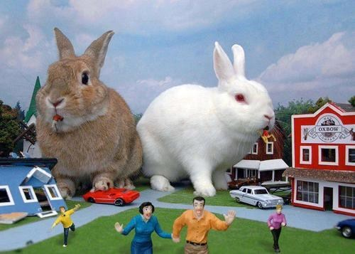
Another bunny comes in front of you and behind you what do you do?

Slide 4
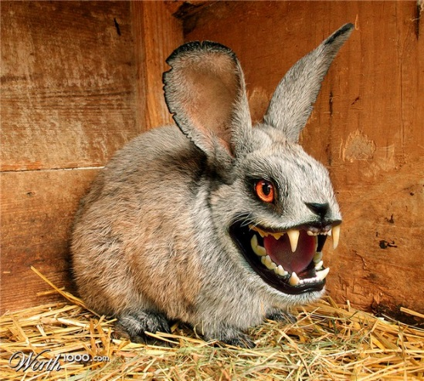
You died

