Slide 1
Oliver w4
Training session 1534

Slide 2
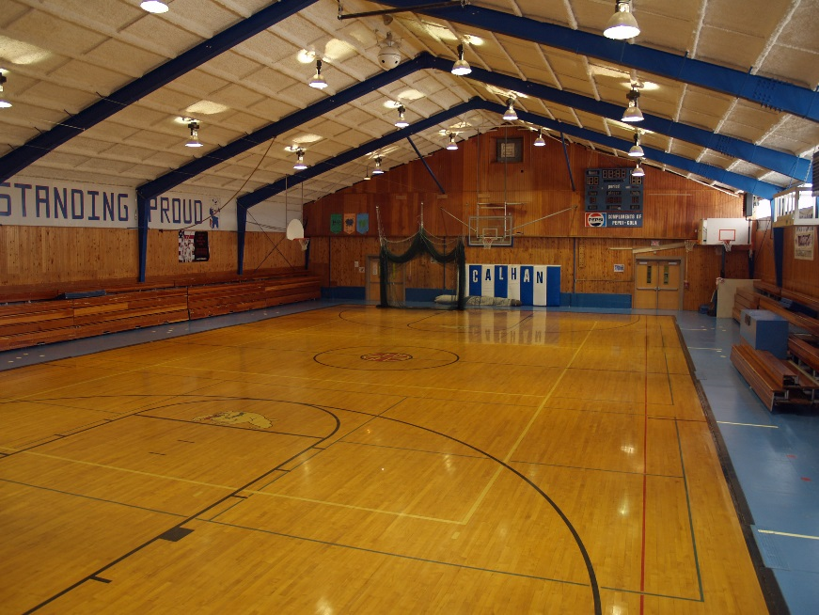
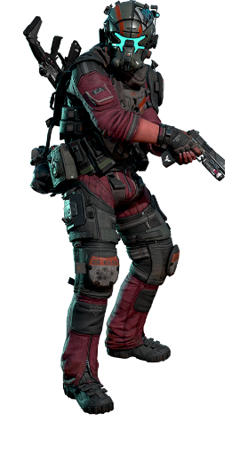
Training session 1534
You walk into the training gym
You put on a training magnet harness.
Do you work on your…
Combos (jump wall run slide roll shoot)
Wall run you
Slide
Or combat roll

Slide 3
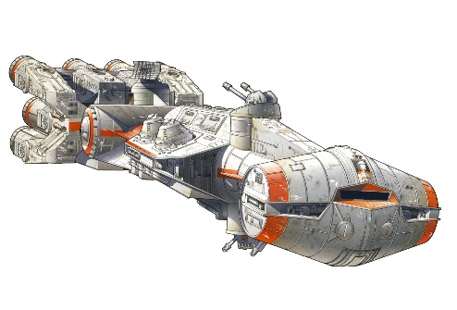
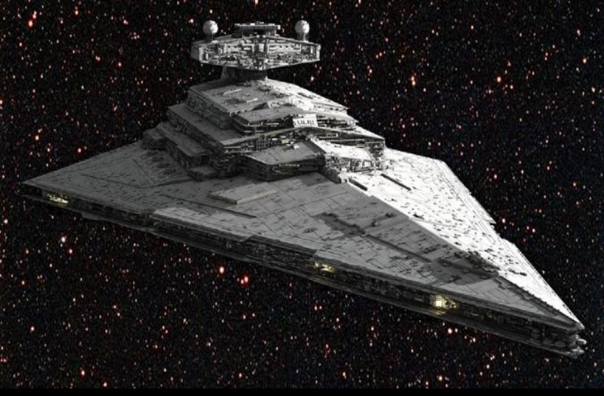
Combat roll
You try to combat roll
You roll then crouch and shoot the target
You succeed on your daily training
Then you hear the ship alarm and “we are under attack by the enemy! Get to your battle stations!”
Do you
Run for the escape pods
Go to a turbolaser

Slide 4
Run for escape pods
You sprint for the escape pods
You hear a massive explosion
Your reactor has been blown up.
Your ship explodes and you die

Slide 5
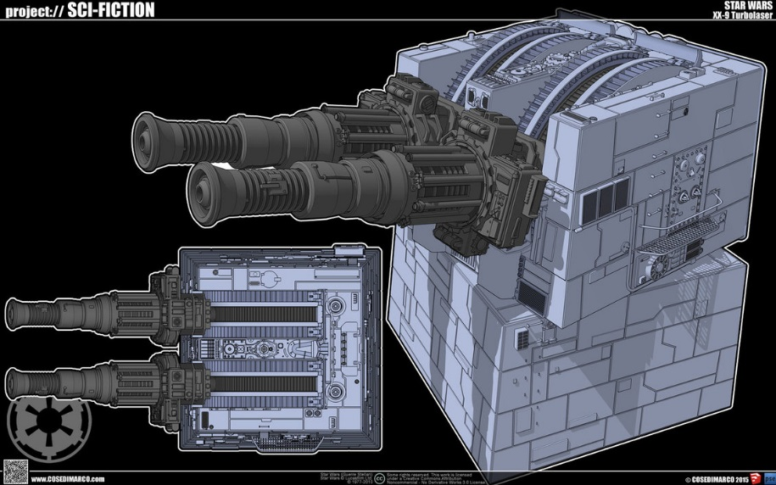
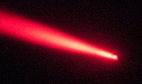
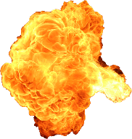
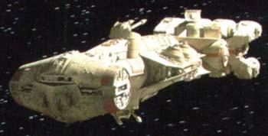
Turbolaser
You get to a turbo laser and begin firing
You hit a crictcal area of their reactor and you blow up the rebels reactor
You win

Slide 6
slide
You atemt to slide and one of your back jets fails and activates
You go flying forward. You black out
It turns out your head bounced of the mat hit your head on the metal floor then your head bounced again and the whiplash broke your neck.
Not knowing you were fully dead . Medical attencion was given to you.
The medical attecion was done by 2 incompetent, idot medics you could feel you died again somehow, curse you steve and allan!

Slide 7
Wall run
You attempt the wall run yet you fall and you see a blue glow around your armor.
The mag lev operatives put you down slowly
Go to combat roll

Slide 8
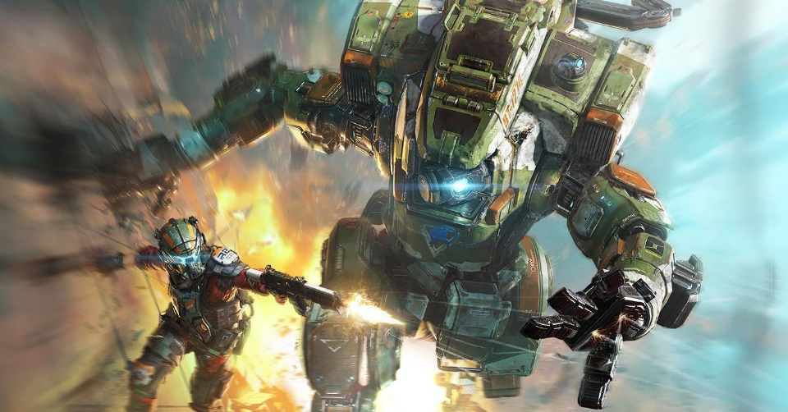
combo
You attempt the combo while wall running you fall, you get caught by a titan.
You goto combat roll

