Slide 1
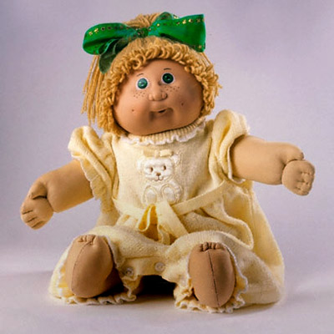
Owen r4
Dolly death…

Slide 2
The beginning…
You are having fun with an ugly 80s doll your grandma got you for your birthday by hanging it on a sting from a tree in your backyard ( btw u r a billionaire ) then it says your name! you saw its mouth open! You are terrified!!
Do you…
Keep torturing it?
Or let go and ask it what it wants?

Slide 3
What do you want?!?
You ask the doll what it wants! But then the dolly swallows you whole! Its stomach is way bigger on the inside! But then you find your sisters doll: Lola!!!! Lola greets you! She hands you a bag of ramen and a stove! Do you
Cook it
Or kick lola?

Slide 4
Torture it!!!!!!!!!
You run to your room on the seventh floor of your house! You get a pocket knife your dad gave you! You go the doll and try to cut it! But then it gets down and takes your knife! You run to your room and hide! You see the dolly grew and it smashed the 8th to 12th stories of your house! It takes over the world and you die!!!!!

Slide 5
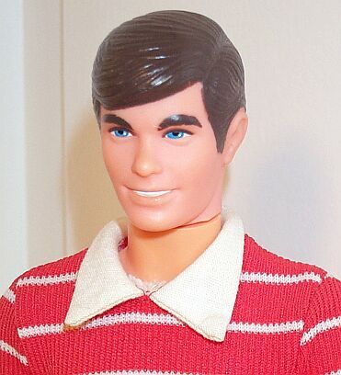
You kick lola!
Lola doges but then a collection of ken dolls come out from nowhere do you
Fight back
Chicken out!

Slide 6
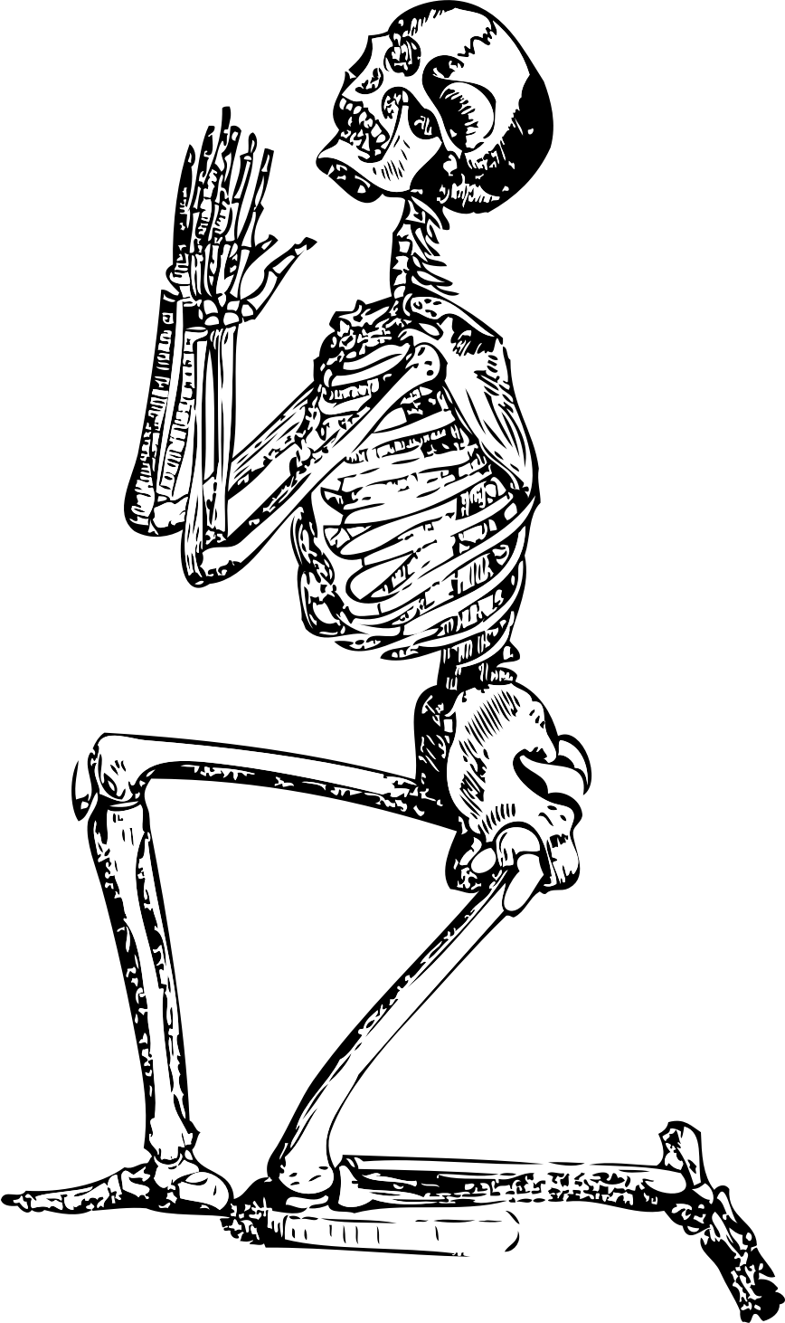
You cook ramen!
You cook ramen! Yummy! But the ramen is hot and you spill! Unfortunatley you are on the dolls tongue and it spits you out under the tree with lola! Dolly this time kills you!

Slide 7
Chicken out!!!
You drop on the floor and before you scream the ken dolls go out and you are left alone in the mouth of dolly! You die the hard way…

Slide 8
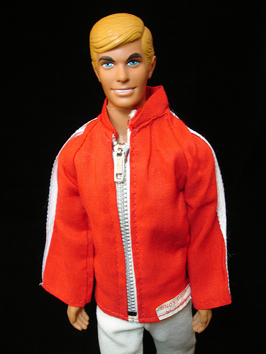
Fight!
Wait! Ken number 147 shouts we want to help. Your doll ate us be like you we survived! We need to get dolly inside here! Do you
Trust kens and lola
Or go alone?

Slide 9
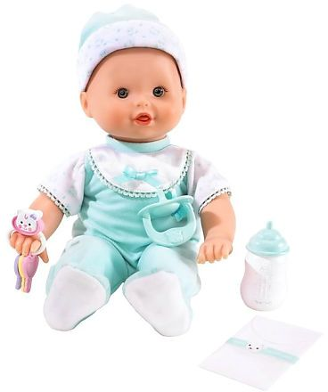
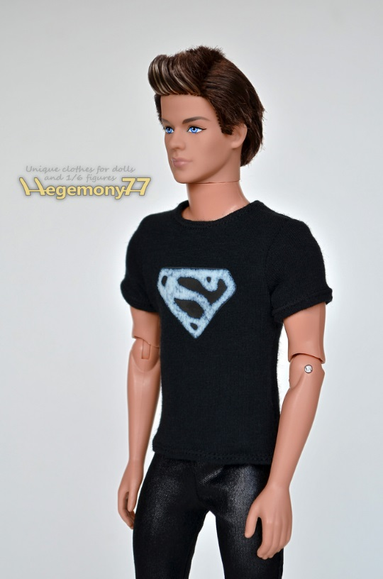
Join forces!
You join forces! You then find something interesting. You ken number one! You sayt. You found out that dolly is actually a doll! Not radioactive doll. So you all of the kens and lola pull dolly’s insides and kill her you and kens and lola win!

Slide 10
Go alone…
You go alone. Whatevs. Say ken number 38. you say goodbye. Then ken 55 comes out and kills you!!!!!!!!!!!!!!!

