Slide 1
Peyton A4
A giant friendly dog named Jojo was flying down from the clouds…

Slide 2
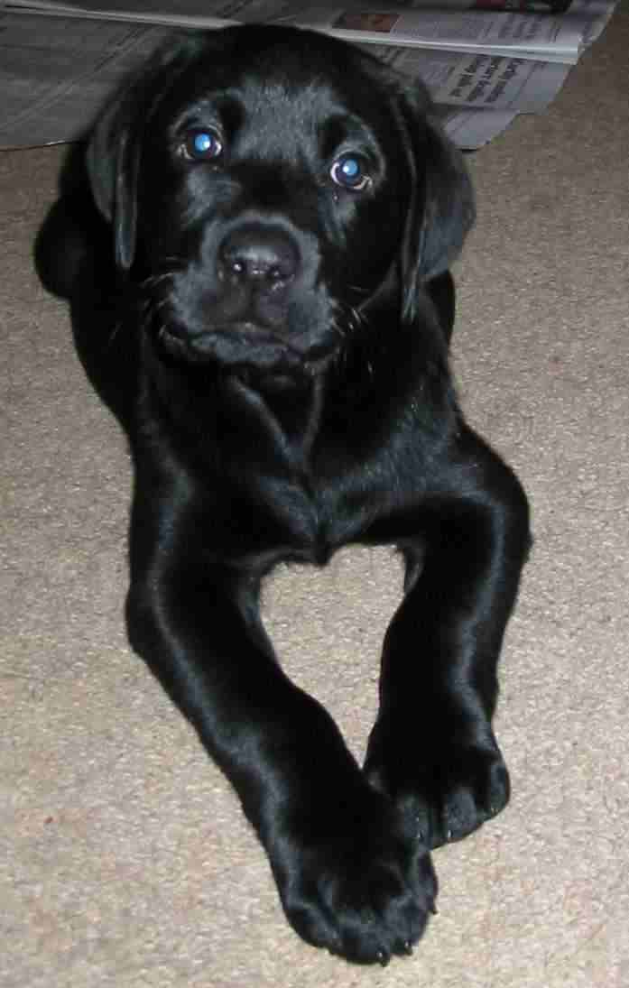
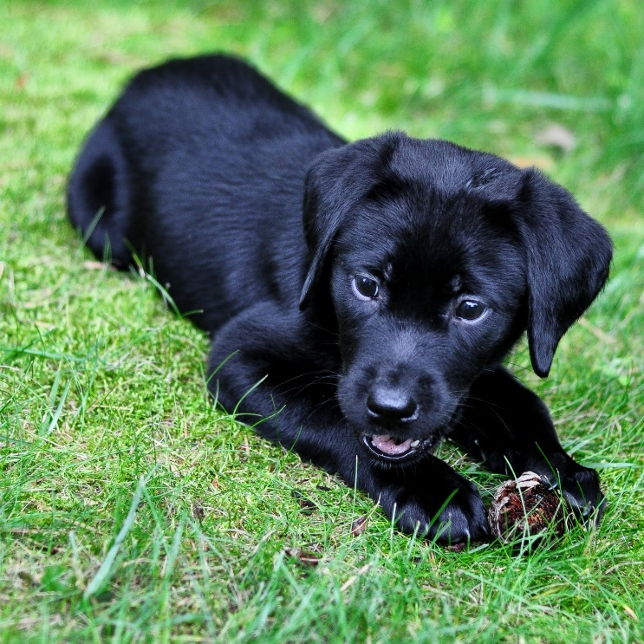
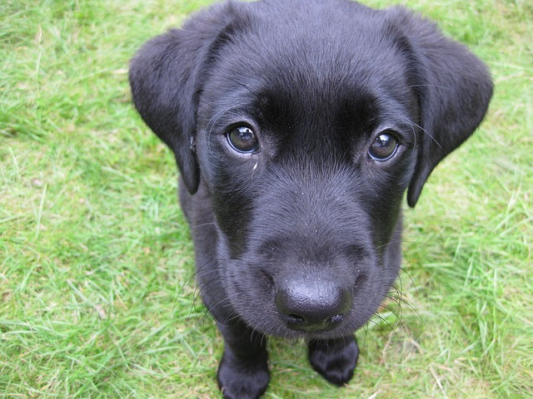
One morning a giant friendly dog named Jojo was flying down from the clouds…
Do you…
Catch it
Run and let it belly flop on a bus

Slide 3
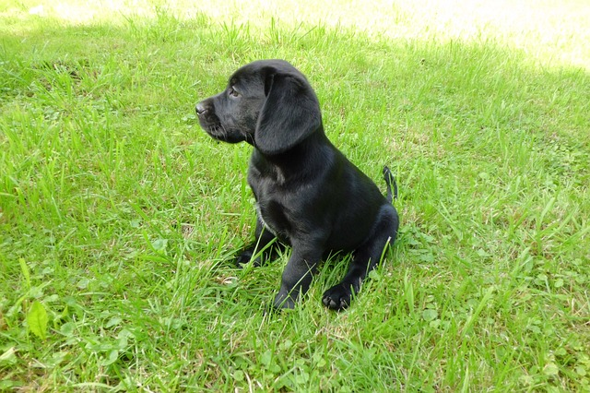
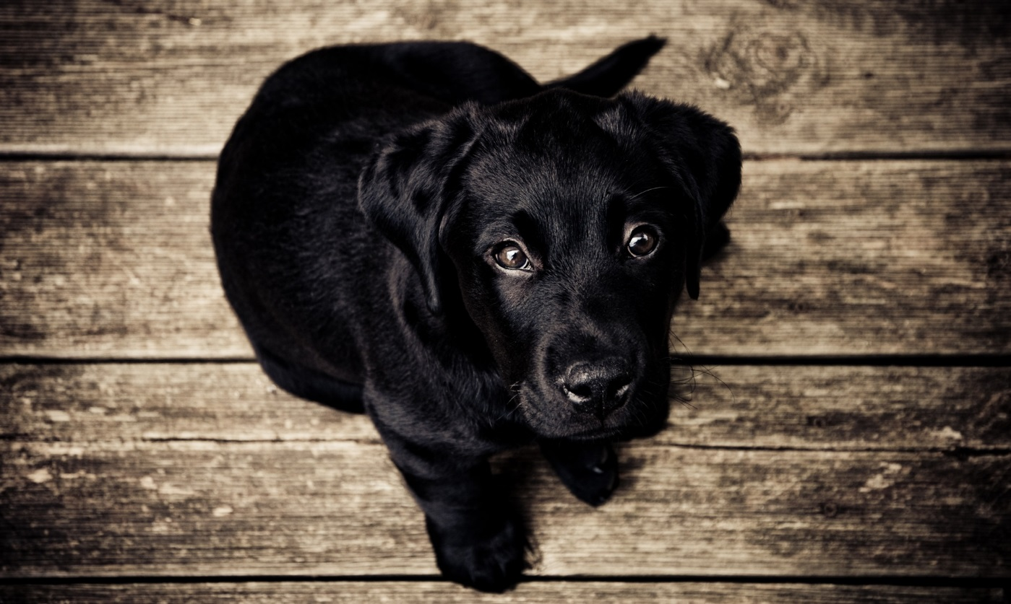
If you catch it…
You die because Jojo falls on you and you break all your bones.

Slide 4
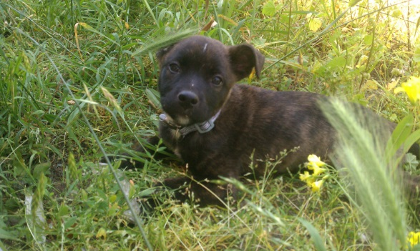
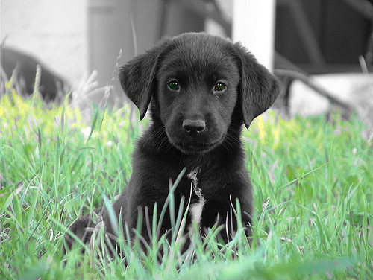
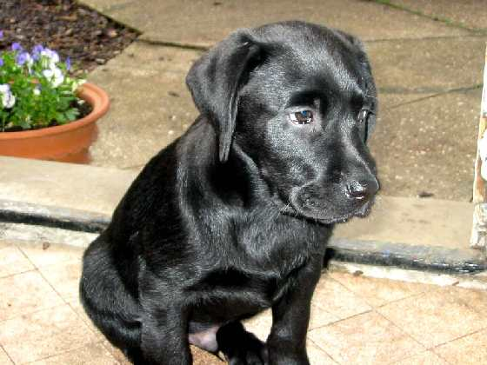
If you let it belly flop on a bus…
You win because you didn’t die and you let jojo die.

