Slide 1
In dangor

Slide 2
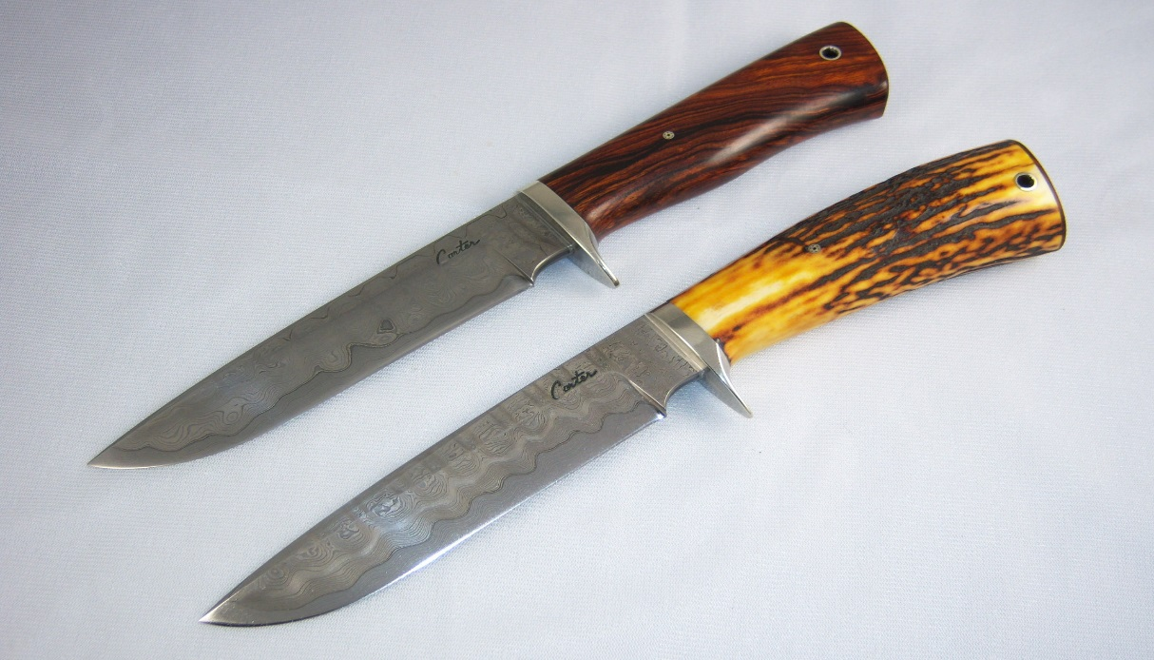
Once upon a time…ther wus a city with a lot of dagorus stuf like nief’s

Slide 3
One day a person got into a litll fiet .one of them pold a nief alt of ther pokit!wut do you do?
Do you fiet bak?
Or hied?

Slide 4
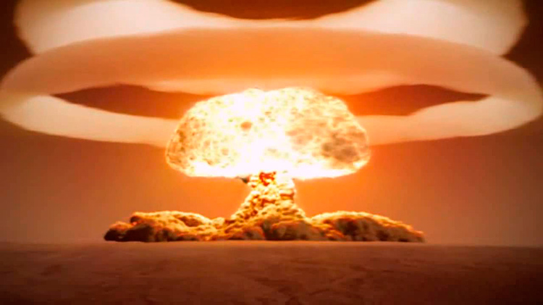
fight
You fiet bake he fros a bomb at you!

Slide 5
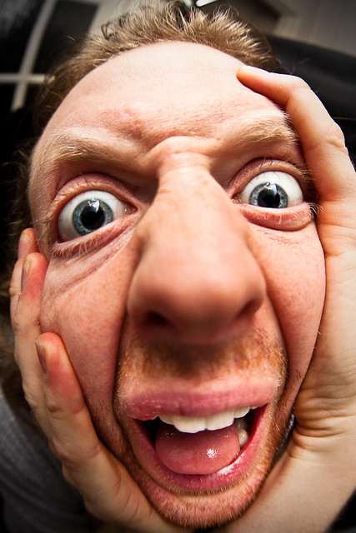
hide
You hied .he kant fiend you.you run of.yor saf nall.you rumembor you haft to get to work?
Skip or
Go to work?

Slide 6
skip
you tel the bos that yorr skipin work! The bos is ok with that.you woch the nos it ses that ther wus a ixploshin

Slide 8
Go to work
You go

