Slide 1
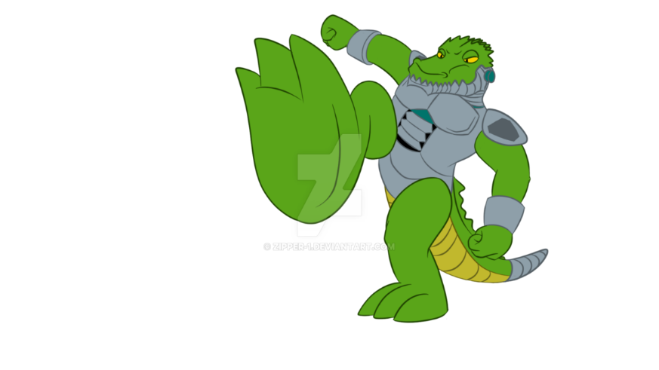
SAM W4
The Hunting Of The Cyborg Gators

Slide 2
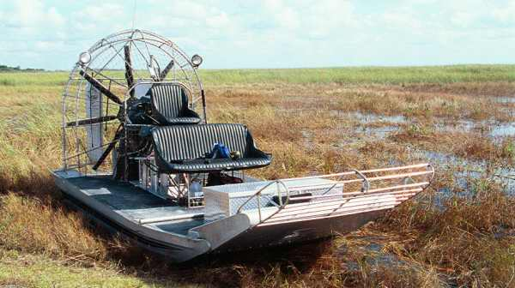
IN A MARSH FAR AWAY IN FLORIDA….
You are on a jet boat joyride when you see a group of cyborg crocodiles swimming at you with laser guns mounted on their heads. What will you do…
Try to out swim the gators
Swim at them

Slide 3
You decide to swim at them
You dodge the lasers and do you…
Decide to run them over
Or do you dodge them

