Slide 1
Serenity A4
DEATH

Slide 2
You have a ride
Car
Bus
die

Slide 3
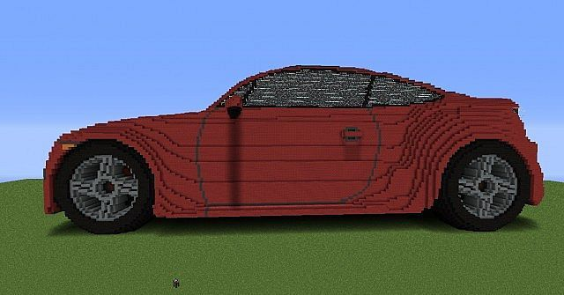
Car you

