Slide 1
Skye m4
Attack of the evil magic spoon

Slide 2
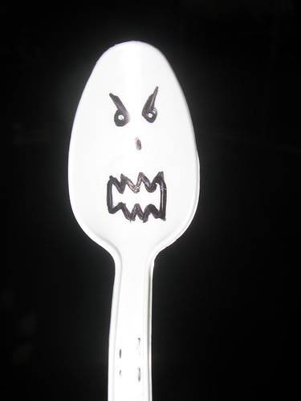
Once upon a time…
There was an evil spoon and he was trying to ATTACK YOU!!!
Do you..
Try to run him over with a car?
Or run away.

Slide 3
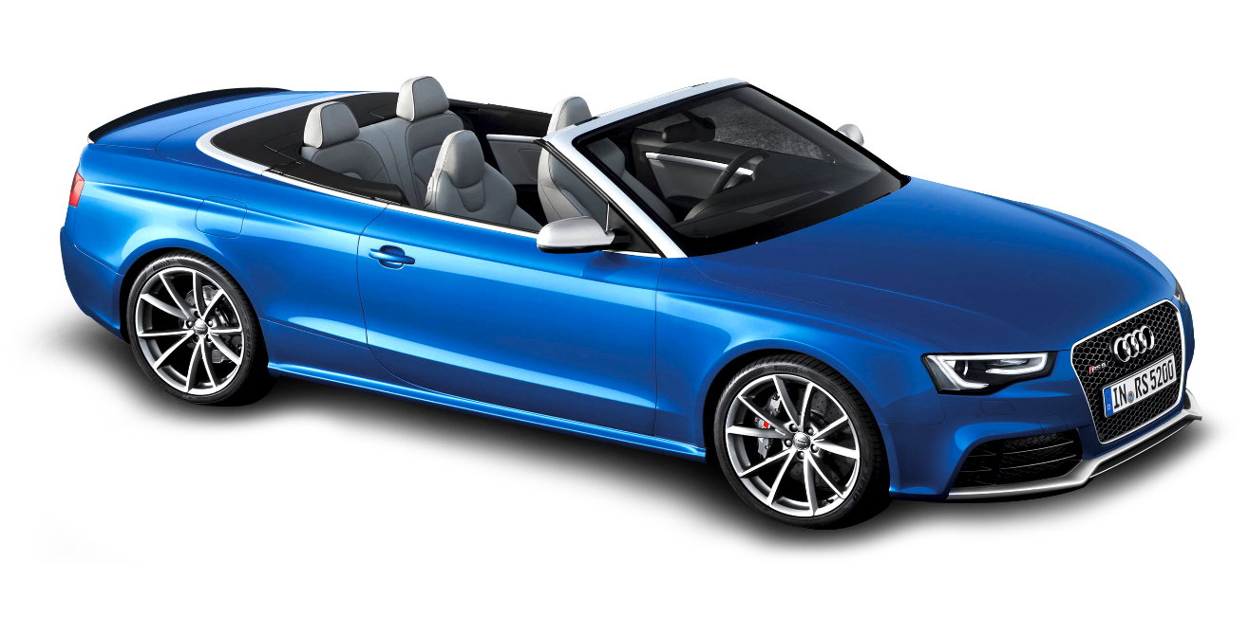
Ran over with a car

