Slide 1
THE TRAIL OF blood
By Chen Esetok

Slide 2
INTRODUCTION
ONE DAY…..there was a trail of blood

Slide 3
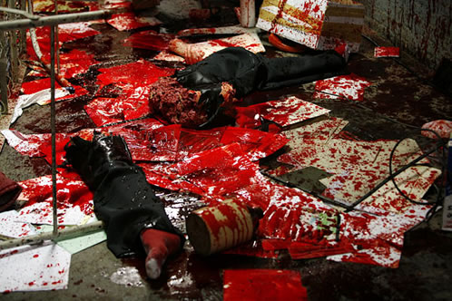
The trail of blood
There was once a bloody trail.

Slide 4
There was a house covered with blood there was a child she was like 4 feet tall she was also 5(cm) cemtimeters)

Slide 5
The little girl was all bloody including her dress……THEN….THERE WAS A BLOODY DOG

