Slide 1
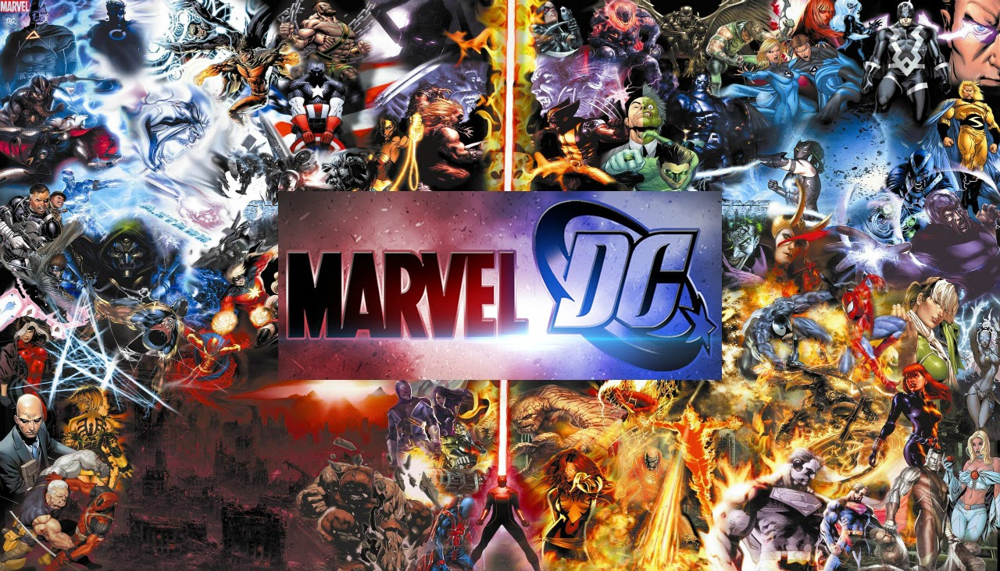
YakhubR4
The battle of Marvels and DC superheros

Slide 2
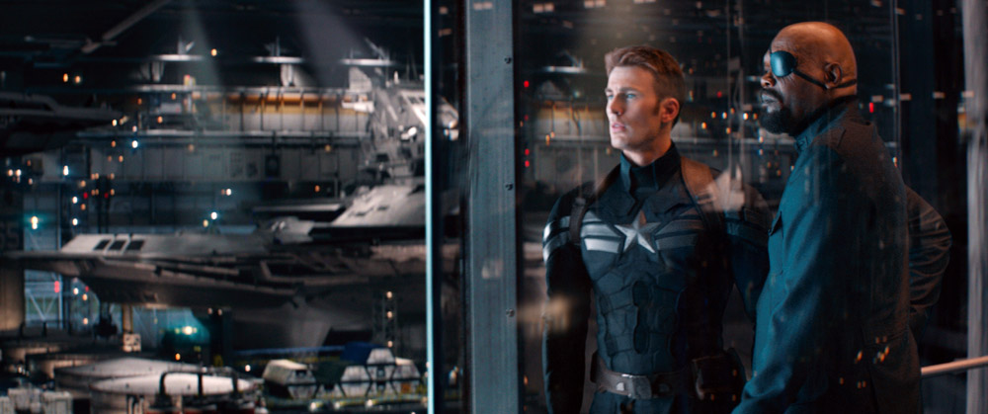
When it started…
Capatin America wanted you to be in the war
His name was Jake
Would you join him
Or will you say no

Slide 3
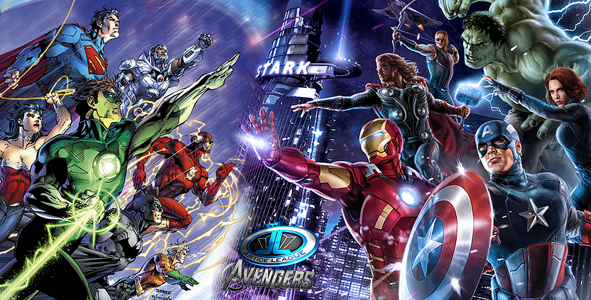
If you sadid yes
You join him and go to off to war
It would take a long time them to come to New York City
YOU DIED FROM SUPERMAN
BY A SUPERPUNCH

Slide 4
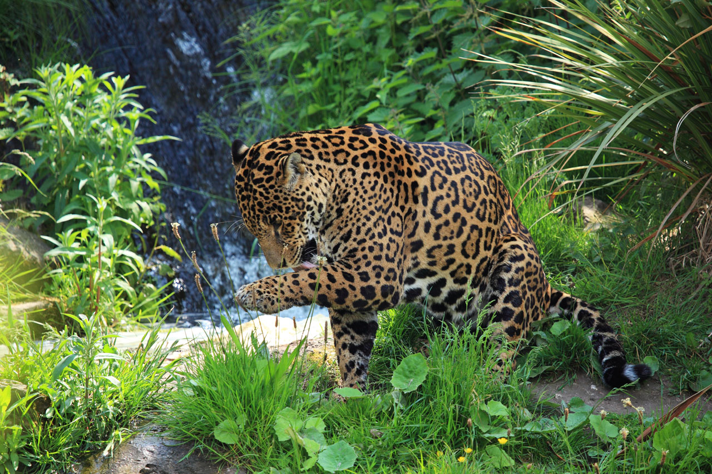
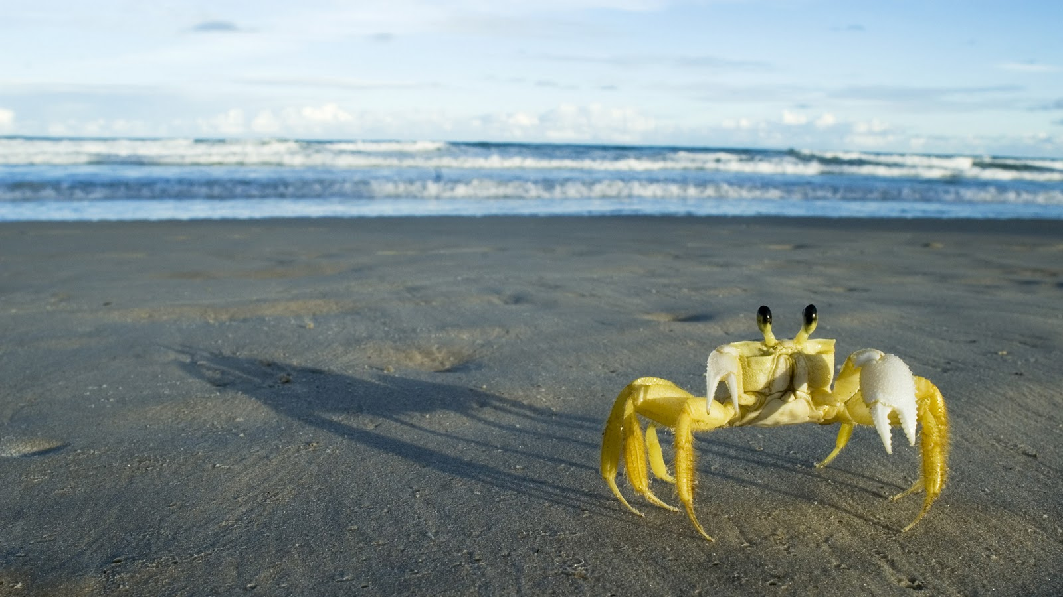
If you sadid no
Your lost would you go to
The forest with lots of wild animals
Or the beach with lots of crabsIf wanted the beach with crabs

Slide 5
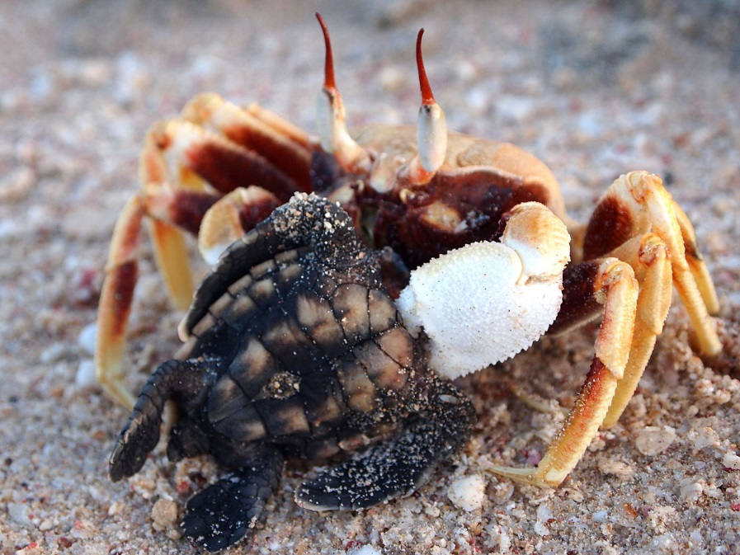
If wanted the beach with crabs
You get snip to peaces
YOU LOSE

Slide 6
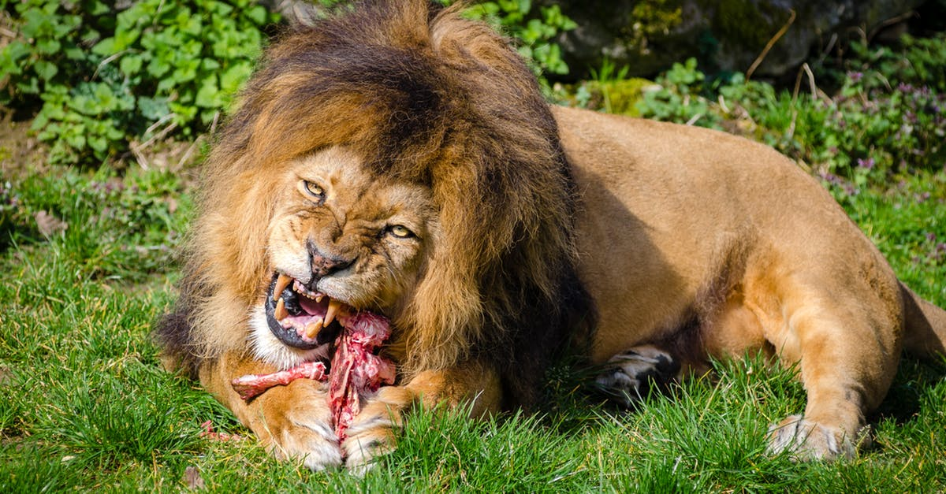
If You wanted to go to the forest
THE ANNIMALS EAT YOU
YOU DIE

