Slide 1
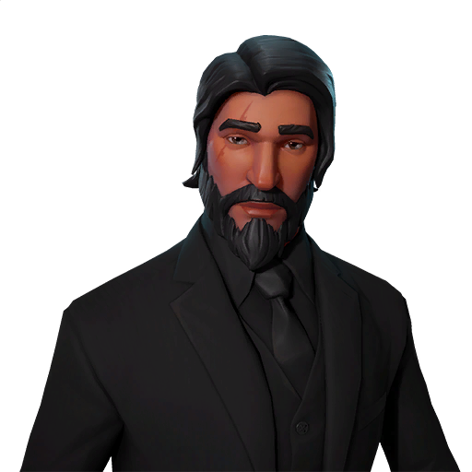
Zahir l3

Slide 2
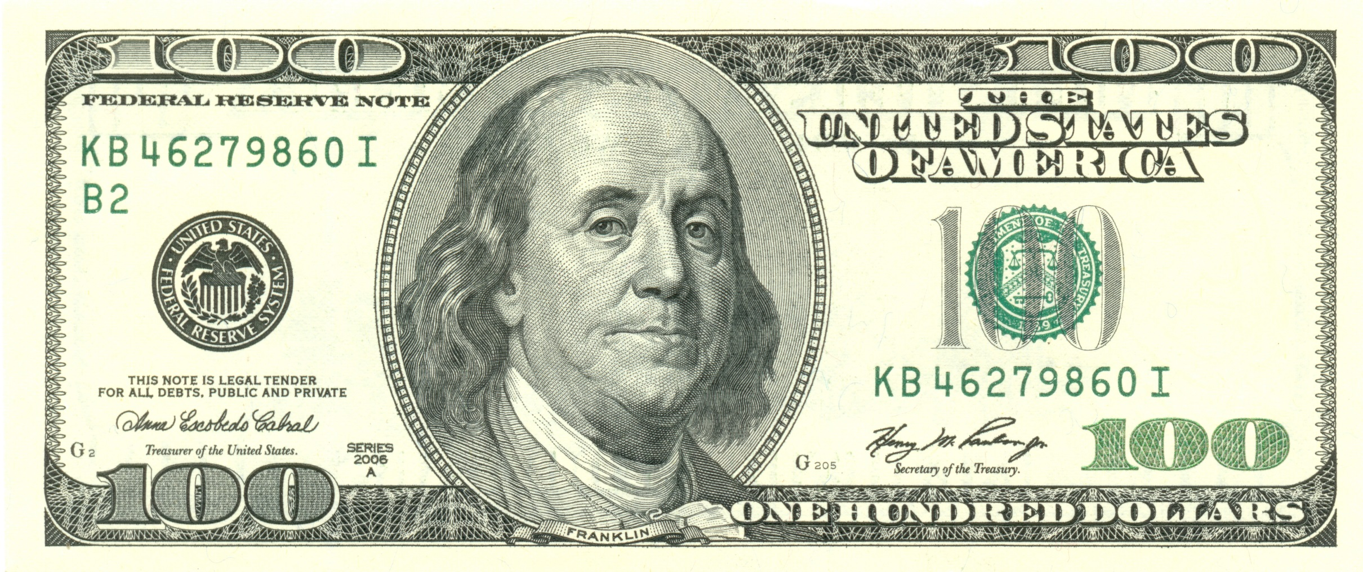
Who invented it
Bengmin franklin

Slide 3
Invented the light bolt bengmin frnkilan
1784

Slide 4
You play fornite on computer

