Slide 1
The doors
By: Ryder

Slide 2
THERE IS THREE DOORS ONE HAS A MILLION DOLLARS IN IT ONE GOES TO THE it’s lair one goes too saw one goes too slender man.

Slide 3
Which door?
IT saw slender man

Slide 4
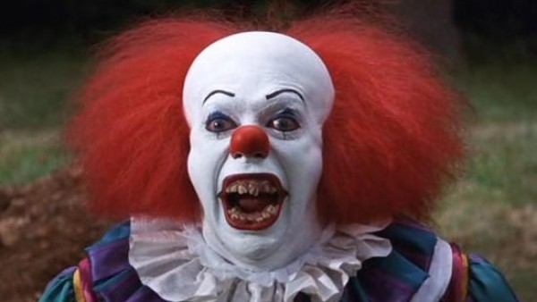

Slide 5
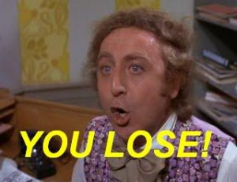

Slide 6
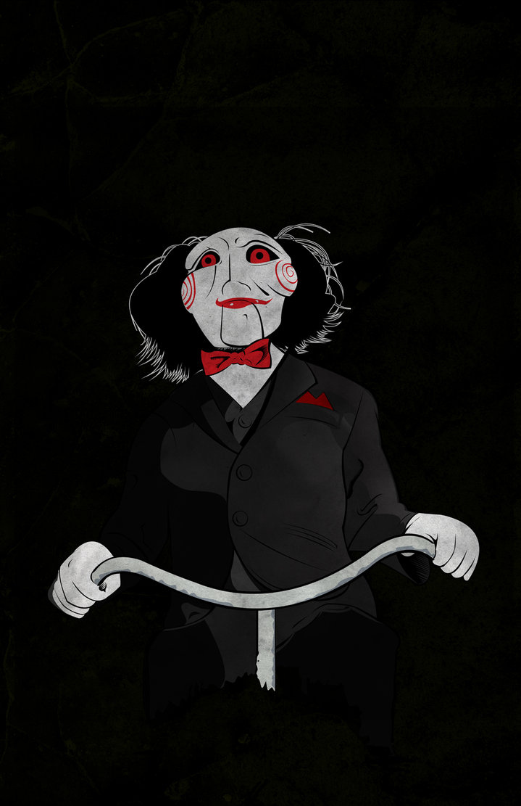

Slide 8
