Slide 1
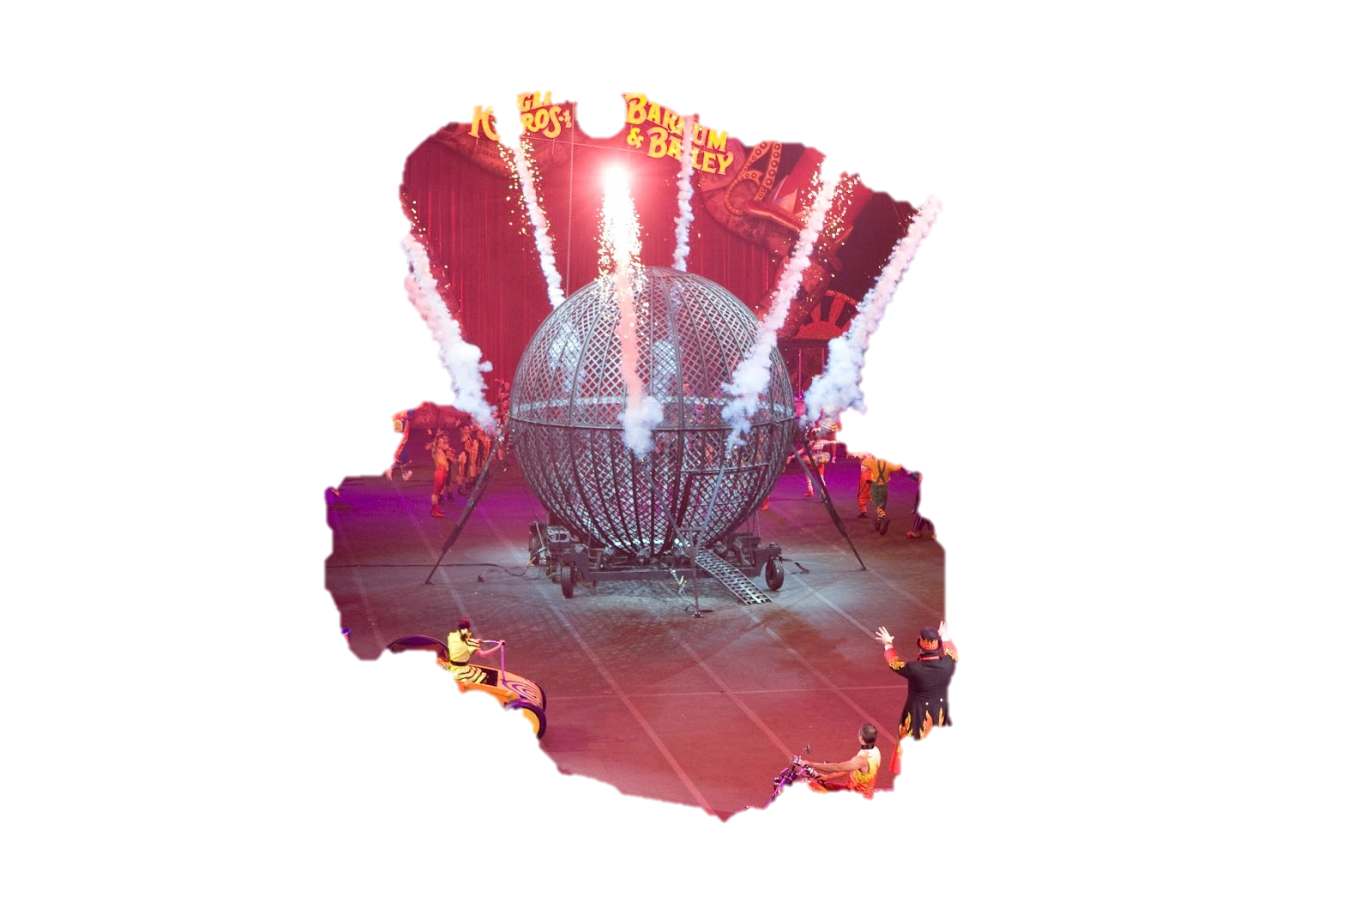
The circus trip
By Samantha Davila Avila

Slide 2
One day you went to the circus
Your mom said to take a pic with a clown
You take a pic with the clown
Or say no thank you

Slide 3
Take a pic with the clown
The clown got you and took you away from your family and you died ma hahahahaha
Play again?
Yes
No

Slide 4
Say no thank you
You lived and whet to go sit down on a chair
You live
Play again ?
Yes
No

Slide 5
NO
THE END

