Slide 1
The death park
By, Samantha Smythe

Slide 2
Introduction
You are on your vacation, and you have chose to go to a park. But it has a strange name “Death park”. When you get there you see two thing that you want to do. The first one is a wheel, and the second one is a roller-coster.
Do you want to...
A: Go on the roller-coster or…
B: Go on the wheel?

Slide 3
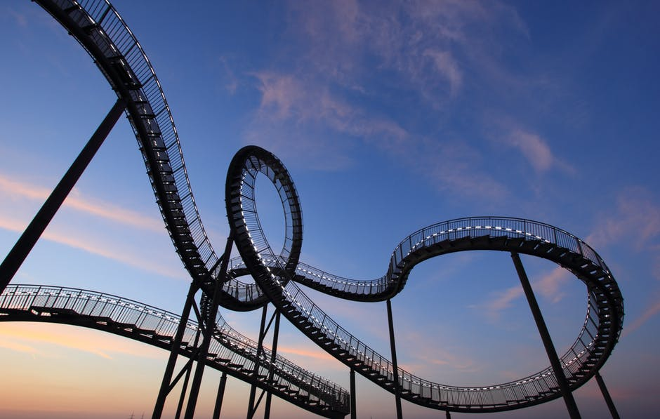
The roller-coster
You want to go on the roller-coster. You get your card (to go on it) and see that this park is very cheep. But you get on the roller coster, and it starts up. Then, and only then, do you see how long and scary the ride looks, but it’s to late to turn back.
The ride is very scary, but you live. Then you feel how hungery you are.
Do you eat ,
Go on the “The wheel”,
Or leave?
https://www.google.com/imgres?imgurl=https%3A%2F%2Fi.ytimg.com%2Fvi%2Fqpph6v5DuPw%2Fmaxresdefault.jpg&imgrefurl=https%3A%2F%2Fwww.youtube.com%2Fwatch%3Fv%3Dqpph6v5DuPw&docid=BVWZKlIvHr_R7M&tbnid=fgqpfENTMT-kGM%3A&vet=10ahUKEwjNqKbw7ebXAhVBw2MKHWzeCucQMwgoKAEwAQ..i&w=1277&h=959&safe=strict&bih=891&biw=1276&q=scary%20and%20dark%20looking%20roller%20coaster%20&ved=0ahUKEwjNqKbw7ebXAhVBw2MKHWzeCucQMwgoKAEwAQ&iact=mrc&uact=8

Slide 4
You eat
You eat… but then you feel strange. You ask what in the food… but they don’t know. But there only one thing that could make you feel this bad… food poisoning. You scramble you your car, but it’s to far away. You fall to the ground, and die.
The End

Slide 5
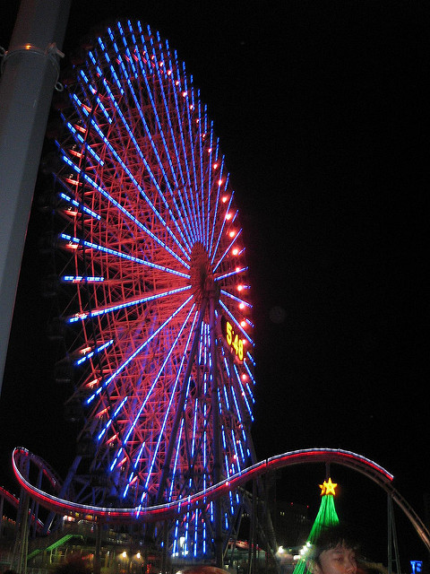
The Wheel
You get on the wheel. It goes faster and faster. But then… It breaks. You fall to the ground, and die.
The End

Slide 6
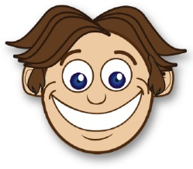
You leave
You have a good vacation and a good life.
The End

