Slide 1
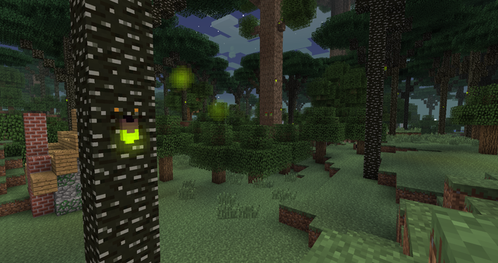
The cave in the forest

Slide 2
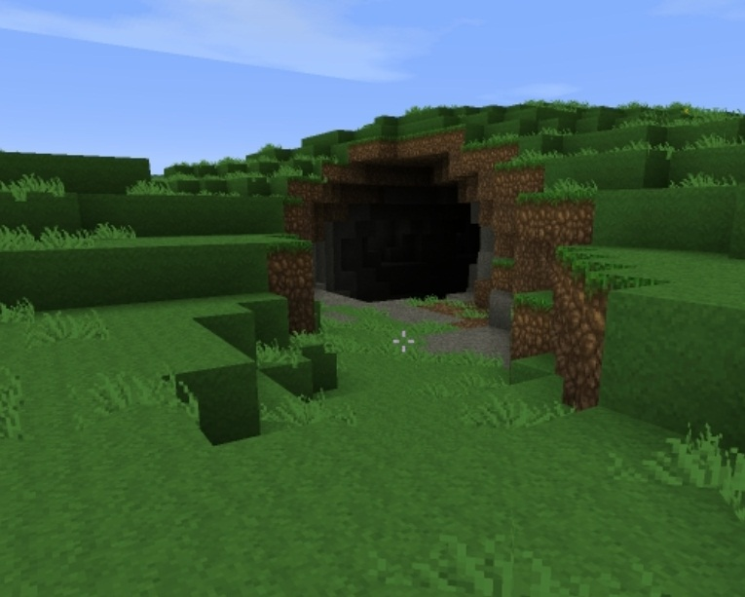
Alex was in a forest chopping down trees. She looked to her right and saw a cave with gold. You:
Go in
Keep chopping trees

Slide 3
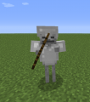
Go in
When you go in and got all of your mining tools, the gold was actually a skeleton in gold armor. You:
Fight back
Run for your life

Slide 4
Keep chopping
All of a sudden jiggly puff shows up you:
Go back to the cave and grab the gold armor.
Keep chopping trees

Slide 5
Run away
A earthquake comes and get hit with stone
You Lose!

Slide 6
Fight back
The skeleton captured you in the cave no where to go.
You lose

Slide 7
Jiggly Puff
Giggly puff use her power grabs the golden armor!!
You win !!!!

Slide 8
You where at the last tree until you were done for the day and chopped a pig the police came.
You Lose

