Slide 1
Strange things
By: Shai Gerard

Slide 2
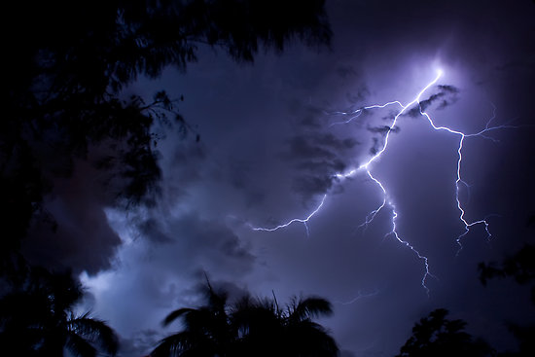
Once a upon a time…
It was a dark and stormy night, and two brothers were fighting outside.
Go outside
Continue to go to sleep
Go do your normal routine

Slide 3
The fight
You get into the fight and someone kills you.
You lose

Slide 4
Continue to go back to sleep
Someone kidnaped you and you get puts you to sleep and dropped on to a deserted island.
You lose

Slide 5
Normal routine
Your GPS is out of battery!
Run to the dollar store and battery’s
You go to the store and by a new GPS

Slide 6
The battery’s
You go in the dollar and see a packet that sais “ it comes with battery’s GPS

