Slide 1
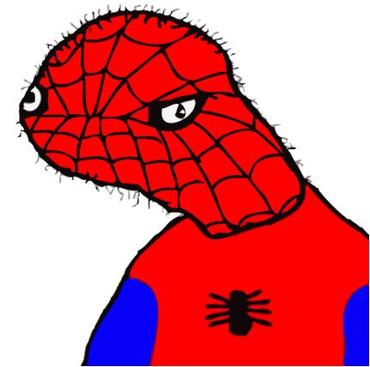
SpooderMan.exe
Please add to gallery

Slide 2
WHY DID GOD ABANDON US. YES I DID ABANDON YOU

Slide 3
OOF

Slide 4
END ME!

Slide 5
WHY AM I ALIVE
Take mE aWaY

Slide 6
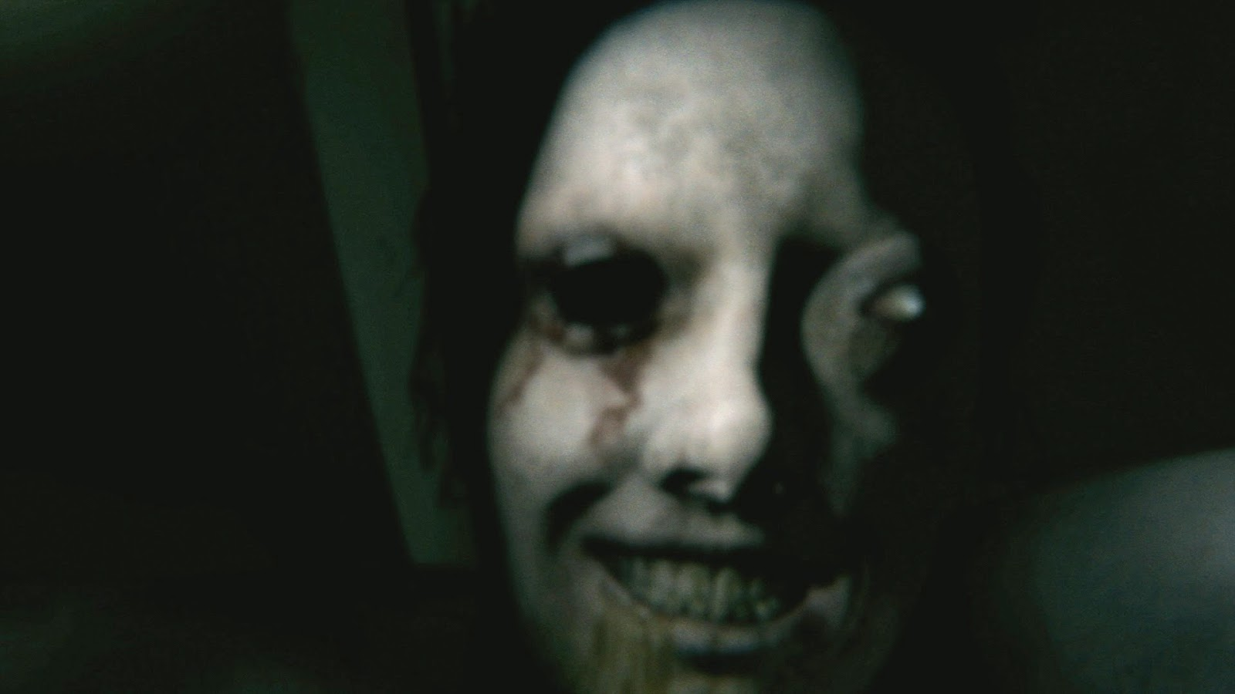
MEOW

Slide 7
Hello!

Slide 8
I NEED FOOD

Slide 9
Me me want dee food

Slide 10
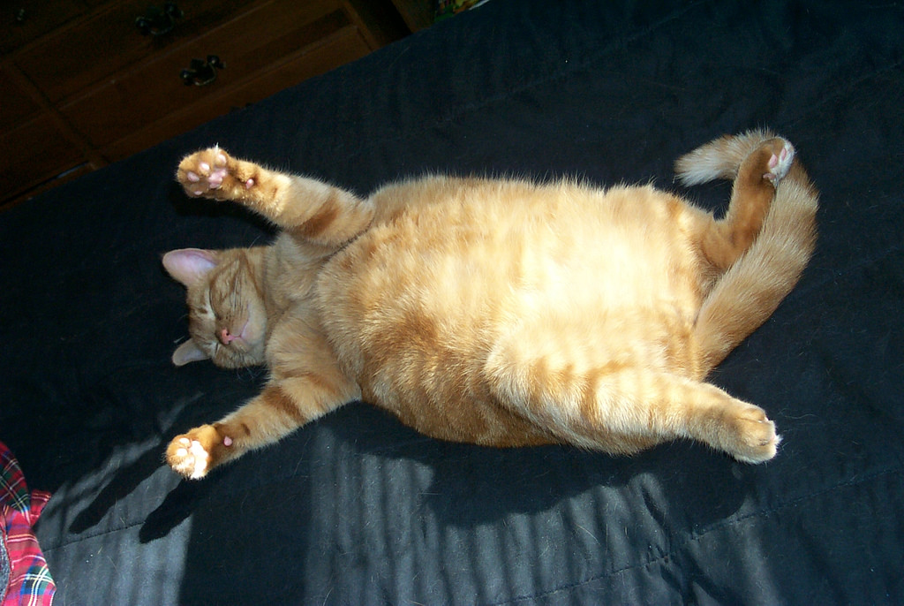
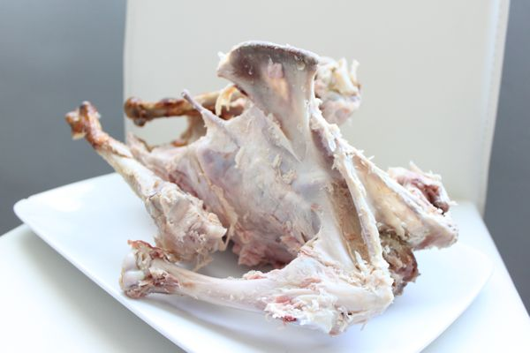
YUMMY FOOD!!!!!!!

