Slide 1
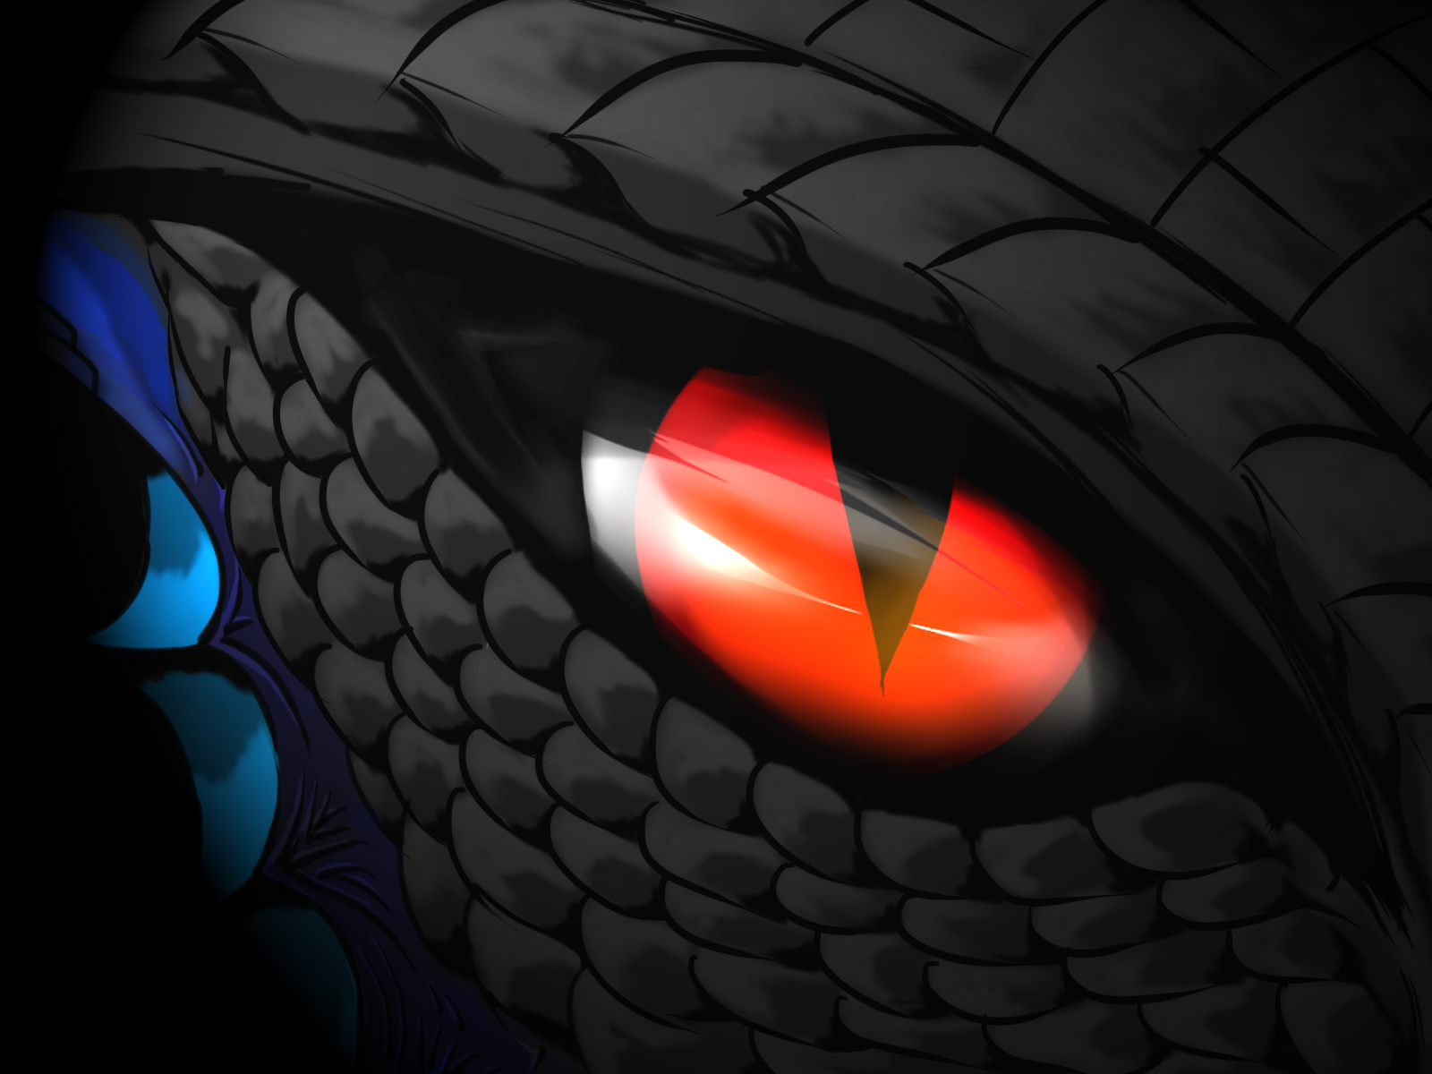
THE DRAGON

Slide 2
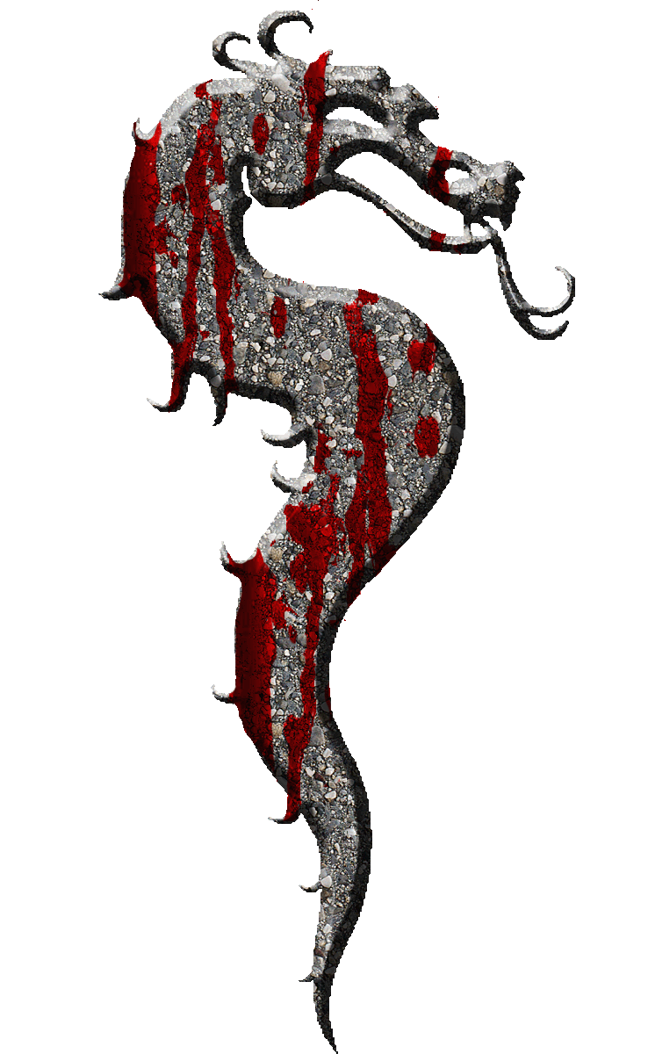

Slide 3
introduction
THE DRAGON…….there was one dragon…..who was really a big dragon!

Slide 4
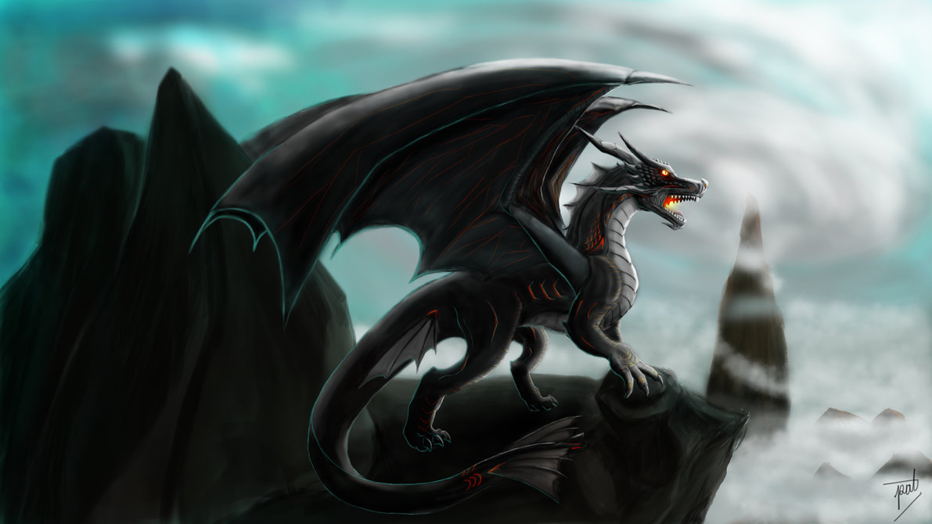
Then……the kids would make these lights that……….were cool but the dragon would again come out of its cave………the dragon came out of his cave the children…………were scared

Slide 5
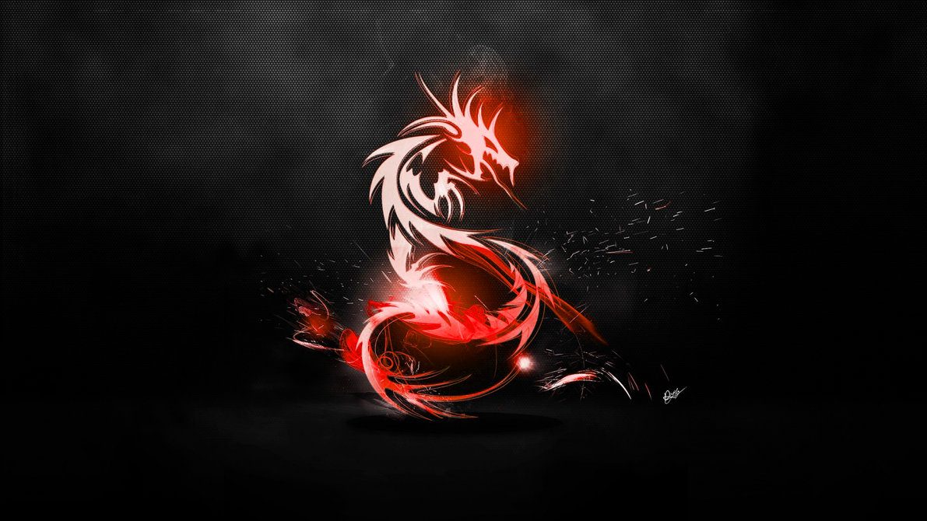

Slide 6
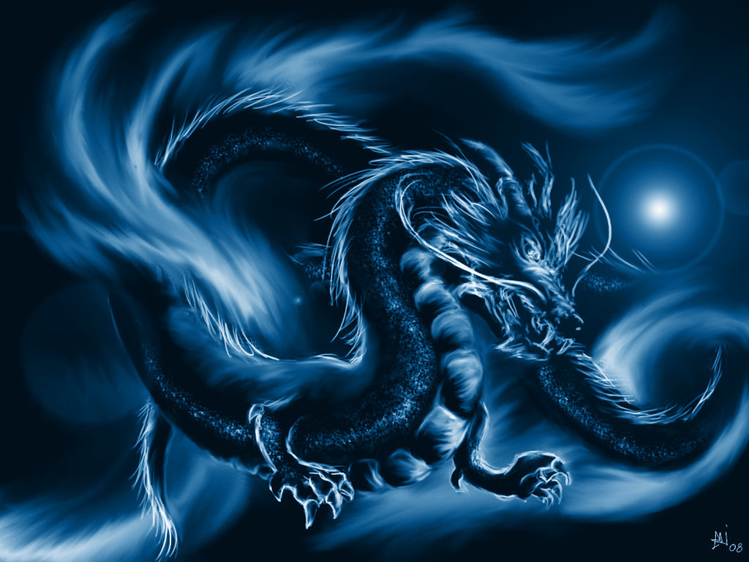
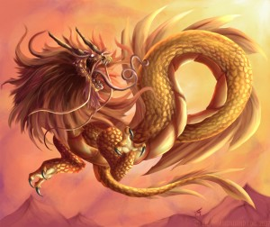
THEN………LATER THAT NIGHT………..THEY…..SAW T H E DRAGON THEN T H E Y…… THE D R A G O N….F I R E BREATH!SOMEONE SAID WAKE UP EVERYONE!!!THE DRAGON IS IS HERE

Slide 7
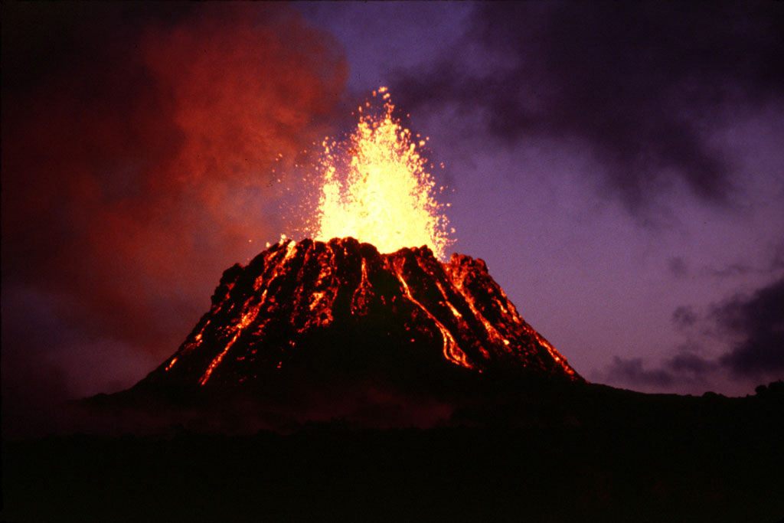
THEN THERE WAS A VOLCANO……WITH RED AND GOLD.THEN IT…………..EXPLODED

Slide 8
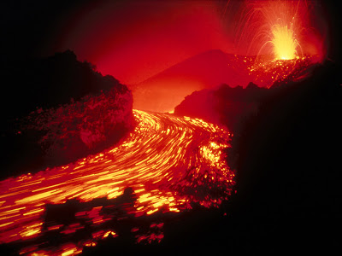
THE VOLCANO POORED LAVA

Slide 9
Then the lava got bigger………and…….bigger……but they couldn’t do nothing so they wanted to stop

Slide 10
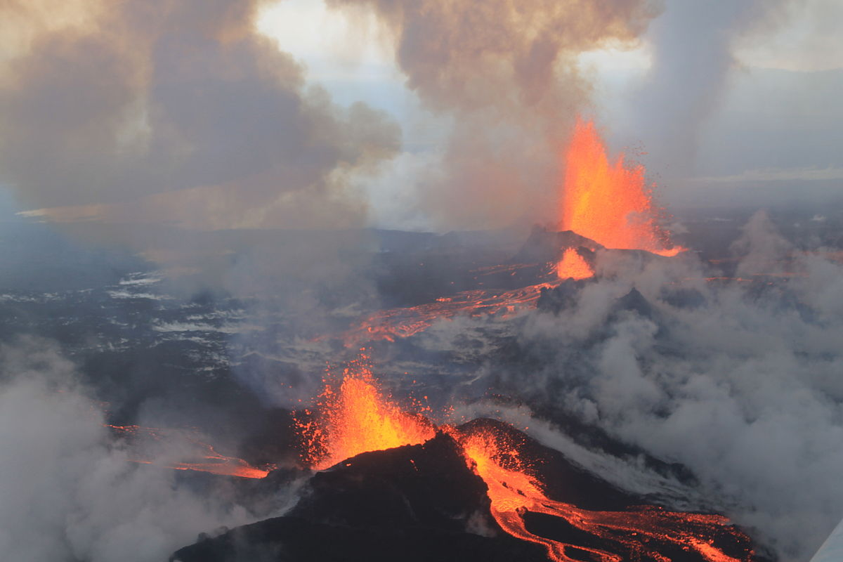
THEN……….THE WHOLE VOLCANO EXPLODED ALL THE WAY TO THE END

Slide 11
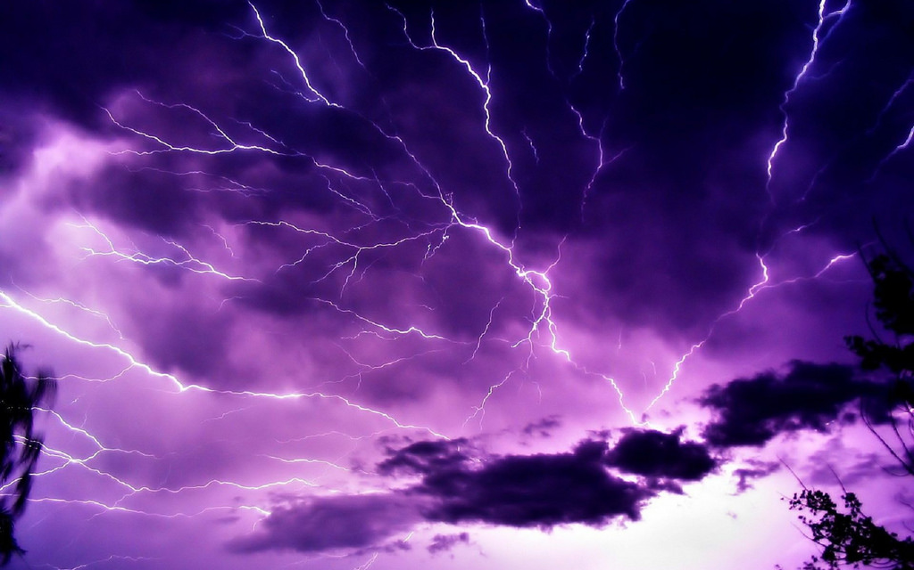
BUT…..THERE WAS LIGHTNING!!!!PEOPLE WERE SO SCARED

Slide 12
YOU HAVE 2 CHOICES
Should you…
Continue sleeping
Stop the lightning!

Slide 13
Continue sleeping
You sleep then…….10 hours later you get up you see broked buildings…then you thought it was strange

Slide 14
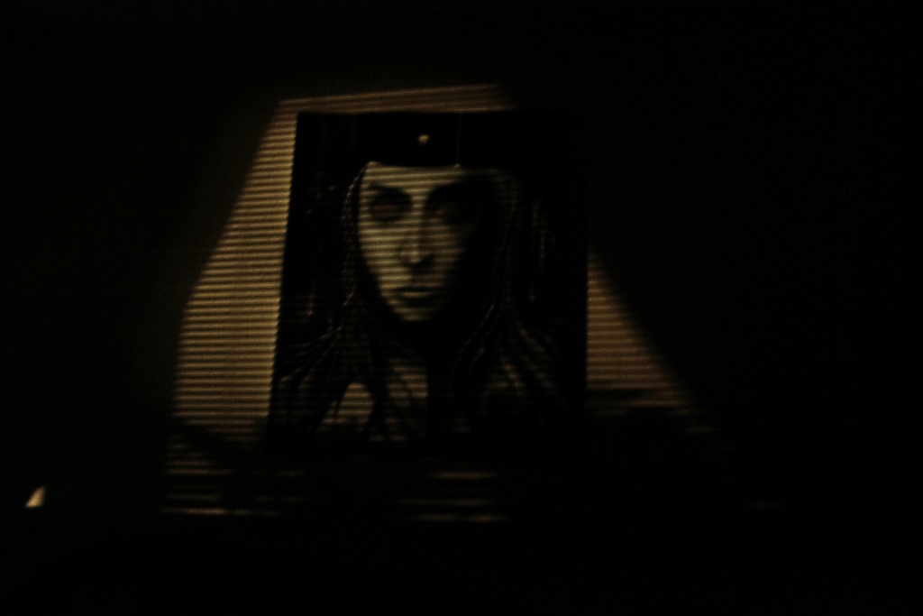
THEN YOU GO OUT OF YOUR HOUSE SOME THING IS BEHIND YOU YOU GET SCARED AND CREEPED OUT

Slide 15
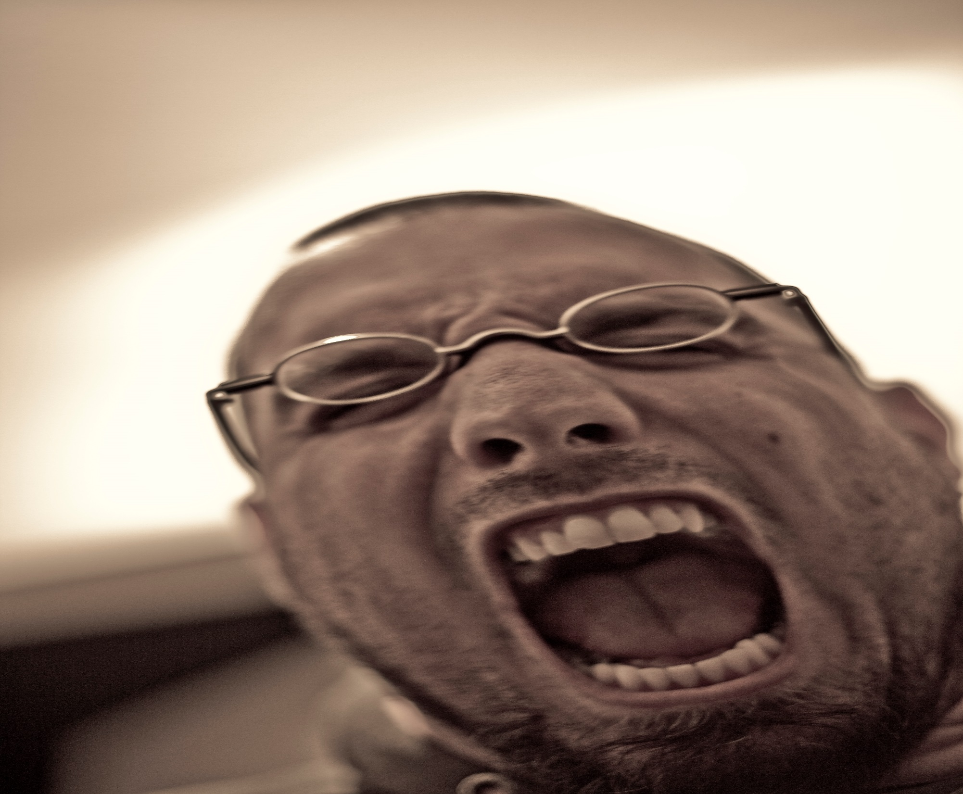
YOU HAVE 2 CHOICES

Slide 16
THEN THEY DIED people were sad when there…..relatives die……

Slide 17
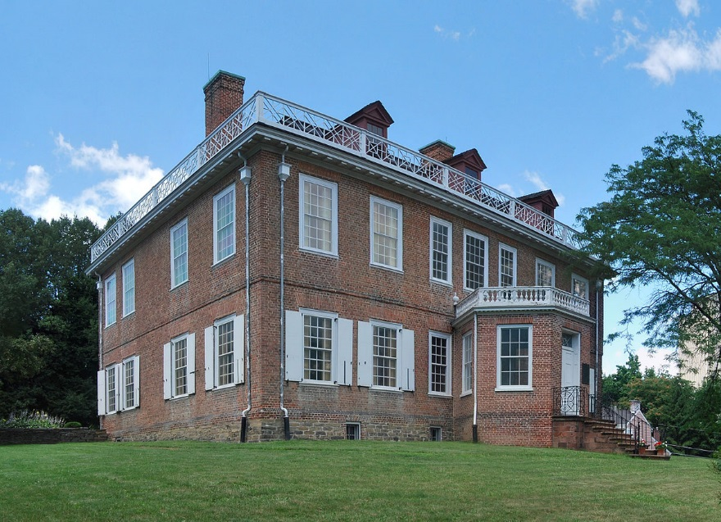
all the way from your house.Then you find something strange you see a house. You go really far from town

Slide 18
There are out there but they won’t hurt you…..but they are scared of Them so they wanted fight back

Slide 19
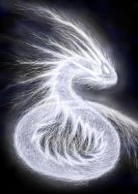
Stop the lightning but you only have one way to win

Slide 20
YOU HAVE 2 CHOICES
You want to stop the lightning… do you:
Let the wind stop the Lightning
Stoping the electricity

Slide 21
Wind stops the lightning
Game over

Slide 22
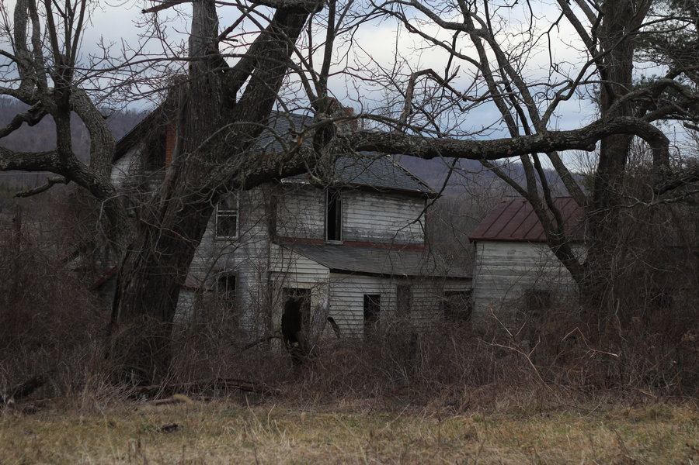
YOU GTG AND HIDE FOR YOUR LIFE.....2 HOURS LATER.YOU SLEEP!!AND YOU HAD A BAD N I G H T M A R E ABOUT HAUNTED STUFF

Slide 23
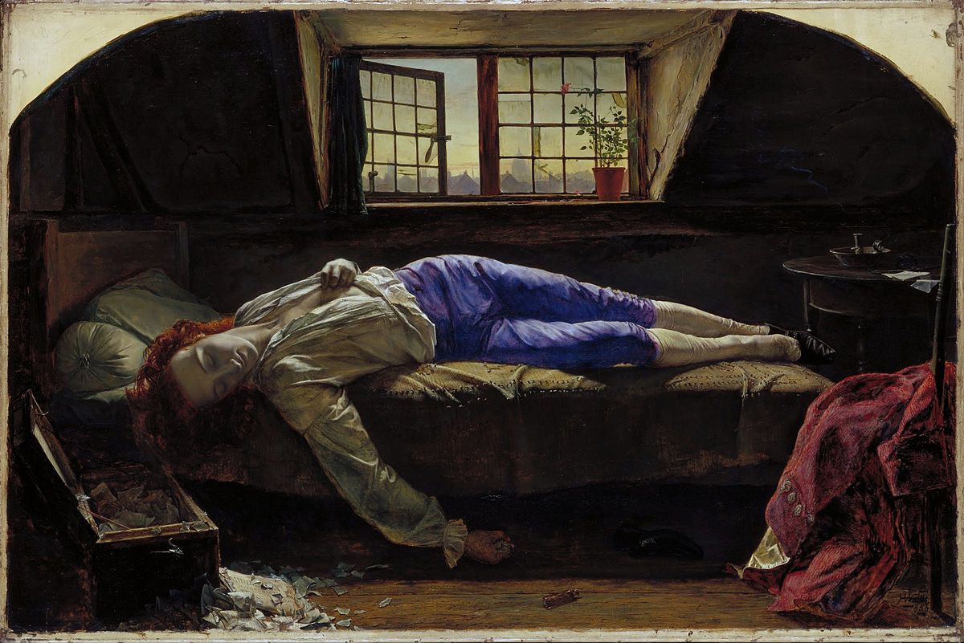
YOU AHHHHH!!!!!!!I HAD A…….N I G H T M A R E!!!!!!!!!!!YOUR MOM CHECKS ON YOU YOU FAINTED

Slide 24
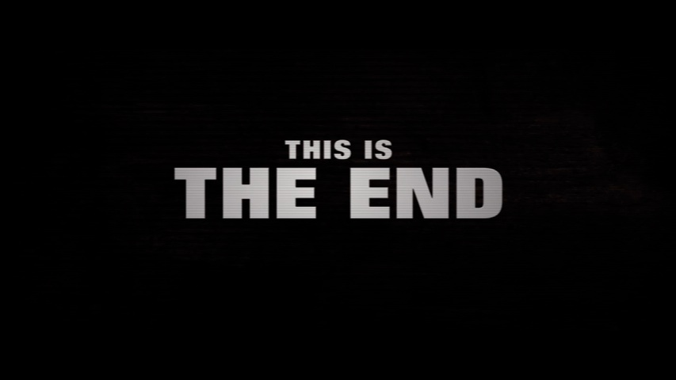
Stoping the ELECTRICITY
You survive your whole life you…made it through that was a long journey.The End

Slide 25
YOUR L I F E……HAS END SADLY ARE YOU ☹☺
THEN IT ENDS

