Slide 1
The Haunting
By tamia nwsome

Slide 2
chapter one you don’t belong here
You wake up to the sound of foot steps running thru your room
You get scared because your home alone and your parents are on vacation
do you…+
Turn on your flashlight
get under cover

Slide 3
You get scared and hide under the cover
You see a shadow walking towards you
You cover opens up slowly

Slide 4
Something pops up in front of you

Slide 5
Your dead [ start over]

Slide 6
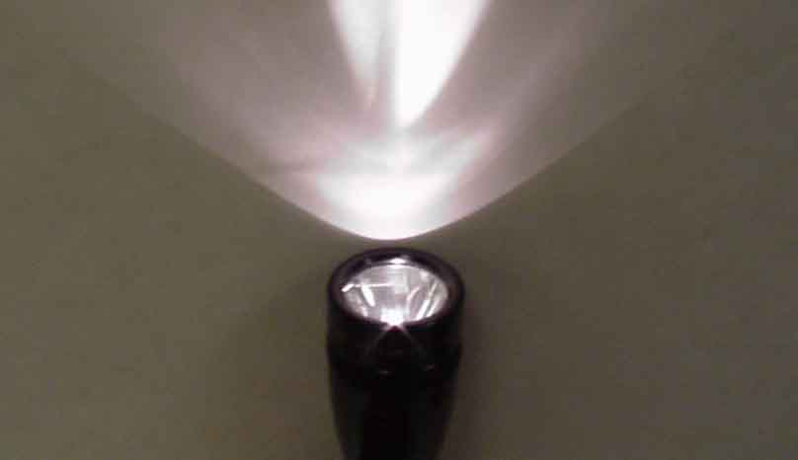
Turn on your flashlight
You turn it on and see nothing. You hear some one scream! Then everything went black.

Slide 7
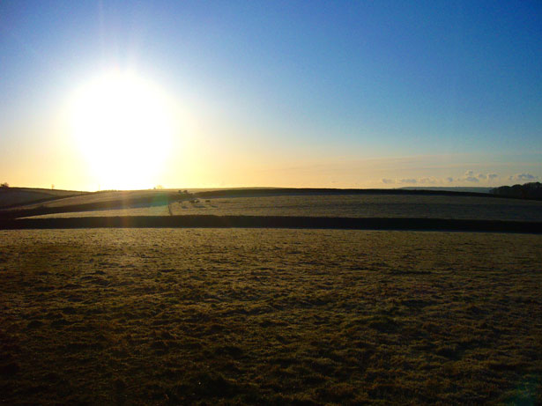
You woke up in the morning. You go downstairs and see a door that says don’t enter.
Do you…
Enter the room
Leave it alone

Slide 8
You choose to enter the room
Its dark in the room you see nothing but suddenly you feel cold and feel something touching you

Slide 9
The room
You turn back looking at the door in the dark room
There is a light shining by the door
You pass out

Slide 10
You woke up
leave the room
Go futher in the room

Slide 11
You choose to Leave the door alone
You walk away you suddenly feel weird and pass out

Slide 12
Game over
Nothing in this town will be explained
You need to be alive to figure out this town
Why did you die from leaving the room
Lets just say somethings out there you don’t wanna see
Back to room scene

Slide 13
Why go further in the room?!?!
You ask yourself what are you doing
But…you do it

Slide 14
You choose to leave
You left the room. As you step out…you realise you left your home to.
You don’t belong here…

Slide 15
Hmm what will happen next don’t you just love a mystery

Slide 16
Play again
[do you want to start over and choose different paths]

