Slide 1
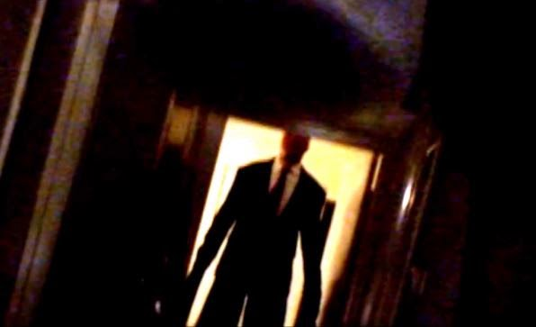
slenderman

Slide 2
slenderman
Slenderman comes in your house
1.run for your life
2. hide in your room

Slide 3
slenderman
Run for your life

Slide 4
slenderman
When you run for your life you will live make sure you don’t yell or he will hear you

Slide 5
hide in your room
When you hide in your room slenderman uses his vision he finds your room and chokes you to death then you die.

Slide 6
You die hahahahaha
The end you died for hiding in your room

