Slide 1
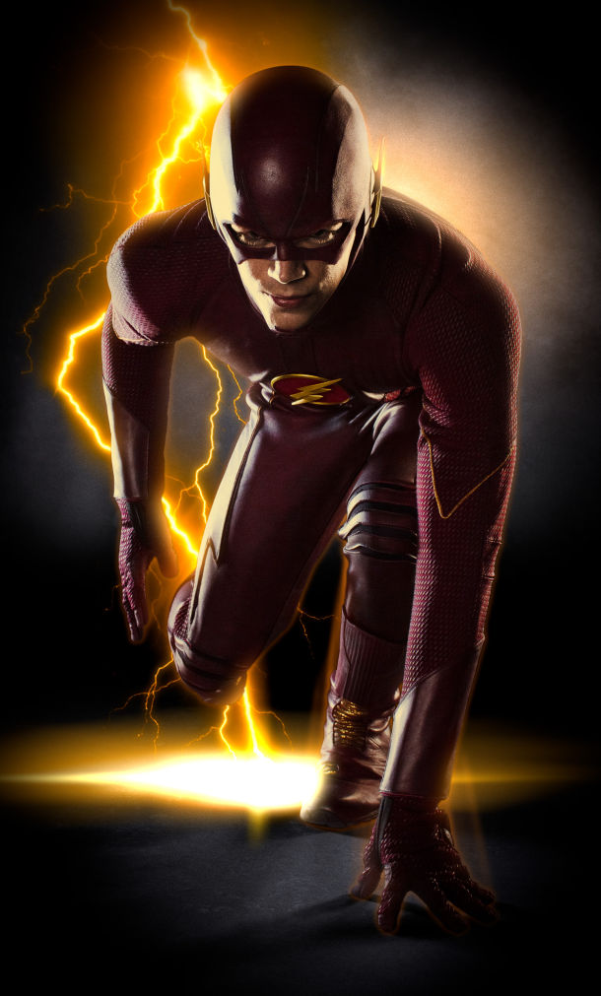
Superhero story

Slide 2
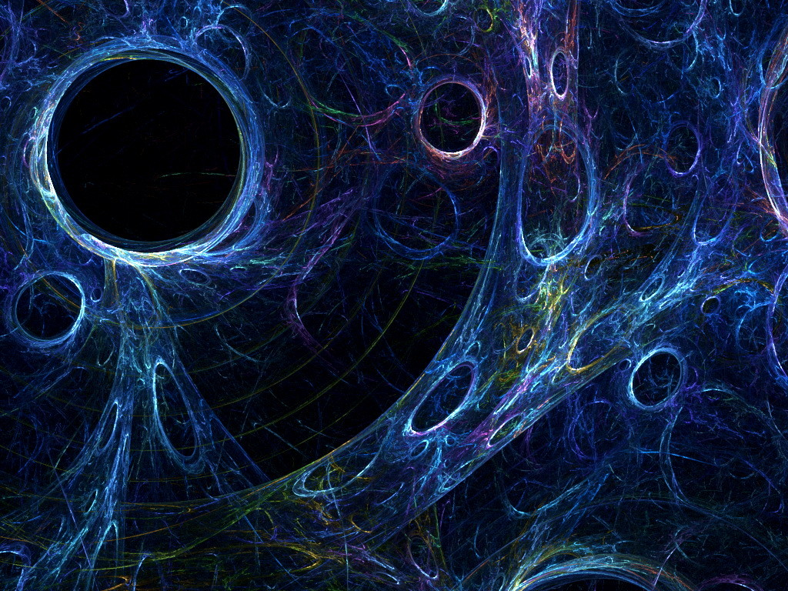
Once upon a time
It was a stormy night a guy was robbing a bank but when he saw a man running faster than the speed of light he got scared. What do you think he should do.
Fight back like a villain and be fighting for hours and one wins.
Just throw the money and run home
Become a villain by getting exposed by dark matter.

Slide 3
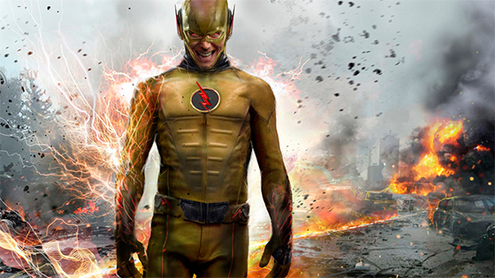
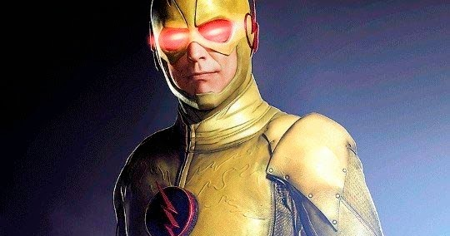
PATH 1
When you are fighting you are going to die by the flash.

Slide 4
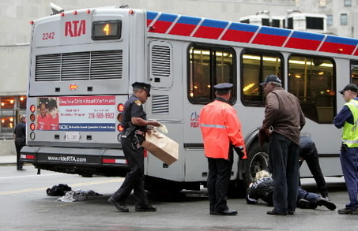
PATH 2
U will get run over by a bus when you are running

Slide 5
PATH 3
You will defeat the flash and be rich in the future will destroy flash with the yellow person.YOU WIN

