Slide 1
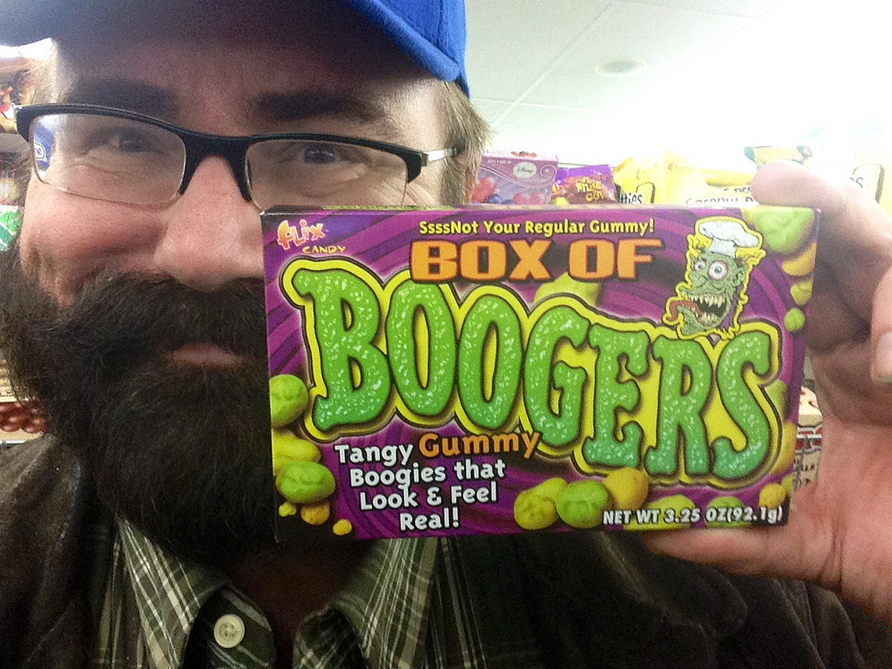
The Booger Story
BOOGERS FOR LIFE

Slide 2
Your Party
You At Your Party And Your Nose Is Itchy And There is A Lot Of People Would You
Do You Pick Your Boogers
Or Want Until the Party Is Over

Slide 3
Wait Until The Party Is Over
Your Nose Gets More Itchy and You Really Want To Pick It
Pick It In Front Of Everyone
Pick It In The Bathroom And lock The Door

Slide 4
Pick Your Boogers
You Picked Your Boogers And Someone Saw You And Person said Give Me 20 Bucks Or I Tell Everyone In School
Give Him The 20 Bucks
Every Knows That You Picked Your Boogers

Slide 5
Everyone Knows You Picked Your Boogers
They Start To Laugh So Hard And Are Embarrassed
Run Away
Get A Minigun Full Of Booger And Shoot Every

Slide 6
Pick It In The Bathroom
A Grandma Is In There
You Lose
Try Again

Slide 7
Give Him 20 Bucks
He Tricks You And He Runs Away
Run Up To Him And Punch Him
Just Stand There

Slide 8
He Tricks You And Runs Away
He Tells Everyone
You Lose
Try Again

Slide 9
Run Up To Him And Punch Him/Get A MiniGun Full of Boogers
You Win

Slide 10
Victory You Take The W
You Win

